Slide 1
5E Hoot Conservation Plan Lab
2015-2016
Ms. McCabe

Slide 2
Engage – movie questions
Name, date, period, and title on your own paper
Answer the 6 movie questions in complete sentences

Slide 3
Explore – Field Guide Site Inventory Phase 1
Choose a place. Make use of the campus to focus your investigation.
Vary the scale. Look for small plants, fungi, or animals (ants, beetles, spiders, butterflies, snails, slugs) as well as larger ones (birds, squirrels, frogs, toads).
Zoom in. Peek under logs and rocks, beneath leaves, on tree bark, and in puddles or other wet areas.

Slide 4
Explore – Field Guide Site Inventory Phase 1
Heed the signs. Tracks, holes, nests, droppings, chewed leaves or twigs, insect and birdcalls, and other signs are all clues about the presence of wildlife.
Determine the problem. In your 2 transects, you will be finding and counting the number of individuals of different species. The species with the smallest number in both transects will be the species in need of conservation.
Do not disturb. Be a good steward. Move slowly and quietly. Treat all organisms with respect. Leave a habitat in better shape than the way it was when you found it.

Slide 5
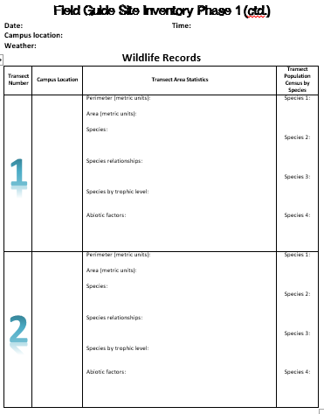
Explore – Field Guide Site Inventory Phase 1
Step 1
Complete the date, time, campus location, and weather fields on your site inventory
Use technology to help you with humidity, temperature, and wind speed

Slide 6
Explore – Field Guide Site Inventory Phase 1
Step 2
Design one transect at a time using meter sticks and yarn.
Choose a different, but nearby area for transect 2.
Give all measurements in centimeters.
Transects must be AT LEAST 10 cm x 10 cm.
Both transects will be the same size.

Slide 7
Explore – Field Guide Site Inventory Phase 1
Step 3
Give a detailed description of where you are on campus for EACH transect
Ex. On the north side of the pond, at the water’s edge, part grass, part water

Slide 8
Explore – Field Guide Site Inventory Phase 1
Step 4
Fill in the required information for each transect in the transect area statistics column.

Slide 9
Explore – Field Guide Site Inventory Phase 1
Step 5
Give the number for each type of species.
There should be about 4 species each.
Choose the same species types for both transects.

Slide 10
Elaborate/Evaluate – Field Guide Site Evaluation & Conservation Plan Phase 2
Directions: Using the inventory and movie questions, you will complete 5 paragraphs to identify resources present, identify the problem in transects, and determine methods for conservation. Complete the plan below to help your essay.

Slide 11
Elaborate/Evaluate – Field Guide Site Evaluation & Conservation Plan Phase 2
Identify Resources
Determine a monetary budget
What materials can be used from this transect to help you
What additional materials will you need
How much will the materials cost
How much labor is involved
How many assistants are needed
Will you need to do research first
Who can you refer to for guidance in this process

Slide 12
Elaborate/Evaluate – Field Guide Site Evaluation & Conservation Plan Phase 2
Identify the Problem
What species had the fewest organisms in your transects
What number did you find in each
As you execute your conservation plan, what number of this species do you hope to reach in these transects
Why is it a problem for this species to diminish
What will suffer or be affected by the decrease of this species
What will be affected by the increase of this species when you execute your plan

Slide 13
Elaborate/Evaluate – Field Guide Site Evaluation & Conservation Plan Phase 2
Conservation Methods
How will you use the materials you listed to best fit your budget
How will you raise the money for your budget
What are you going to do to solve the problem

