Slide 1
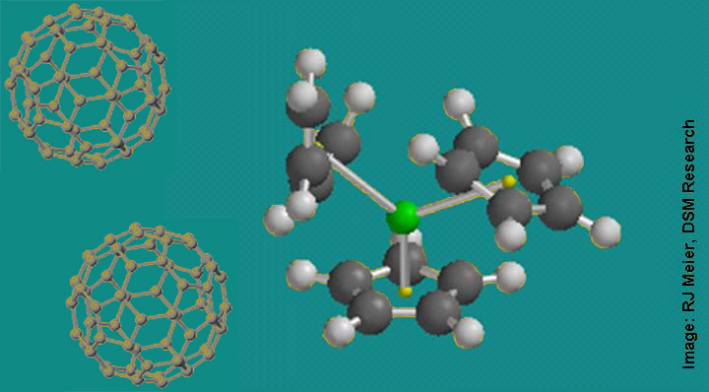
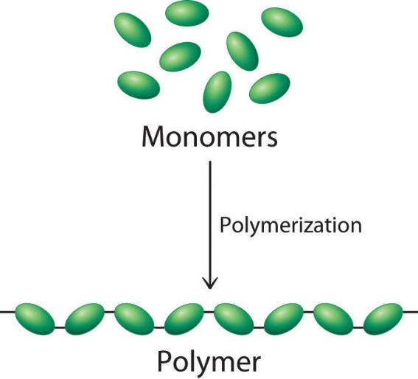
Biological macromolecules 5E Lesson
SC.912.L.18.1
Describe the basic molecular structures and primary functions of the four major categories of biological macromolecules.
SC.912.L.18.2 (Honors)
Describe the important structural characteristics of monosaccharides, disaccharides, and polysaccharides and explain the functions of carbohydrates in living things.
SC.912.L.18.3 (Honors)
Describe the structures of fatty acids, triglycerides, phospholipids, and steroids. Explain the functions of lipids in living organisms. Identify some reactions that fatty acids undergo. Relate the structure and function of cell membranes.
SC.912.L.18.4 (Honors)
Describe the structures of proteins and amino acids. Explain the functions of proteins in living organism. Identify some reactions that amino acids undergo. Relate the structure and function of enzymes.
SC.912.L.18.11
Explain the role of enzymes as catalysts that lower the activation energy of biochemical reactions.

Slide 2
Guiding Questions
How are structure and function of the major biomolecules related?
How do enzymes impact chemical reactions in an organism?

Slide 3
ENGAGE – On a notecard…
Write down everything that you have consumed today. (If you have not eaten anything, write down what you had for dinner last night)
Share your response with your shoulder partner and discuss the importance of eating.
Attempt to identify the foods that are mostly carbohydrates (carbs), lipids (fats), and proteins.
KEEP YOUR NOTECARD!!!

Slide 4
EXPLORE – Video

Slide 5
EXPLORE – Card Sorting
You should have 4 Yellow cards:
Carbohydrates
Lipids
Nucleic Acids
Proteins
You should have several food cards
Lay out your 4 yellow cards
Sort each food into the 4 yellow groups

Slide 6
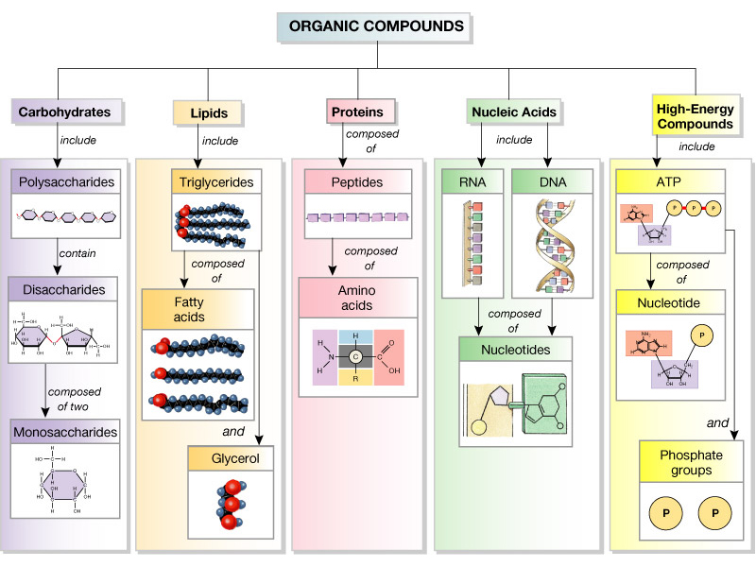

Slide 7
EXPLAIN – Prezi
<iframe width="550" height="400" id="iframe_container" src="https://prezi.com/embed/vj5ee96ce6p0/?bgcolor=ffffff&amp;lock_to_path=0&amp;autoplay=0&amp;autohide_ctrls=0&amp;landing_data=bHVZS2czc0xFVDVJVDdxaTR3NTg3ajBmRDdRVnpQeWI&amp;landing_sign=VyJIyw0NdzELiVJwJeFmds1Hn6OVYES5zEe-kW4vG7A" frameborder="0" allowfullscreen="" webkitAllowFullScreen="" mozAllowFullscreen=""></iframe>

Slide 8
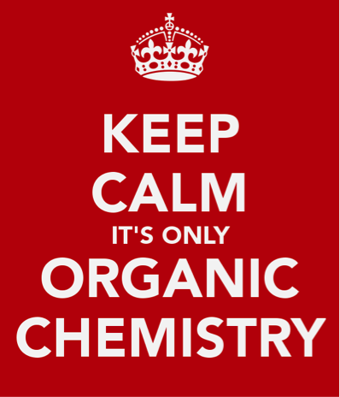
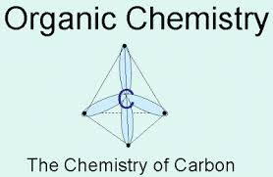
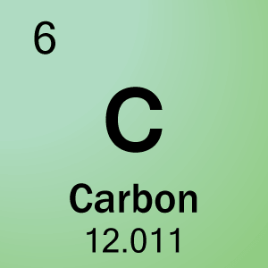
Organic Chemistry
The study of
carbon-containing
compounds.
Notes:
Make sure that the students understand that they have to understand carbon compounds before they can move on to macromolecules.

Slide 9
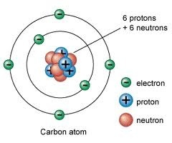
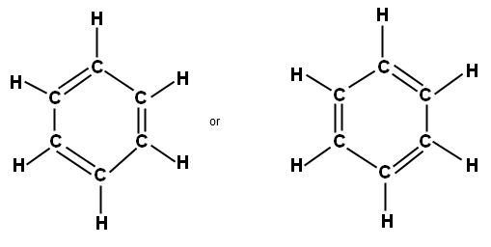
CARBON (pg. 45)
4 valence electrons
Carbon can bond with many elements, including hydrogen (H), oxygen (O), phosphorus (P), sulfur (S), and nitrogen (N) to form molecules of life.
One carbon atom can bond to another carbon atom
Gives carbon the ability to form chains
Single, double, or triple covalent chains
May form rings
Notes:
Question: So why would there be an entire branch of chemistry dedicated to understanding carbon compounds?
*Make sure that students note the one-letter symbols to represent these elements that are all vital to life.
*Review covalent bonds

Slide 10
Single, Double, Triple Covalent Bonds

Slide 11
Macromolecules (Pg. 46)
“giant molecules”
“macro”= giant
Made from thousands or even hundreds of thousands of smaller molecules.
Formed through “polymerization”
Large compounds (polymers) are built by joining smaller ones (monomers) together.
Notes:
Compare polymers to the entire watch, while monomers are the links of the watch.

Slide 12
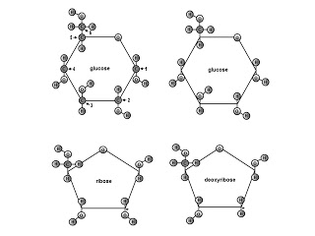
4 Groups of Macromolecules (Pgs. 46-49)
Carbohydrates
Simple sugars
Complex carbs
Lipids (fats)
Saturated
Unsaturated
Nucleic Acids
RNA
DNA
Protein

Slide 13
Guiding Question
How are structure and function of the major biomolecules related?

Slide 14
EXPLAIN – Book
Take out your 4 Biological Macromolecules Book
Complete the “F” or “Function” pages of each macromolecule by explaining:
Definition
Primary job/function (How does it work?)
Nutritional importance

Slide 15
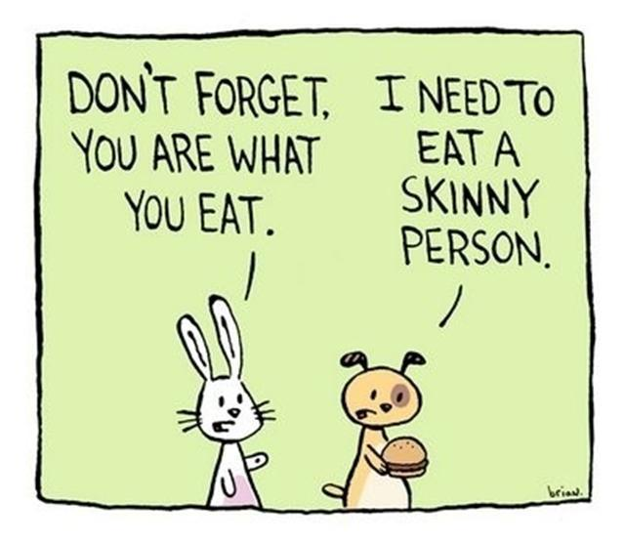
EVALUATE – On a notecard…
Refer back to your notecard…
Attempt to individually categorize your meal items based on the four groups of macromolecules.

Slide 17
Guiding Question
How do enzymes impact chemical reactions in an organism?

Slide 18
Chemical Reaction pg. 50
A process that changes, or transforms, one set of chemicals into another.
Energy and mass are conserved during chemical transformations
(Law of Conservation of Energy)
Involves changes in chemical bonds that join atoms in compounds.
Breaking old bonds to create new bonds
Necessary for organism to maintain all characteristics of life
Requires reactants to produce product(s).
Notes:
*Briefly review the characteristics of life (ex. growth and development, reproduction, response to environmental stimuli, adaptation, and movement (certain organisms), etc…)

Slide 19
Reactants and Products
The elements or compounds that enter into a chemical reaction are known as reactants.
The elements or compounds that are produced by a chemical reaction are known as products.
Notes:
Challenge the students to think of any chemical reactions that may be taking place in their bodies.

Slide 20
Notes:
Example of a chemical reaction to show reactants and products

Slide 21
Chemical reactions that are going on in your body at this moment:
Metabolism: Sum of all of the chemical reactions that take place within living cells, by which complex molecules are broken down to produce energy and by which energy is used to build up complex molecules.
Digestion
Absorption
Cellular respiration
Etc…

Slide 22
Chemical Reactions and Energy
Energy is released or absorbed whenever chemical bonds are formed or broken.
Therefore, chemical reactions also involve changes in energy. (pg. 51)
Chemical reactions that release energy often occur on their own (spontaneously) but not always.
(Ex. Cellular Respiration and digestion)
Chemical reactions that absorb energy will not occur without a source of energy.
(Ex. Photosynthesis)
Notes:
*Remind students of the “Law of Conservation of Energy” (Energy is never lost, it is conserved during transformations)
*Be careful with the terms “exothermic” and “endothermic” to not confuse the students.
*Talk about the comparison between cellular respiration and photosynthesis

Slide 24
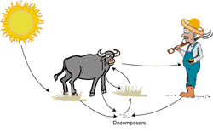
Main Sources of Energy
SUNLIGHT (plants)
Eating (animals eat plants and/or other animals)

Slide 25
How do we get a reaction started?
ACTIVATION ENERGY =
The energy that is needed to start a reaction.

Slide 26
Notes:
Discuss how a higher activation energy means slower reaction/ more energy required to get the reaction going.

Slide 27
Guiding Question
How do enzymes impact chemical reactions in an organism?

Slide 28
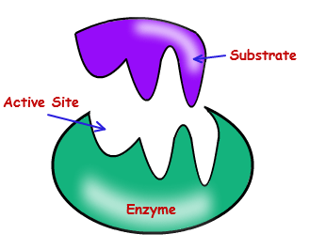
Is it possible to speed up the rate of a chemical reaction?
YES!!!
Enzymes: Also known as “nature’s catalysts”, are proteins that speed up the rate of chemical reactions by lowering the activation energy (pg. 52).
Notes:
Make sure that students understand that enzymes LOWER THE ACTIVATION ENERGY!!!

Slide 30
Notes:
Continue to stress that enzymes lower the activation energy

Slide 31
Enzyme-Substrate Complex (pg. 52)

Slide 32
Regulation of Enzyme Activity (pg. 53)
Temperature, pH, and regulatory molecules can affect the activity of enzymes.
Enzymes produced by human cells generally function best at temperatures close to 37°C (normal temperature of human body)
Enzymes work best at certain ionic conditions and pH values.
Example: Pepsin (stomach enzyme) works best under acidic conditions.
Notes:
Mention denaturation (change of proteins shape so that it loses its function). Essential amino acids are still available after denaturation.

Slide 33
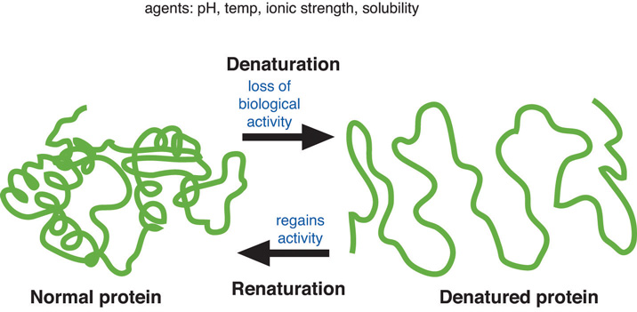
Protein Denaturation
Notes:
Note that renaturation (reversal of denaturation) is rare but possible.

Slide 34
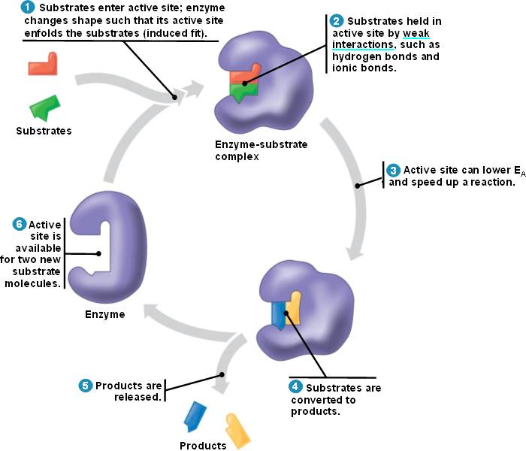
So what happens to enzymes once the chemical reaction has occurred?
The enzyme “resets” itself to be used again.

Slide 35
So what will you take into the world today?
Write at least one paragraph that summarizes this lesson on biological macromolecules.
Use relevant vocabulary terms (used correctly), interesting facts, and information about the four major groups of macromolecules and enzymes.
Please include any question that you may still have pertaining to this lesson.
Notice: We will have a lab next class!
Be sure to have your lab safety contracts turned in and wear closed-toe shoes!!!

Slide 36
ELABORATE – Lab
Fat Test
Heavy cream
Peanut butter
Egg whites
Egg yolks
Yogurt
Water
Starch Test
Flour
Potato
Sugar
Bread
Water

