Slide 1
Chemical Compounds & Properties of Water
SC.912.P.8.7 (Honors)
Interpret formula representations of molecules and compounds in terms of composition and structure.
SC.912.L.18.12
Discuss the special properties of water that contribute to Earth's suitability as an environment for life: cohesive behavior, ability to moderate temperature, expansion upon freezing, and versatility as a solvent.

Slide 2
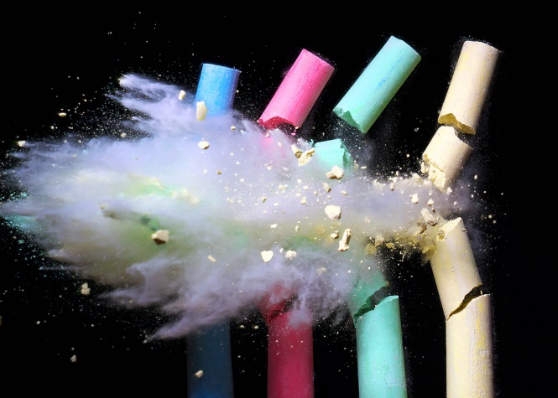
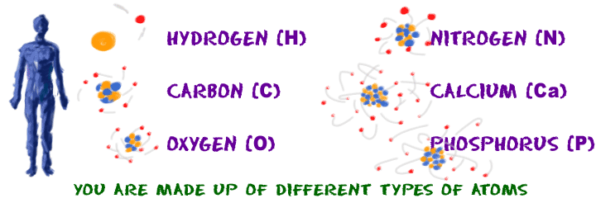
Can you continue to cut or divide something forever without it changing into something else?

Slide 3
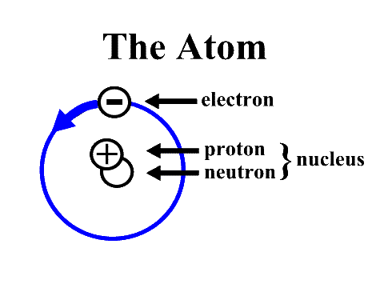
Atoms
= Basic unit of matter (not life!)
Atoms are incredibly small
They are made of protons, neutrons, and electrons

Slide 4
Atoms
Protons (p⁺) & neutrons (n⁰) have similar masses
Protons have a positive charge
Neutrons have no charge
Electrons have a negative charge

Slide 5
Atoms
Atoms have the same number of protons and electrons
The positive and negative charges balance out
Their overall charge is zero = neutral

Slide 6
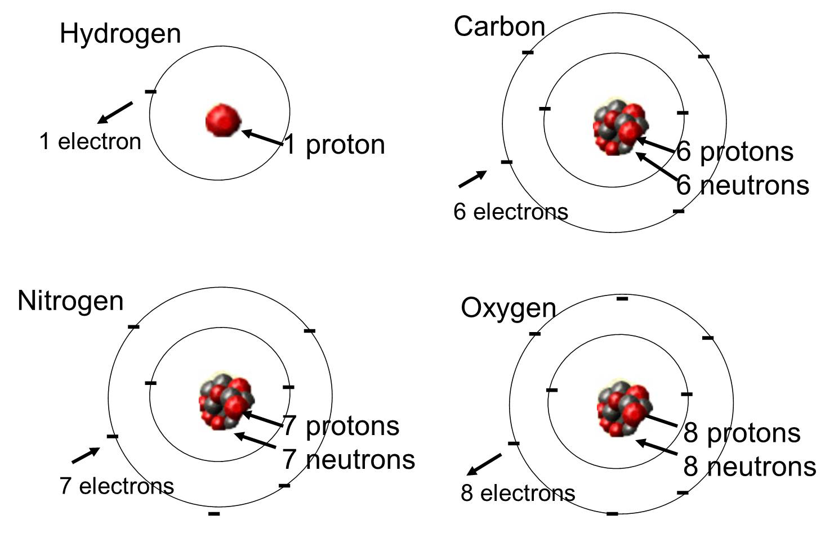
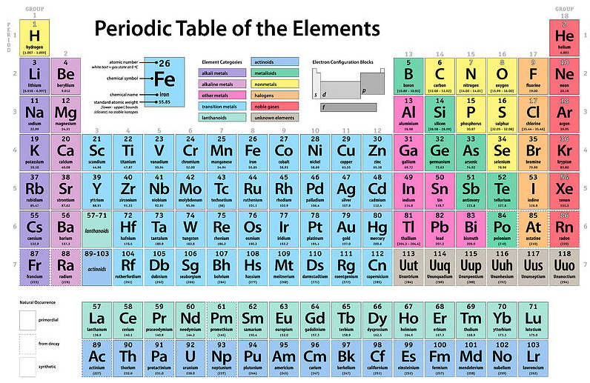
Element
Made up of only one type of atom

Slide 7
Isotope
What do the following pictures have in common?
How are they similar?

Slide 8
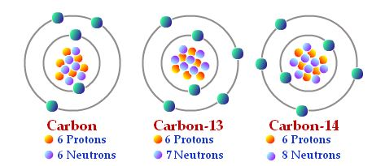
Isotope
Atoms of an element with different numbers of neutrons

Slide 9
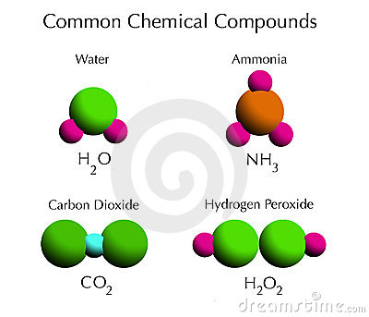
Compounds
Combos of two or more elements
Definite proportions (ex. think ratios 2:1)
2H : 1 O
1N : 3H
1C : 2 O
2H : 2 O

Slide 10
Chemical Bonds
Ionic = transferring electrons, giving away
Ex. Table salt, NaCl
Covalent = sharing electrons
Ex. Water, H2O

Slide 11
Compounds
Combos of two or more elements
Definite proportions (ex. think ratios 2:1)
2H : 1 O
1N : 3H
1C : 2 O
2H : 2 O

Slide 12
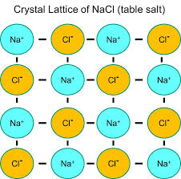
On your notes paper…
Send person 2B to get 2 textbooks per team
Turn to page 36-37
Complete the Quick Lab with your shoulder partner (As with Bs)
Partner As = you are a sodium atom
Partner Bs = you are a chlorine atom
Answer #s 1-2 on your own paper
Use picture at right for step 4

