Slide 1
Population Ecology Lab
Ms. McCabe
10/5-6/15
Biology/Biology Honors

Slide 2
Engage/Do Now 10/5-6/15
On a sheet of notebook paper, define the following:
Exponential growth curve – pg. 132
Logistic growth curve – pg. 135
Carrying capacity – pg. 135
Density-dependent limiting factor – pg. 138
Density-independent limiting factor – pg. 140

Slide 3
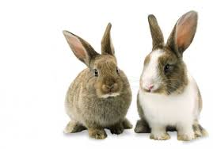
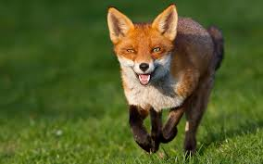
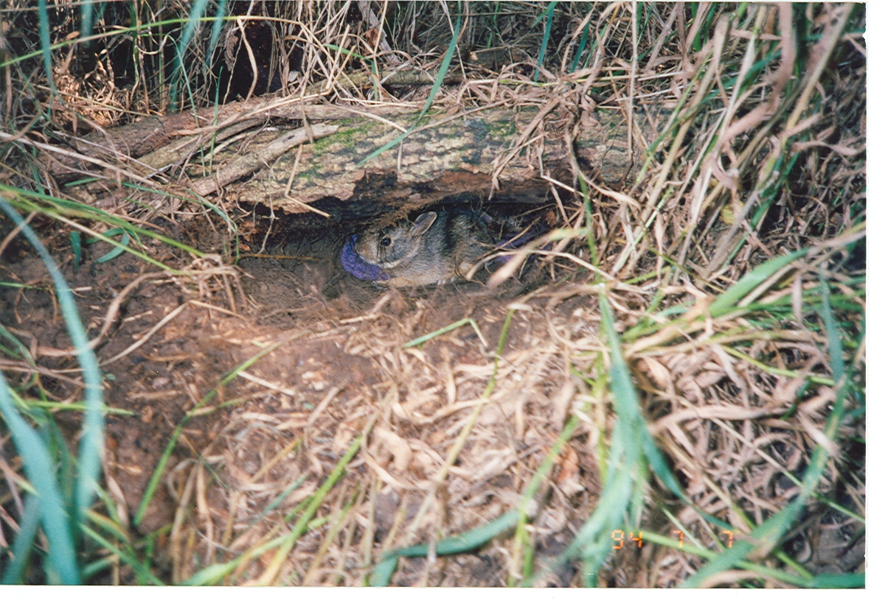
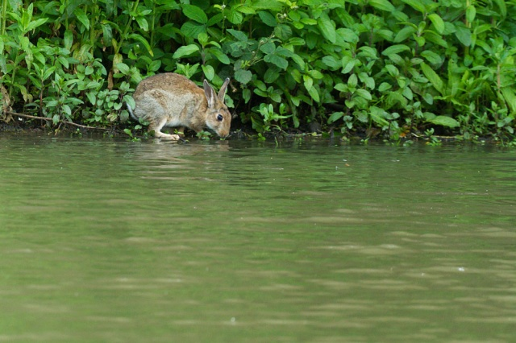
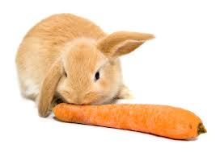
Engage/Do Now – Outdoor activity 10/5-6/15
For today, I will need only two people to act as rabbits
Everyone else will be parts of the environment
Shelter = hold hands in a triangle over your head
Water = place one hand over your mouth
Food = place one hand over your stomach
Once you choose to be a resource, you cannot change it

Slide 4
Directions
We will line up at the door
Bring your pencil and lab paper and a clipboard (1 per group)
We will quietly and quickly walk to the space in front of the library

Slide 5
Generation | Rabbit | Environment | Fox
1 | 2 |  | 0
2
3
4
5
6
7
8
9
10
11
12
13
14
15
16

