Slide 1
Properties of Water
Biology I/ Biology I Honors
Ms. Thomas
2015-2016
Unit 1: The Science and Chemistry of Life

Slide 2
Standard
SC.912.L.18.12
Discuss the special properties of water that contribute to Earth's suitability as an environment for life: cohesive behavior, ability to moderate temperature, expansion upon freezing, and versatility as a solvent.

Slide 3
Guiding Questions
How do the special properties of water contribute to Earth’s suitability as an environment for life?
How does the arrangement of covalent bonds within a water molecule lead to its polar property?

Slide 4
So what are you made of?
Just as buildings are made from bricks, steel, glass, and wood, living things are made from chemical compounds. (p. 34)

Slide 5
Just
Rip
It!
Notes:
Give each student a notecard and have them rip it continuously until they can no longer rip it. Ask them if it is still paper.

Slide 6
“If you take an object like a stick of chalk and break it in half, are both halves still chalk?”
But what happens if you break it in half again and again… and again… and again… and again…
Notes:
Add a picture of Democritus and explain.

Slide 8
Atom
The Basic unit of matter.
*Matter: Anything that has mass and takes up space.
Notes:
Democritus decided that there had to be limit and called the smallest fragment the atom (Greek: atomos: unable to be cut)

Slide 9
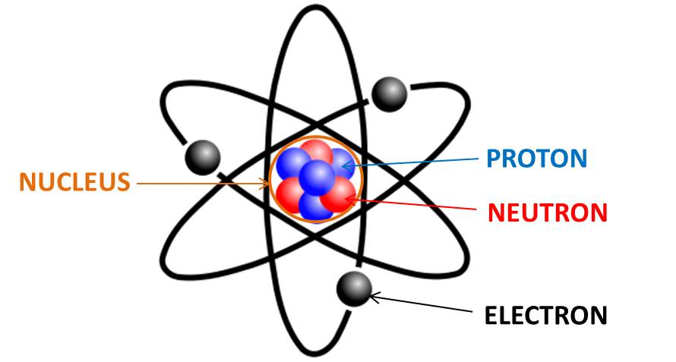
Subatomic particles
Protons (+)
Neutrons (0)
Electrons (-)
Notes:
Strong forces bind protons and neutrons together to form the nucleus, at the center of the atom. (pg. 34)
Electrons are in constant motion in the space surrounding the nucleus.
Atoms have an equal # of protons and electrons so atoms themselves are electrically neutral.

Slide 10
Elements
A pure substance that consists entirely of one type of atom. (Represented by one- or two- letter symbols)
*Only about two dozen are commonly found in living organisms
Notes:
More than 100 Elements are known

Slide 11
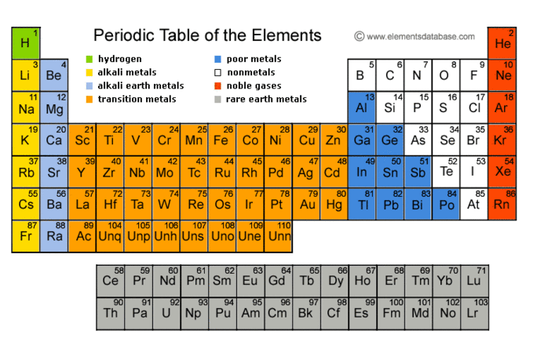
Notes:
Add a picture of the periodic table. Make sure that each student has a copy of the periodic table and understands the atomic #.

Slide 12
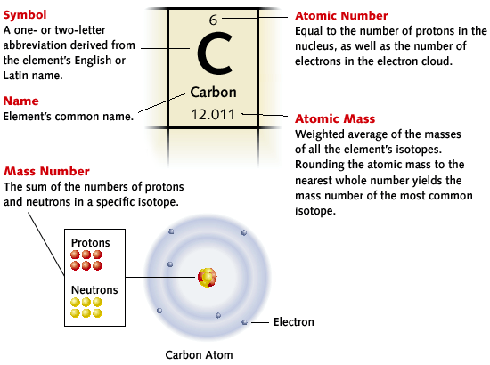
Notes:
Carbon is one of the main essential elements of life

Slide 13
Elements combine with other elements to form?
chemical compounds
substances formed by the chemical combination of two or more elements in definite proportions. (p. 36)
Notes:
Elements combine to form compounds

Slide 14
Note:
The physical and chemical properties of a compound are usually very different from those of the elements from which it is formed.

Slide 16
How do we “keep it together”?
Chemical Bonding
Chemical bonding involves the electrons that surround each atomic nucleus. The electrons that are available to form bonds are called valence electrons.
Notes:
Only Honors is responsible for Ionic and Covalent bonds

Slide 17
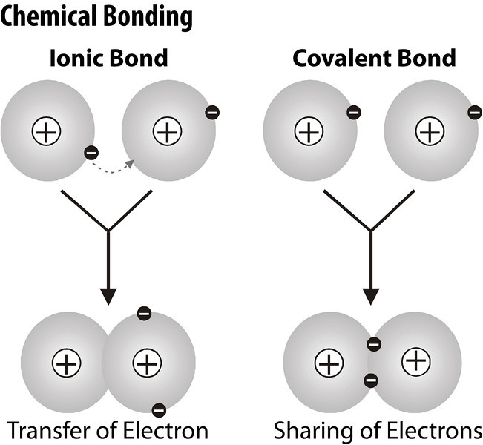
Main types of chemical bonds:
Ionic bonds
Covalent bonds

Slide 19
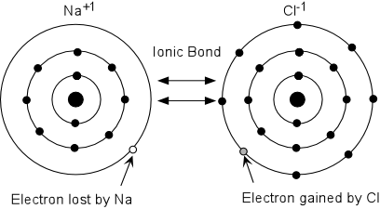
Ionic Compounds
FORMED BY ionic bonds; one or more electrons are transferred from one atom to another.

Slide 20
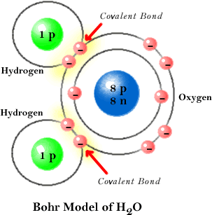
Covalent Compounds
Formed by covalent bonds; the sharing of electrons.
Notes:
Explain single, double and triple covalent bonds

Slide 21
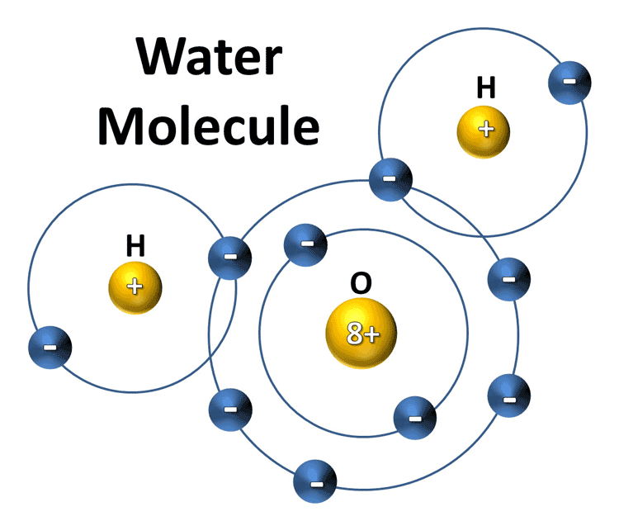
Molecule
The smallest unit of most compounds.
Atoms combine to form the molecules of chemical compounds.

Slide 22
WATER
Notes:
Have students come to board and write down things that they know about water

Slide 23
Guiding Questions
How do the special properties of water contribute to Earth’s suitability as an environment for life?
How does the arrangement of covalent bonds within a water molecule lead to its polar property?

Slide 25
The properties of water:
Polarity
solubility
Hydrogen Bonding
Cohesion = molecules of same substance stick together
Adhesion = molecules of different substances stick together
Ability to moderate temperature
Heat Capacity = reason for most water on earth being liquid
Expansion upon freezing

Slide 26
Polarity
Unequal sharing of electrons
(oxygen pulls more on shared electrons than hydrogen resulting in partial negative charge)

Slide 28
Water is the Universal Solvent

Slide 29
Reminder:
The “Properties of Water” lab will be conducted this Monday/Tuesday! Wear closed-toe shoes and be sure to have lab safety contracts signed by you and your parent/guardian or you will receive a grade of “0/f”!!!

