Slide 1
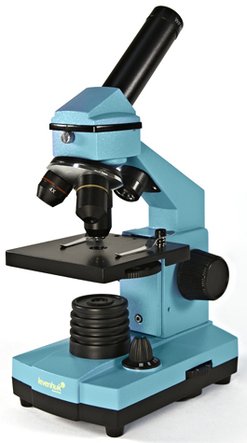
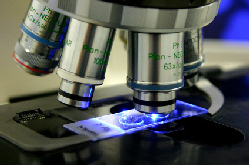
The Microscope: Seeing is believing (part 1)
SC.912.L.14.4 Compare and contrast structure and function of various types of microscopes.

Slide 2
Guiding Questions
How can we demonstrate the uses and functions of the compound light microscope?
How do we calculate the total magnifying power of a typical light microscope when given the magnification of the objectives?
How can we describe the structure and function (usefulness) of the different types of microscopes used in the study of biology?

Slide 3
How do microscopes work?
Microscopes produce a larger image of something very small
Most microscopes use lenses to magnify the image of an object by focusing light or electrons.

Slide 4
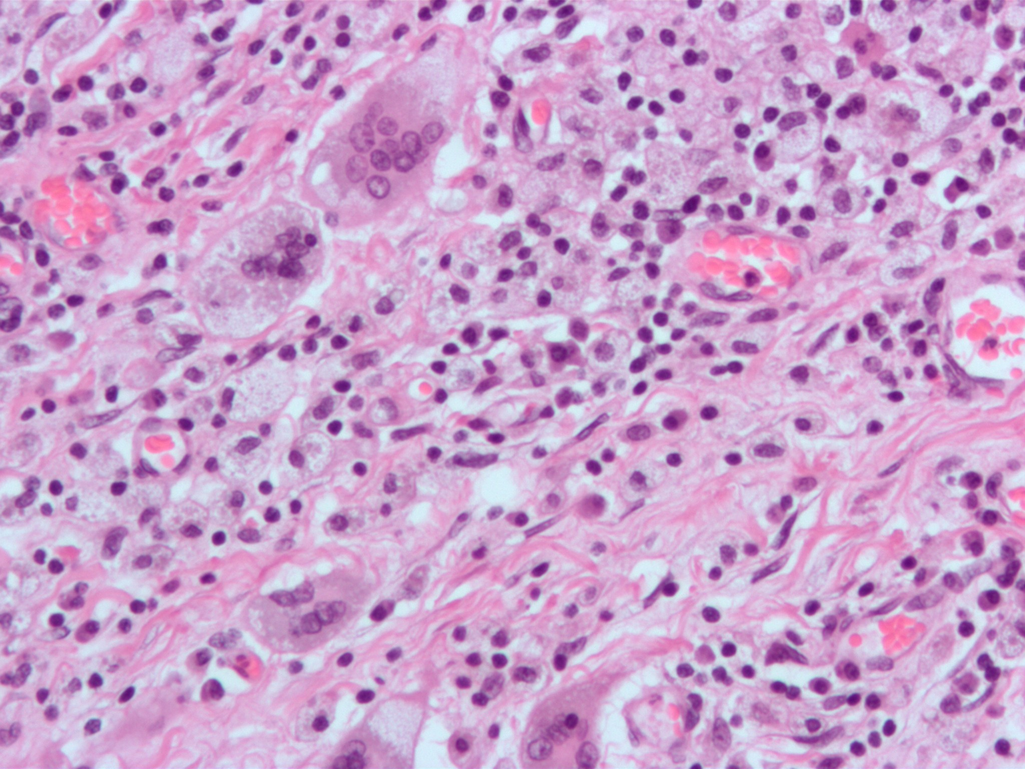
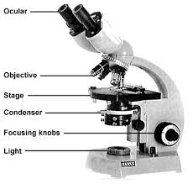
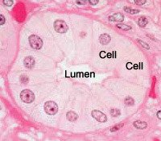
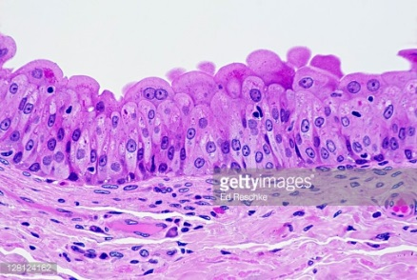
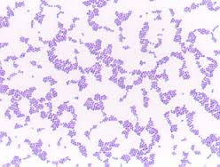
Light microscopes & cell stains
Allows light to pass through a specimen using 2 lenses to form an image
Lens #1 is the objective lens, located just above the specimen
Enlarges the image
Lens #2 is the ocular lens that also magnifies the image
Can be used to see cells and structures as small as 1/1,000,000 of a meter!
Microscopes are limited by light diffraction to magnification by 1000x
Notes:
Pic 3 = human bladder
Pic 4 = staph

Slide 5
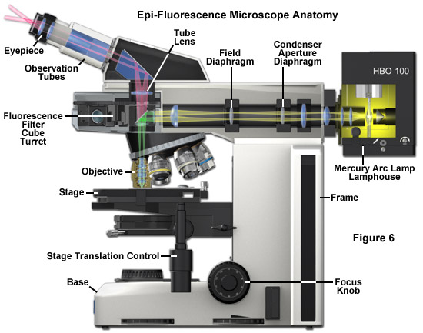
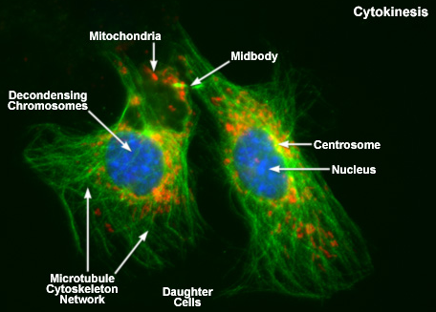
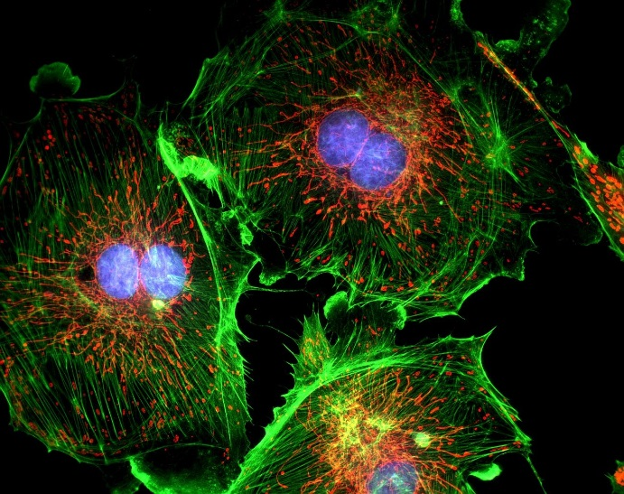
Light microscopes & cell stains
Most cells are transparent, so using dyes or stains can help solve this problem
Some stains are so specific, they can show specific parts within a cell
Flourescence = type of staining where dyes give off light of a particular color when viewed under specific wavelengths of light

Slide 6
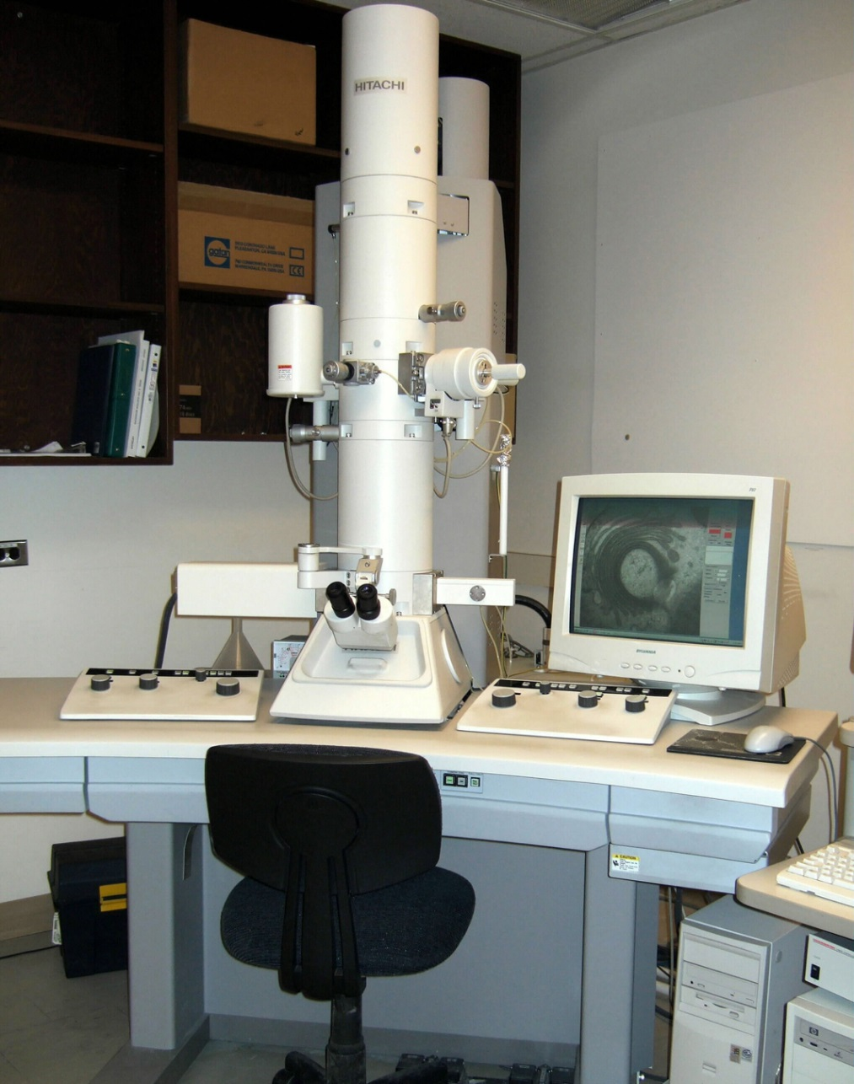
Electron microscopes
Used to see structures smaller than what light microscopes can see
Can see viruses or DNA molecules with EMs
Can only be used on preserved, non-living cells or tissues
Use beams of electrons that are focused by magnetic fields
Much higher resolution than light microscopes

Slide 7
Electron microscopes
Two types of EMs:
Transmission Electron Microscope = can see cell structures & large proteins, appear flat and 2-dimensional
Scanning Electron Microscope = 3-dimensional images produced
Stains/dyes are added to specimen, the actual image is in black and white

Slide 8
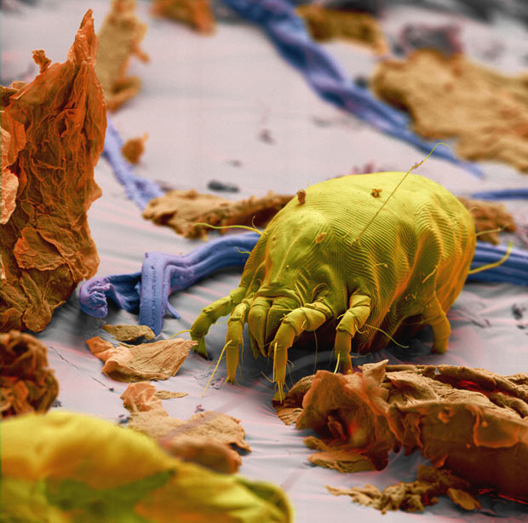
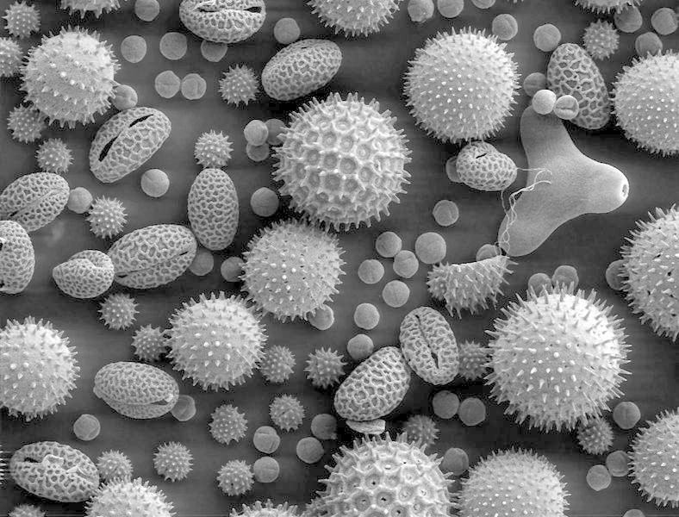
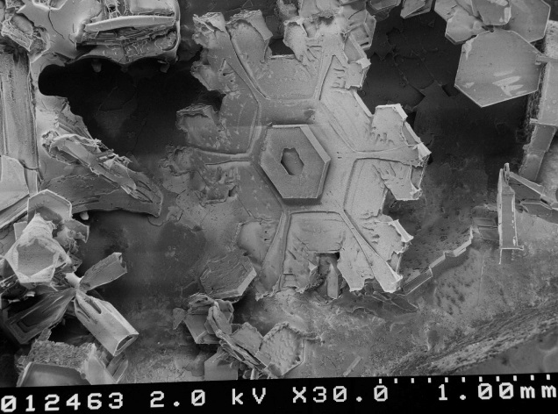
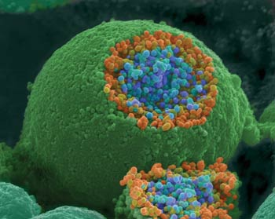
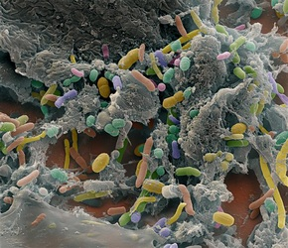
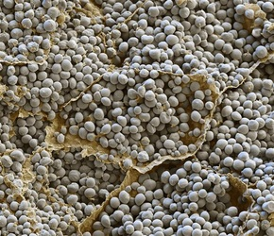
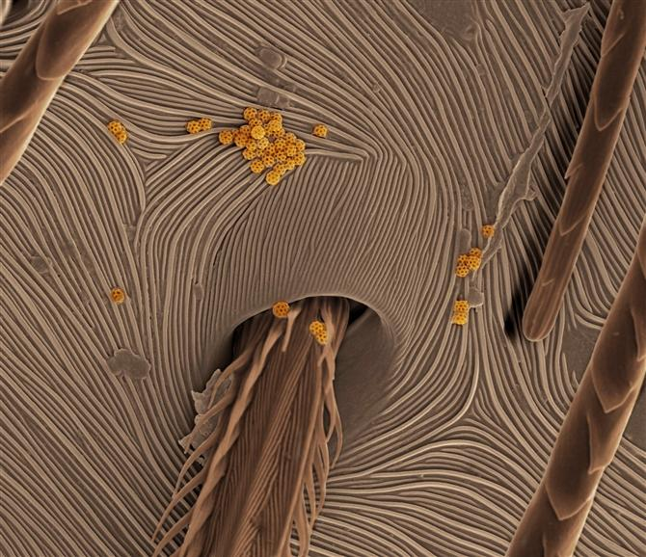
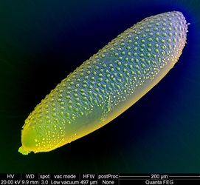
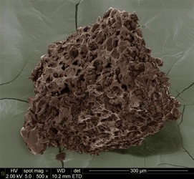
Electron microscopes
Notes:
Pollen, snowflakes, dust mite, SEM nerve endings, human gut bacteria, corn starch, spider skin, mosquito egg, ground coffee

Slide 9
The Microscope WS
We will use the following website to help us identify parts of the microscope:
http://www.udel.edu/biology/ketcham/microscope/scope.html
On your paper, complete the functions for each part. Then, label the back image of the microscope.

Slide 10
The Microscope Lab
You will need:
A pen or pencil
Colored pencils
These notes
Quietly take your seat in the lab and begin reading the Lab Introduction and complete the Pre-Lab questions

