Slide 1
Humans in the Biosphere
2015-2016
Ms. McCabe
Biology/Biology Honors
Notes:
SC.912.L.17.8 Recognize the consequences of the losses of biodiversity due to catastrophic events, climate changes, human activity, and the introduction of invasive, non-native species.
SC.912.L.17.20 Predict the impact of individuals on environmental systems and examine how human lifestyles affect sustainability.
SC.912.L.17.11 Evaluate the costs and benefits of renewable and nonrenewable resources, such as water, energy, fossil fuels, wildlife, and forests.
SC.912.L.17.16 (Honors) Discuss the large-scale environmental impacts resulting from human activity, including waste spills, oil spills, runoff, greenhouse gases, ozone depletion, and surface and groundwater pollution.
HE.912.C.1.3 Evaluate how environment and personal health are interrelated.

Slide 2
Guiding Questions
What are the major causes and effects of the loss of biodiversity?
How can we predict the impact humans have on environmental systems and sustainability?
What are the short- and long-term costs and benefits associated with our use of renewable and nonrenewable resources?

Slide 3
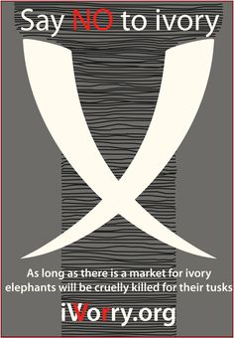
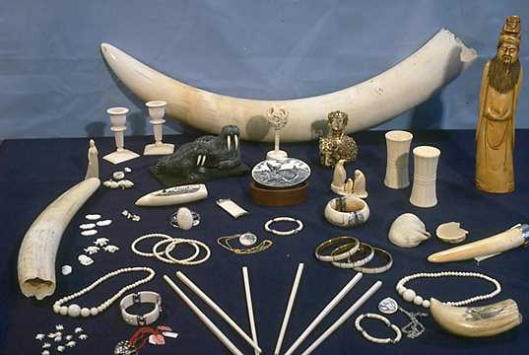
Do Now 10/13-14/15
These are products made of ivory from elephant tusks. There are laws against killing elephants to take their tusks, and trade in ivory products has been banned by international law, but a market for ivory still exists.
Predict how this demand for ivory affects elephant populations and the biosphere.

Slide 4
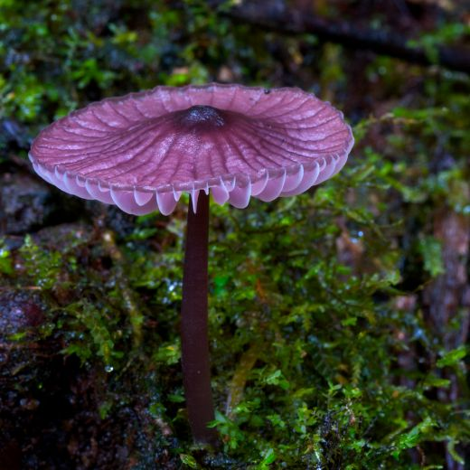
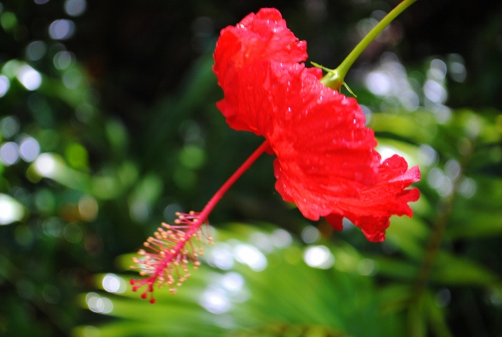
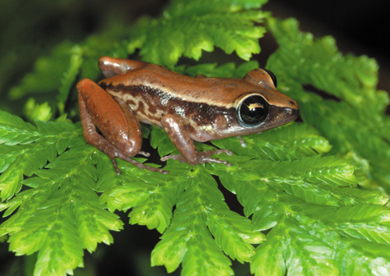
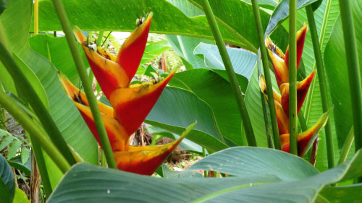
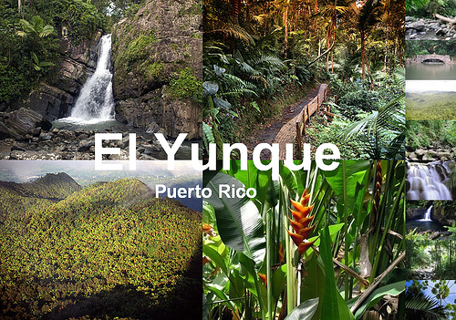
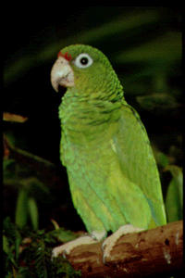
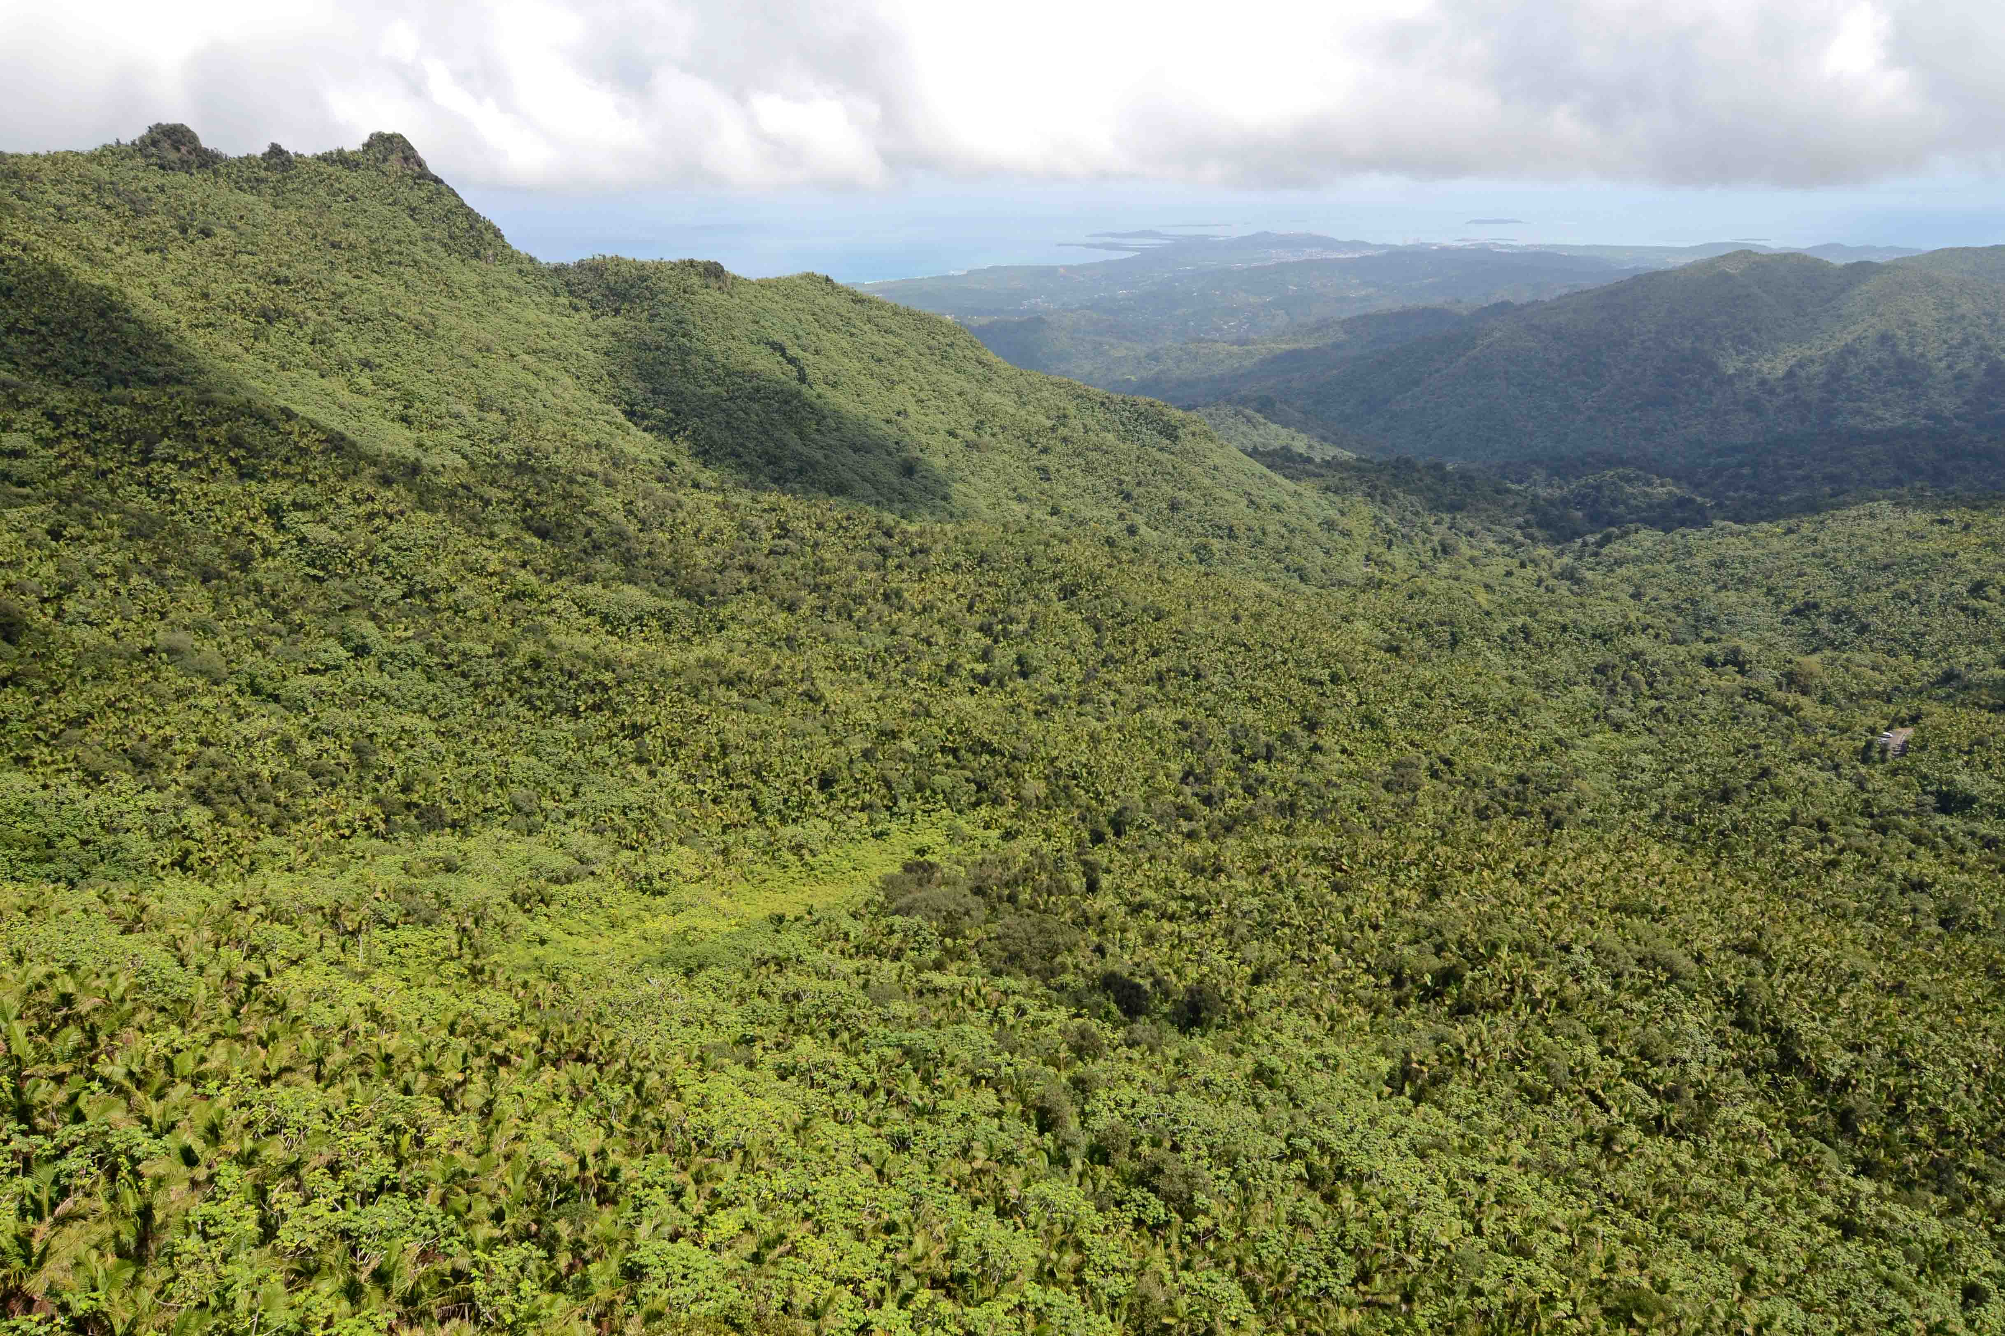
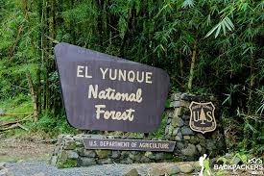
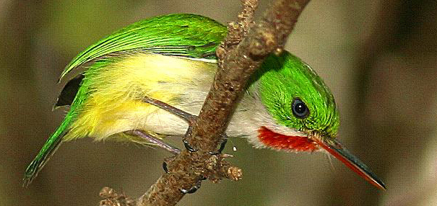
“Variety is the spice of life”
Think of some of your favorite places to visit in nature
The beach?
The mountains?
The rainforest?
Now, think of the many species that live there
Notes:
Name and describe some of the species shown in the rainforest of El Yunque in Puerto Rico

Slide 5
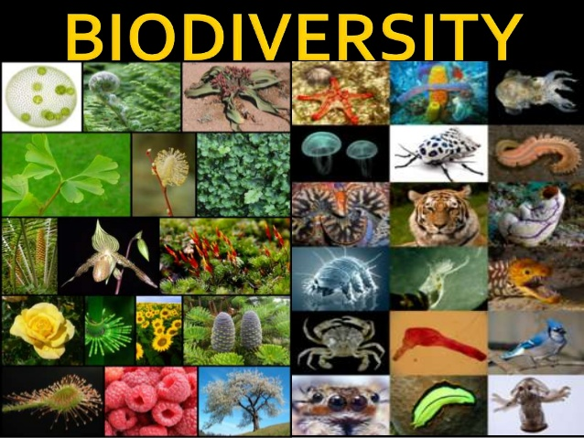
Biological Diversity
Variety gives us more than just interesting things and species to look at
Biodiversity = the total of all the genetically based variation in all organisms in the biosphere
To biologists, biodiversity is precious and worth preserving

Slide 6
Notes:
Biodiversity – Ted Ed

Slide 7
Biodiversity (BD): 3 Types
Genetic BD = differences in genetic info (DNA) within a species
Ex. Green, red, and yellow mangoes
Species BD = differences in types of species or organisms in an environment
Ex. Hummingbirds, bees, and butterflies
Ecosystem BD = different types of ecosystems in a larger area
Ex. Coral reefs, forests, deserts, grasslands, oceans, and wetlands

Slide 8
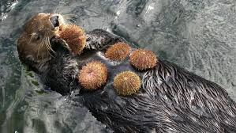
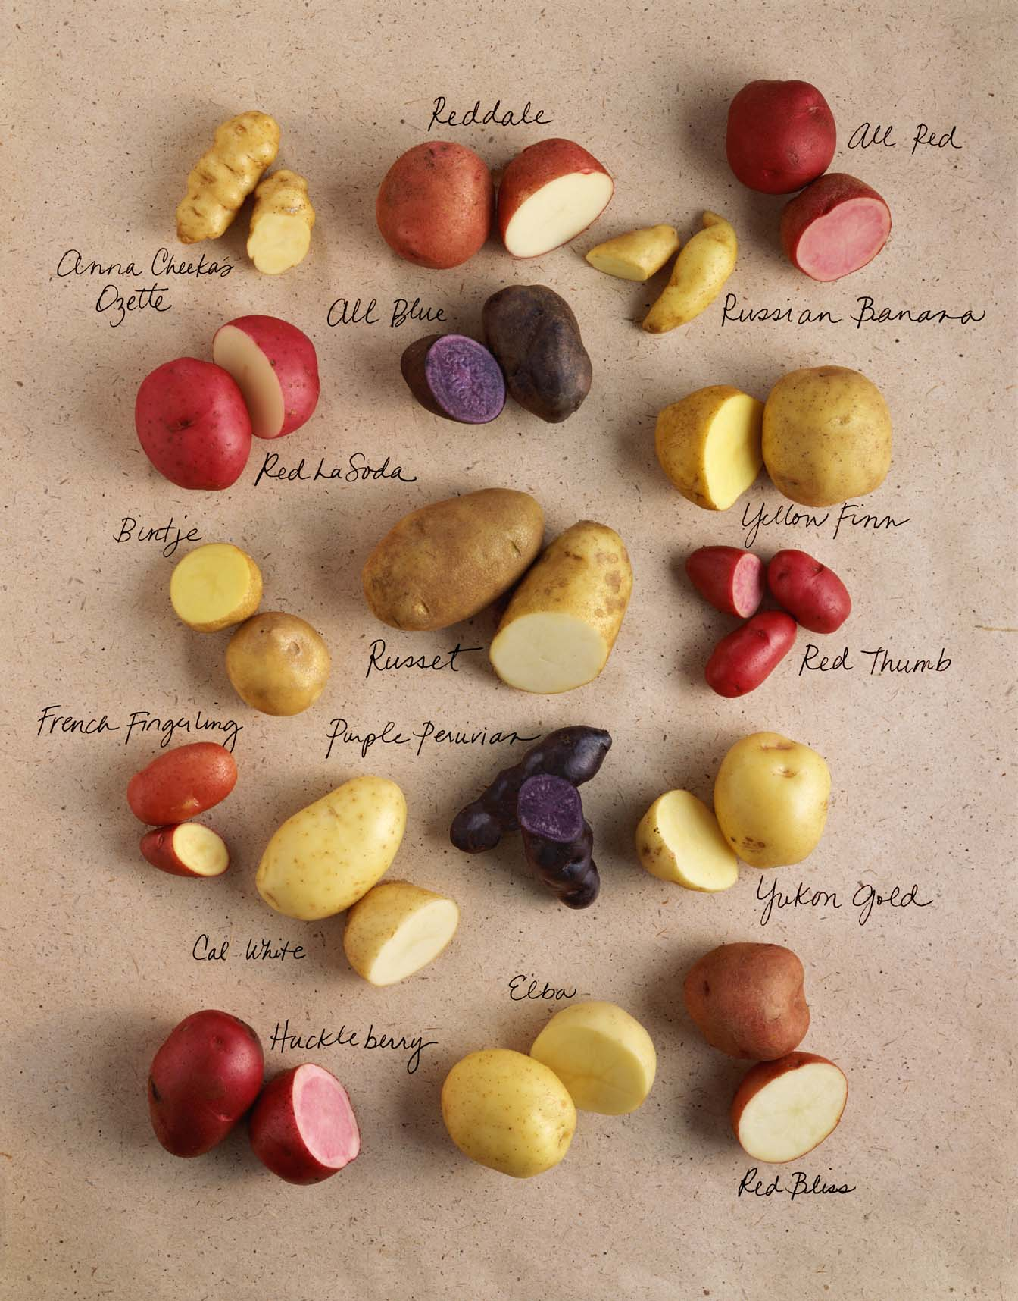
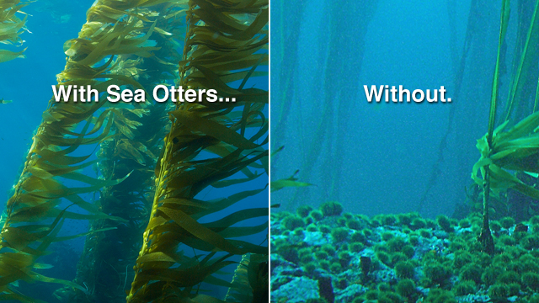
Values of Biodiversity
Contributes to medicine & agriculture
Wild foxglove contains compounds used to treat heart failure
Wild relatives of crops (such as potatoes) with genes for disease or pest resistance
Provides ecosystem goods & services
Sea otters are a keystone species
When otters decrease, its prey, sea urchins, increase which leads to a decrease in kelp, the sea urchin’s favorite food

Slide 9
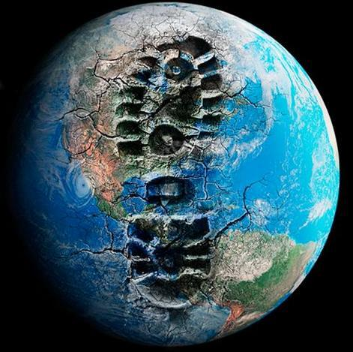
Do humans have a positive or negative impact on the biosphere?
Notes:
(Think-pair-share)

Slide 10
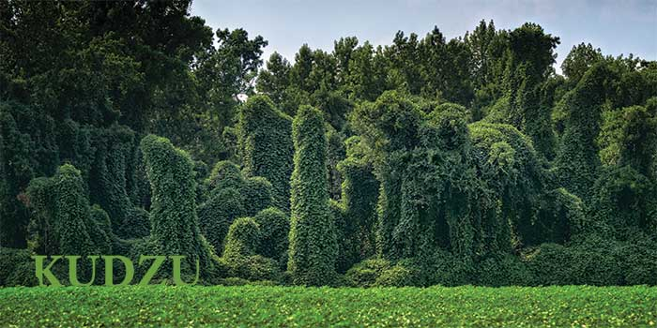
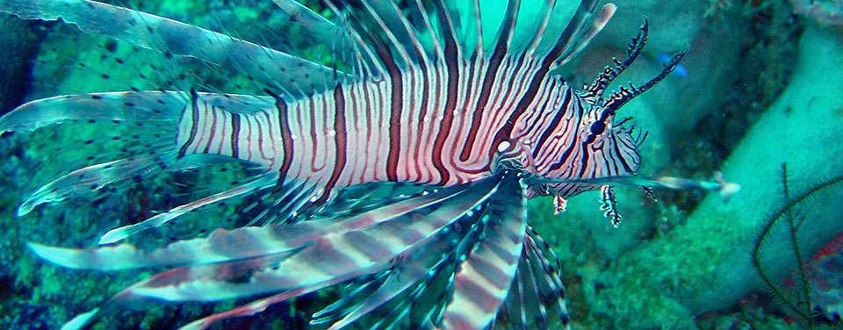
Threats to Biodiversity
The more genetically diverse a species is, the greater its chances of surviving disturbances.
Humans reduce BD by…
Habitat fragmentation/degradation = splitting of ecosystems to leave habitat “islands”
Hunting
Introducing invasive species (kudzu and lionfish)
Notes:
Species have been evolving, changing, and dying out since life began. Scientists estimate that over 99% of the species that have ever lived are now extinct.

Slide 11
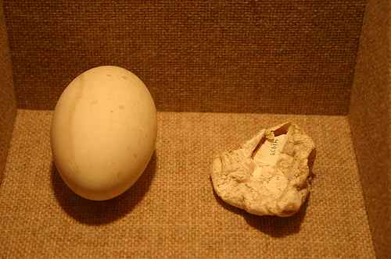
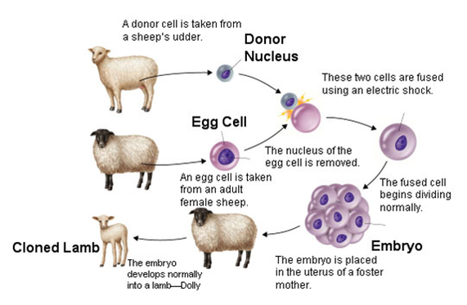
Threats to Biodiversity
Humans reduce BD by…
Releasing pollution into food webs
DDT (pesticide) prevents birds from laying healthy eggs
Acid rain stresses water organisms
Increased CO₂ makes oceans more acidic which leads to coral bleaching
Contributing to climate change = if abiotic conditions change beyond an organism’s tolerance, the organism must migrate, adapt, or die.
Cloning crops or animals
Notes:
Species have been evolving, changing, and dying out since life began. Scientists estimate that over 99% of the species that have ever lived are now extinct.

Slide 12
Guiding Questions
What are the major causes and effects of the loss of biodiversity?
How can we predict the impact humans have on environmental systems and sustainability?
What are the short- and long-term costs and benefits associated with our use of renewable and nonrenewable resources?

Slide 13
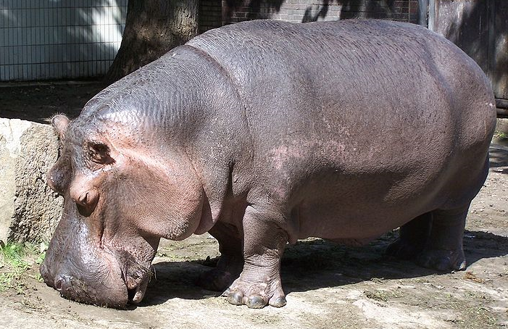
Why is Biodiversity Declining?
Think H.I.P.P.O. C.!
http://commons.wikimedia.org/wiki/File:Hroch_obojzivelny.jpg

Slide 14
H.I.P.P.O C.
H-Habitat Loss-destruction, degradation and fragmentation (mostly due to humans)
I-Invasive Species
P-Population of humans increasing
P-Pollution ( mostly from us homo sapiens)
O-Overharvesting—Taking too much at a time!
C- Climate Change

Slide 15
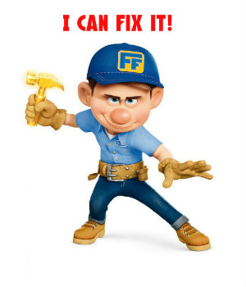
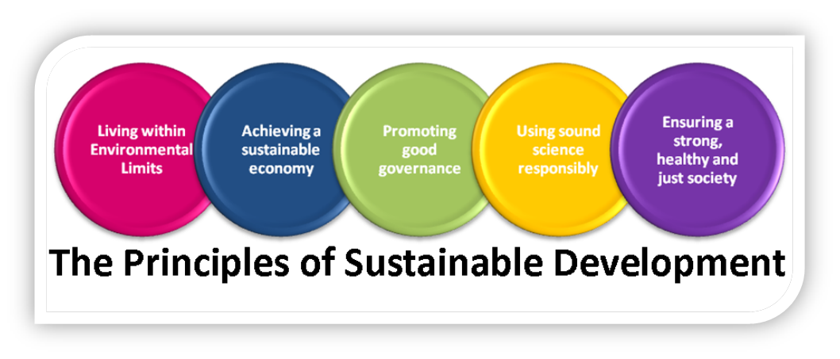
How can we fix it?
Sustainable Development
Provides for human needs while preserving the ecosystems that produce natural resources.
No long-term harm to soil, water, or climate
Flexible to survive environmental stresses

Slide 16
Guiding Questions
What are the major causes and effects of the loss of biodiversity?
How can we predict the impact humans have on environmental systems and sustainability?
What are the short- and long-term costs and benefits associated with our use of renewable and nonrenewable resources?

Slide 17
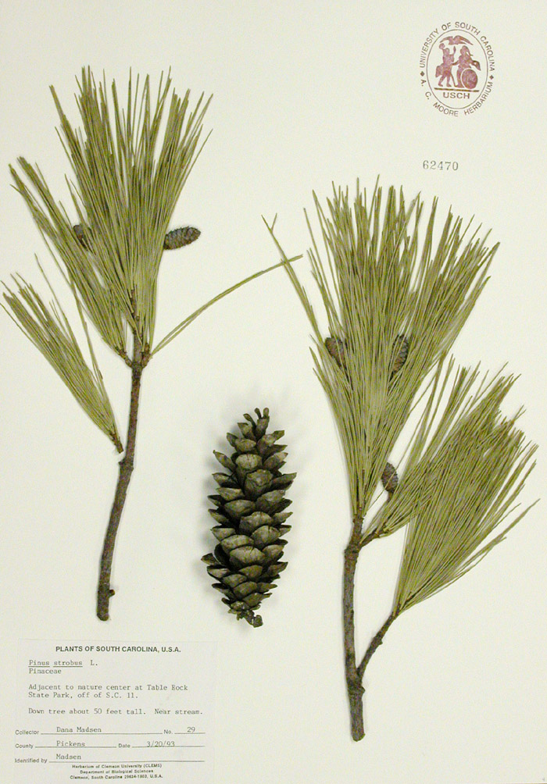
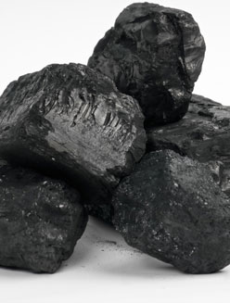
Renewable Resources vs Nonrenewable Resources
Renewable Resource:
Ecosystem good or service that can be produced or replenished by a healthy ecosystem.
Nonrenewable Resource:
Ecosystem good or service that is not able to be replenished via natural processes within a reasonable amount of time.
Notes:
List other renewable and nonrenewable resources

Slide 18
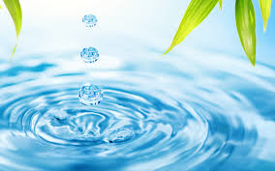
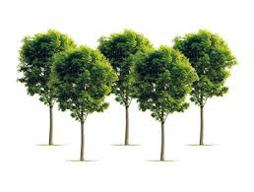
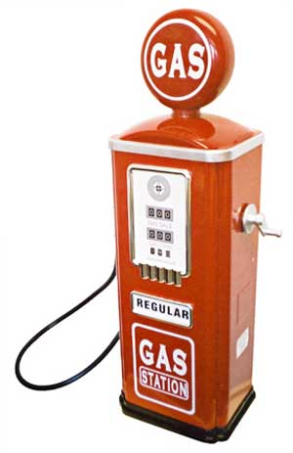
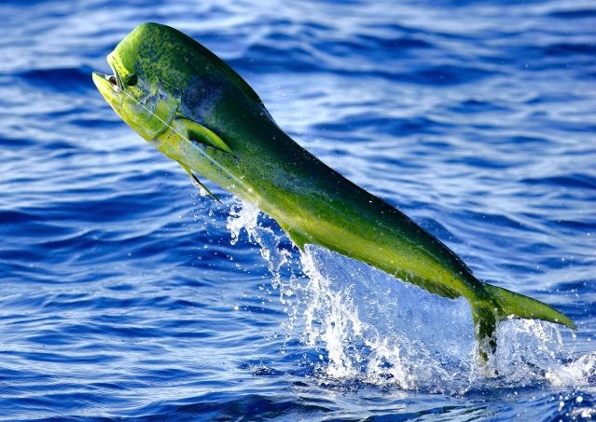
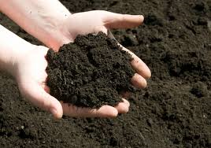
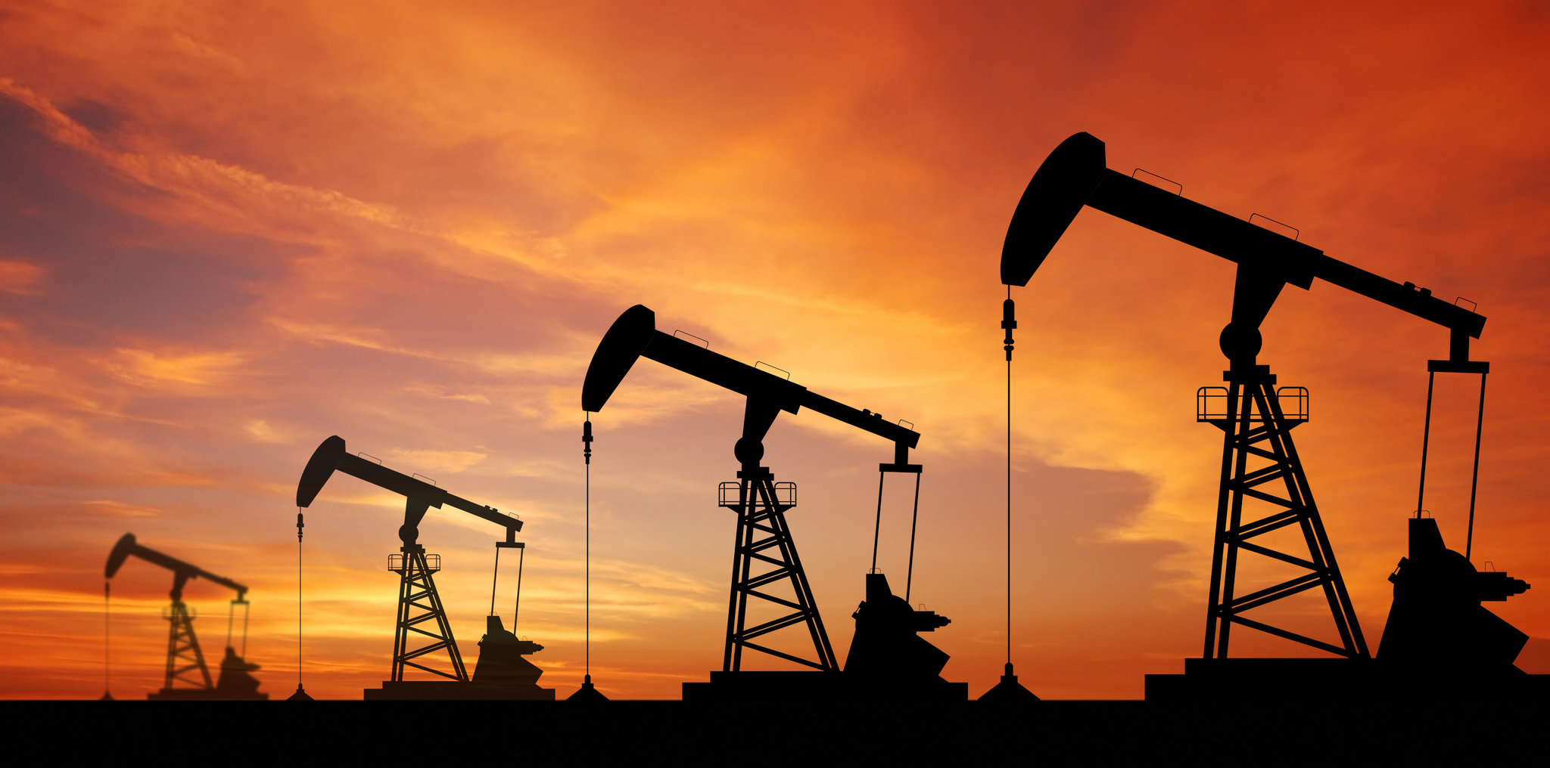
Individual Activity
Copy the 8 random resources onto your paper
If the resource is renewable, write RR next to the resource
If the resource is nonrenewable, write NR next to the resource
Be prepared for random calls!
Notes:
RR = trees, fish, soil, sunlight, water, wind
NR = gas, oil

Slide 19
If you said…
RR = trees, fish, soil, sunlight, water, wind
NR = gas, oil
Then you’re correct!
Notes:
RR = trees, fish, soil, sunlight, water, wind
NR = gas, oil

Slide 20
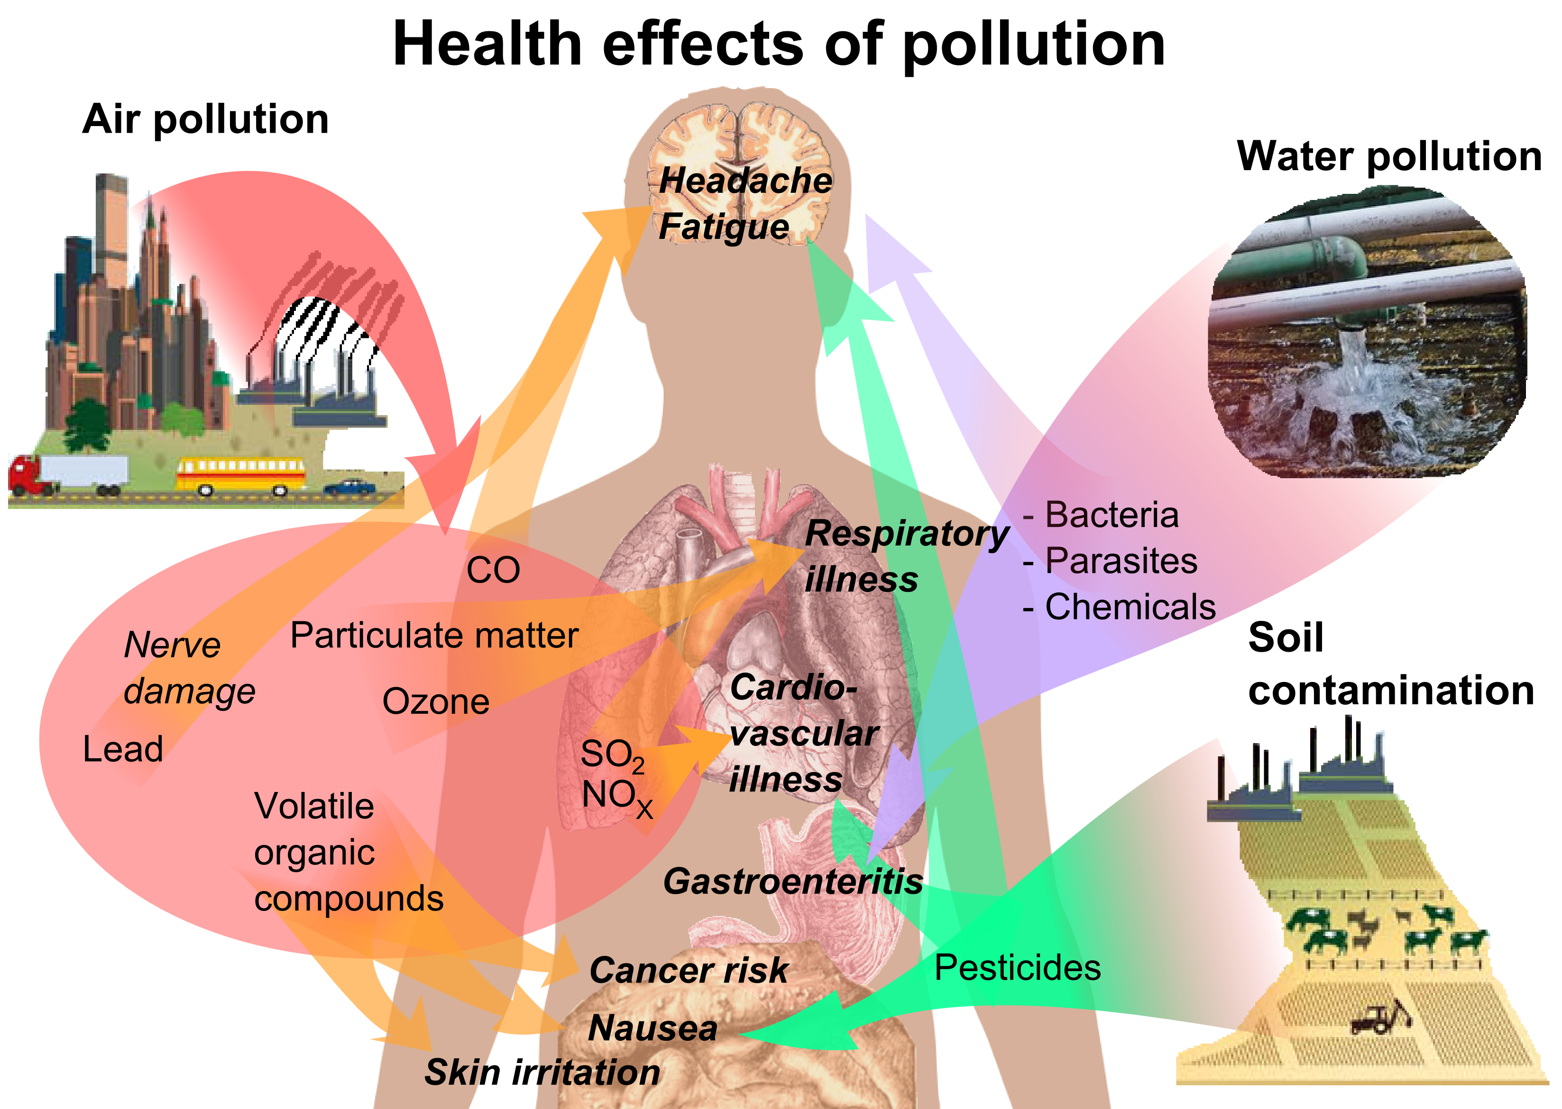
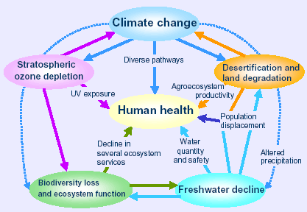
Impacts on Human Health

