Slide 1
Population Biology: Succession
Biology I/ Biology I Honors
Ms. McCabe
2015-2016
Unit 2: Ecology
Notes:
Teacher: Do the “Candy Overload” demonstration prior to showing this slide show. Remind students to write down notes that appear in light green.

Slide 2
Standards
SC.912.L.17.4
Describe changes in ecosystems resulting from seasonal variations, climate change and succession.
SC.912.L.17.2
Explain the general distribution of life in aquatic systems as a function of chemistry, geography, light, depth, salinity, and temperature.

Slide 3
Lesson Guiding Questions
How can we describe the conditions that may cause changes in ecosystems over time?
How do multiple factors (chemistry, depth, salinity, light, and temperature) affect the distribution and variation of life in aquatic systems?

Slide 4
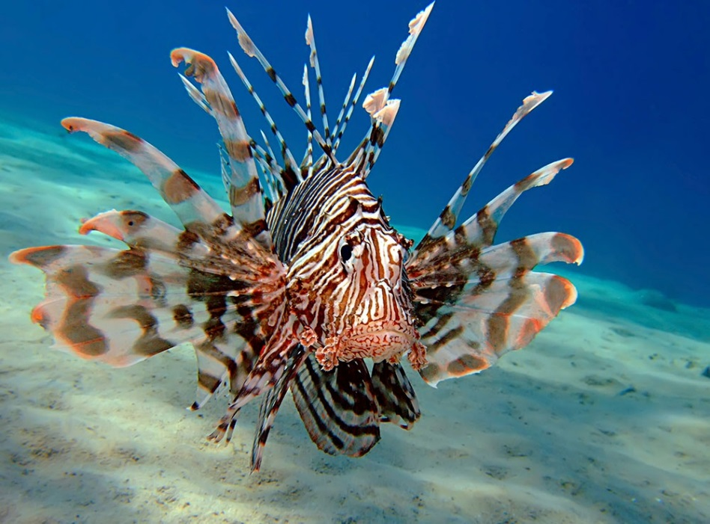
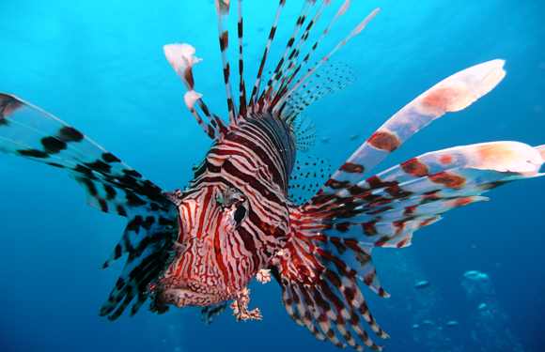
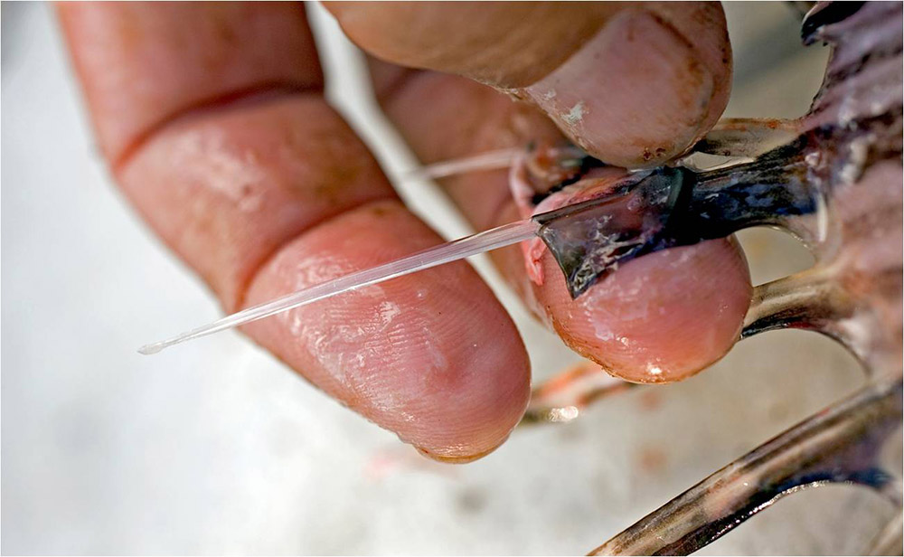
Do Now 10/9-10/15
The exotic venomous lionfish is native to the Indian and South Pacific Oceans.
Tell some possible effects of introducing this species to an area in the Atlantic Ocean.

Slide 5
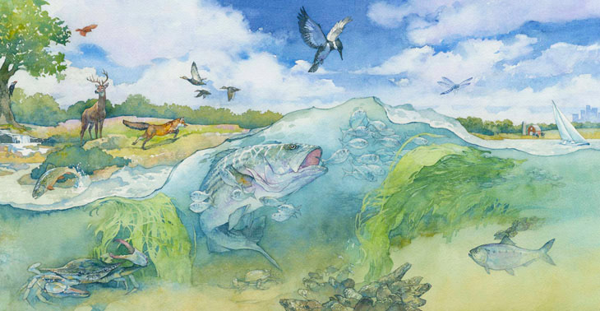
Something to think about:
Ecosystems are composed of interacting populations of organisms along with abiotic factors. As these various factors interact with each other, changes can occur which can ultimately result in the changing of the ecosystem. Species survive because of, and in spite of, interactions with other species.
Notes:
Review terms: “ecosystem”, “species”, “population”, “biotic” and “abiotic”.

Slide 6
Exponential Growth -vs- Logistic Growth pgs. 132-135
Notes:
Exponential growth occurs when resources are not limited. Logistic growth occurs when resources become more and more limited as the populations grow. Therefore population growth slows or stops, leveling off at the carrying capacity. Logistic growth is more realistic for most populations. (Use the comparison of a household… the more children (mouths to feed) the less available the resources become etc…)

Slide 7
Notes:
This video explains carrying capacity

Slide 8
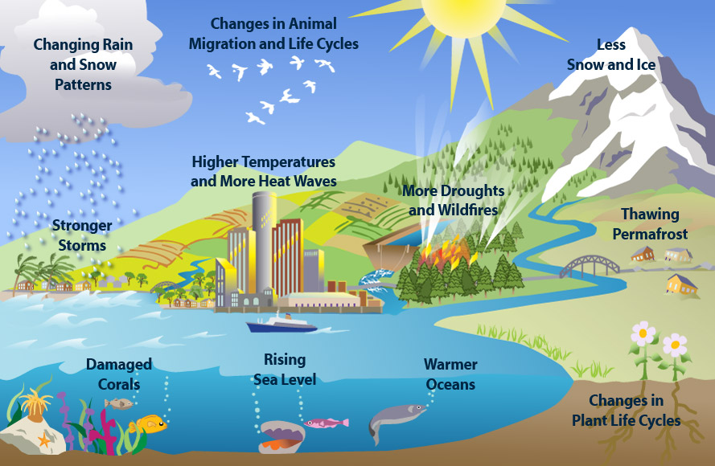
Lesson Guiding Question
How can we describe the conditions that may cause changes in ecosystems over time?
Notes:
Introduces seasonal variations, climate change and “succession”

Slide 9
Notes:
Question: Why do organisms migrate? Review the terms “immigration” and “emigration”.

Slide 10
Notes:
Question: Do “climate” and “seasonal variations” cause changes in ecosystems over time? Absolutely! Refer back to the lab and use real-world examples (natural disasters etc…). Also add that seasonal variations cause migrations in some organisms etc. Have the students to jot down their own examples. You may even briefly discuss biomes to show that climate affects ecosystems.
Go back to “natural disasters” and changes to ecosystems and begin discussing succession.

Slide 11
Notes:
Introduces succession…Ecological succession by the Amoeba Sisters. Have the students to use a notecard to jot down unfamiliar terms as they watch the video.

Slide 12
Primary Succession pg. 106
Succession that begins in an area with no remnants of an older community.
Make a sketch of this image
Notes:
Encourage students to sketch

Slide 13
Secondary Succession pg. 107
Make a sketch of this image
Succession in which a disturbance affects the community without completely destroying it.
Notes:
Encourage students to sketch. Note: Species adapt to the event and secondary succession is beneficial to the environment as opposed to being a disaster.

Slide 14
Primary vs. Secondary Succession pg. 106
Create a Venn Diagram to compare/contrast
Primary Succession
Secondary Succession
6 Points
Notes:
Encourage students to sketch

Slide 15
Notes:
(primary succession) The ecological pioneer that grows on back rock is lichen, which shares a mutualistic relationship with fungus and alga. Over time, lichen converts atmospheric nitrogen into useful forms for other organisms, break down rock and add organic material to form soil. (secondary succession) a disturbance affects the community without completely destroying it. Occurs faster because soil remains. The students can also draw a Venn-Diagram in their notes so that they are able to compare and contrast primary and secondary succession.

Slide 16
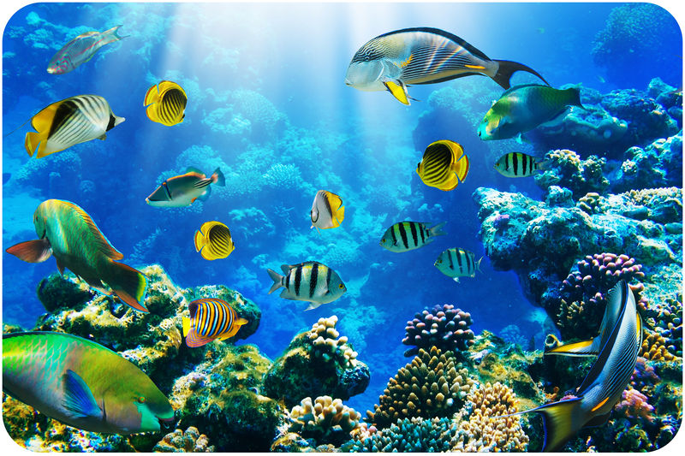
Lesson Guiding Question
How do multiple factors (chemistry, depth, salinity, light, and temperature) affect the distribution and variation of life in aquatic systems?
Notes:
Question: “What factors affect life in aquatic ecosystems?”

Slide 17
What factors affect life in aquatic ecosystems? Pg. 117-118
Like organisms living on land, underwater organisms are affected by a variety of environmental factors.
Aquatic organisms are affected primarily by the water’s depth, temperature, flow, and amount of dissolved nutrients.
Notes:
Allow the video to play while you talk about the factors that affect life in aquatic ecosystems.

Slide 18
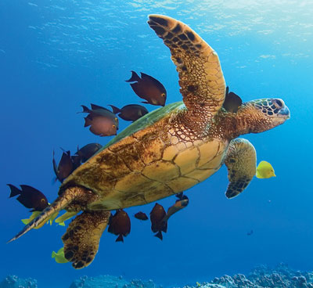
Distribution and Variation of Aquatic Life pg. 117-121
The types of organisms that live in specific aquatic ecosystems is determined by factors such as water depth, temperature, and nutrient availability.
The environment’s conditions has to be favorable for that organism in order for the organism to live there.

Slide 19
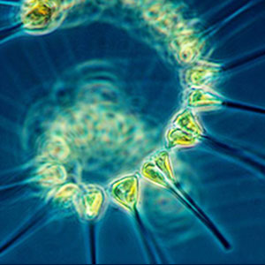
Water Depth pg. 117
Photic Zone: The sunlit region near the surface of the water in which photosynthesis can occur.
Phytoplankton: Photosynthetic algae that live in the photic zone and are eaten by zooplankton (tiny free-floating animals)
Normally the first step in many aquatic food webs.
Aphotic Zone: The region below the photic zone, where photosynthesis cannot occur.
Notes:
Note: Water depth strongly influences aquatic life because sunlight penetrates only a relatively short distance through water. The clearer the water, the deeper light can penetrate.
Question: What is the energy role of the phytoplankton? (Producer)

Slide 20
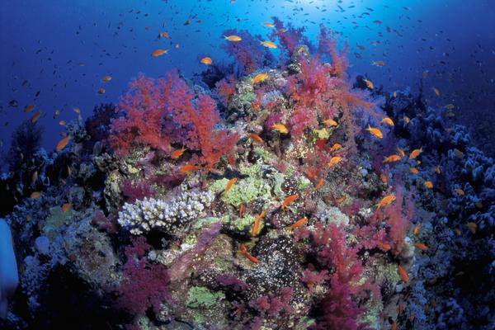
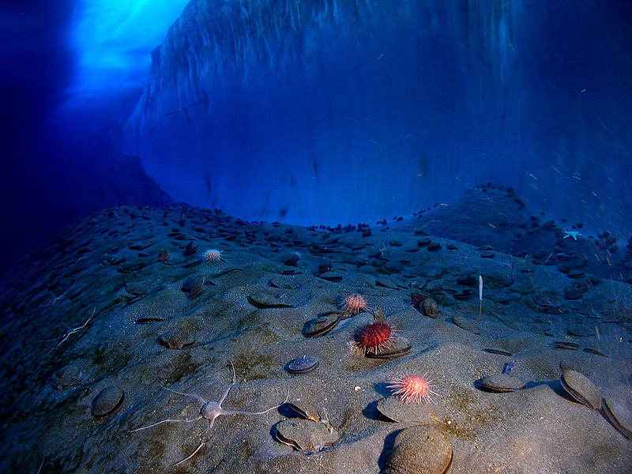
Water Depth cont… pg. 117
Benthic zone: The region that contains benthos, which are aquatic organisms that live on, or in, rocks or sediments on the bottoms of lakes, streams, and oceans.
Where water is shallow enough for benthos to be in the photic zone, algae and rooted aquatic plants can grow.
When the benthic zone is in the aphotic zone (below the photic zone), chemosynthetic autotrophs are the only primary producers.
Notes:
Note: Water depth strongly influences aquatic life because sunlight penetrates only a relatively short distance through water. The clearer the water, the deeper light can penetrate.
Question: What is the energy role of the phytoplankton? (Producer)

Slide 21
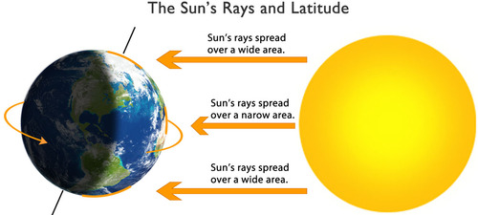
Aquatic Temperature pg. 118
The deepest parts of lakes and oceans are often colder than surface waters.
Aquatic habitats are warmer near the equator and colder near the poles.
Currents in lakes and oceans can dramatically affect water temperature because they can carry water that is significantly warmer or cooler.
Notes:
Just an interesting fact to share: Global warming is leading to rises in the temperature of our waters which in turn is leading to rises in our sea-levels. That compromises many aquatic and land habitats as well as strengthen the intensity of storms (hurricanes).

Slide 22
Complete the Succession Worksheets
If you do not finish, they are homework
Bring shoeboxes and make-up assignments next week
Make-up assignments are due by Friday, October 22
Absolutely no exceptions if you want the credit!!

