Slide 1
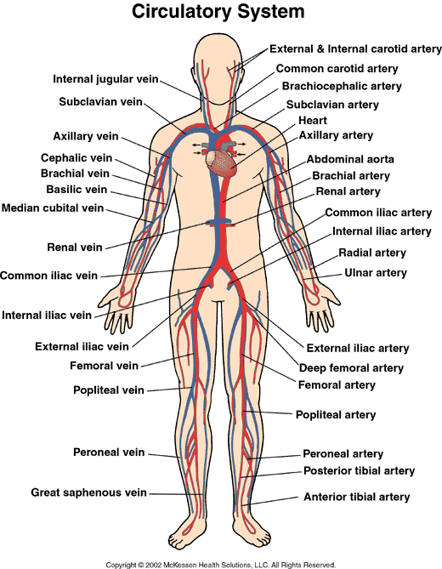
Cardiovascular/Circulatory System
2015-2016
Ms. McCabe

Slide 2
WHAT ARE WE LEARNING TODAY?
BENCHMARK
OBJECTIVE
SC.912.L.14.36:
Describe the factors affecting blood flow through the cardiovascular system.
Identify and investigate the general functions of the circulatory system.
Describe the structure of the heart and explain how it pumps blood through the body.

Slide 3
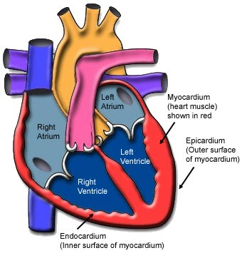
What is the essential vocabulary?
Atrium (aurícula):
Upper chamber of the heart that receives blood from the rest of the body
Pulmonary (poumon or pulmon):
Refers to the lungs
Systemic (Systémica):
Spread throughout the entire body
Ventricle: (Ventrículo):
Lower chamber of the heart that pumps blood out of the heart to the rest of the body
Viscosity:
Refers to how fluid a liquid is

Slide 4
What are the Functions of the Circulatory System?
Transports oxygen, carbon dioxide, food molecules, hormones, and other materials to and from the cells of the body.
Helps maintain a constant body temperature.
Carries cells that help protect the body from disease.

Slide 5
What is the Heart?
The heart is a muscular organ that pumps blood throughout the body.
Located near the center of your chest.
Hollow and about the size of your clenched fist.
Notes:
Show actual heart

Slide 6
How does your blood circulate through the Body?
The heart functions as two separate pumps.
The left side of the heart pumps oxygen-rich blood to the rest of the body in a pathway referred to as systemic circulation.
The right side pumps oxygen-depleted blood from the heart to the lungs in a pathway knows as pulmonary circulation.

Slide 7
How is the heart divided?
Each half of the heart has an upper and lower chamber.
The right atrium, receives deoxygenated blood from the body.
The right ventricle pumps blood into the lungs.
The left atrium receives oxygenated blood from the lungs.
The left ventricle pumps oxygenated blood to the rest of the body.
Notes:
Right atrium receives Deoxygenated blood from the body
4 pumps in one

Slide 8
How is the heart divided?
The arteries are the vessels that carry blood away from the heart.
Carry oxygenated blood
Pulmonary arteries carry deoxygenated blood to the lungs.
The veins bring blood back to the heart.
Carry Deoxygenated Blood
Pulmonary Veins carry oxygenated blood because they are coming from the lungs.
Notes:
Right atrium recieves Deoxygenated blood from the body
4 pumps in one

Slide 9
Circulation Through the Heart
Oxygen-poor blood flows into the heart from both the superior and inferior vena cava.
Blood first enters the right atrium and is pumped into the right ventricle.
From the right ventricle, the blood is pumped through the pulmonary arteries.
The pulmonary arteries transport blood to the lungs, where it picks up O₂ and gets rid off CO₂.
Notes:
FOR THE WE DO

Slide 10
Circulation Through the Heart
The pulmonary veins transport the newly oxygenated blood from the lungs back to the heart.
The left atrium receives oxygen-rich blood and pump it to the next chamber.
The left ventricle is the final chamber through which blood flows.
The aorta pumps blood rich in O₂ to both sides of the body.

Slide 11
What is the Heartbeat?
When you are sitting still, your heart pumps about 5 L of blood each time.
When you are active, your heart pumps up to 35 L.

Slide 12
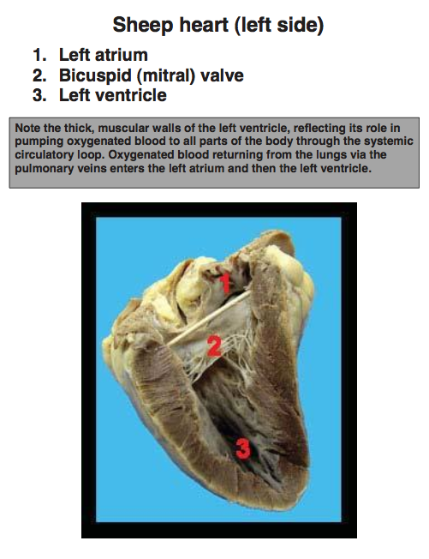
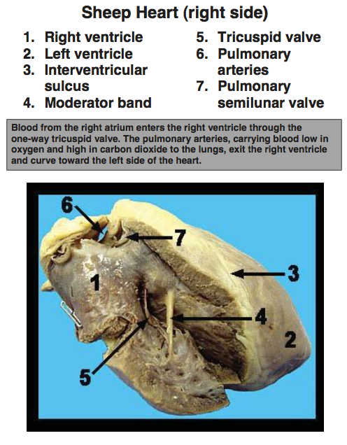

Slide 13
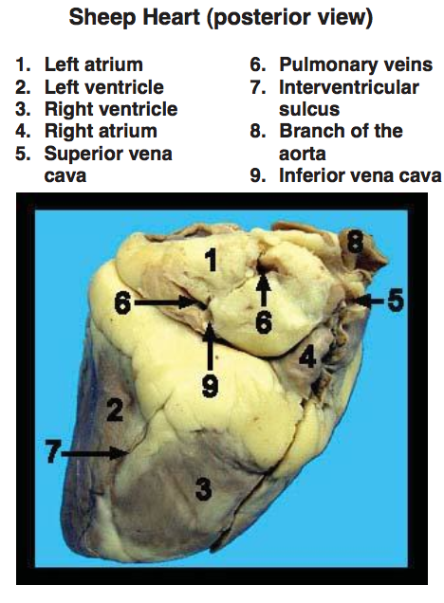
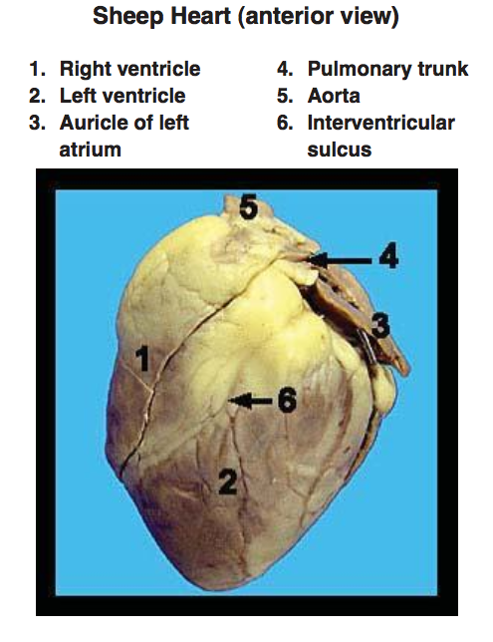

Slide 14
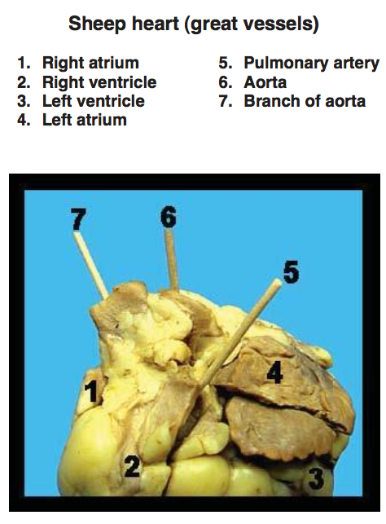

Slide 15
What are the Blood Vessels?
As blood flows through the circulatory system, it moves through three types of blood vessels:
Arteries
Capillaries
Veins

Slide 16
What are the arteries?
Large, tough, and highly elastic
Have thick walls that help them withstand the powerful pressure produced when the heart contracts.
Carry blood AWAY from the heart to the tissues of the body.
Except for the pulmonary arteries, all arteries carry oxygen-rich blood.
The aorta is the first of a series of blood vessels that carry the blood on its round trip around the body.
Notes:
The largest arteries are about as thick as a thumb.

Slide 17
What are the capillaries?
Walls are one cell thick.
Smallest of the blood vessels.
Most are so narrow that blood cells must pass through them in single file.
Bring nutrients and oxygen to the tissues
Absorb carbon dioxide and other waste from the tissues

Slide 18
What are the veins?
Return blood to the heart.
As with arteries, the thin walls of veins contain connective tissue and smooth muscle.
Large veins contain valves that keep blood moving TOWARD the heart.

Slide 19
What is blood pressure?
When the heart contracts, it produces a wave of fluid pressure in the arteries.
Blood pressure is the force of the blood on the arteries’ walls.
Several factors may affect blood pressure.
Exercise
Nutrition
Stress
Smoking and Alcohol
Genetics
Notes:
Medical workers can measure blood pressure with a device called sphygmomanometer. If blood pressure is too high, medical problems may result.
People with hypertension are more likely to develop coronary heart disease and to suffer from other cardiovascular diseases.
Hypertension increases the risk of a heart attack and stroke

Slide 20
What are common diseases of the circulatory system?
Cardiovascular diseases are diseases of the heart and blood vessels.
Leading cause of death in the United States, claiming about 1,000,000 lives every year.
Cardiovascular diseases develop gradually, so their symptoms may not appear for decades.

Slide 21
What are common diseases of the circulatory system?
High blood pressure, or hypertension, forces the heart to work harder, which may weaken or damage the heart muscle and blood vessels.
The most common arterial disease, and the one which is most often a contributory cause of death, particularly in old people, is arteriosclerosis, known popularly as hardening of the arteries.
The hardening usually is preceded by atherosclerosis, an accumulation of fatty deposits, or plaque, on the inner lining of the arterial wall.
The deposits reduce the normal flow of the blood through the artery.
One of the substances associated with atherosclerosis is cholesterol.

Slide 22
HOW DO BLOOD CLOTS FORM?
Notes:
KEEP

Slide 23
How does a Heart Attack happen?
If one of the coronary arteries becomes blocked, part of the heart muscle may begin to die from a lack of oxygen.
If enough muscle is damaged, a condition known as a heart attack occurs.
Symptoms include nausea, shortness of breath, and severe, crushing chest pain.

Slide 24
What causes a Stroke?
If a blood clot gets free and gets stuck in one of the blood vessels leading to the brain, the brain cells served by the particular blood vessel gradually die from oxygen starvation, and brain function in that region may be lost.
This condition is known as a stroke and may cause paralysis, loss of the ability to speak, and even death.

Slide 25
Collaborative Activity: Heart Diagram
Get a Heart Diagram.
Cut in half.
With one partner, locate the structure and place the function with it using pg. 949 in your book.
Check answers & color.
Glue/tape into your blank page for the body book

Slide 26
Homework
Get a Homework: Factors Affecting Blood Flow WS.
Complete with Chapter 33 and other internet sources.
Due next class.

