Slide 1
Do Now Week 16

Slide 2
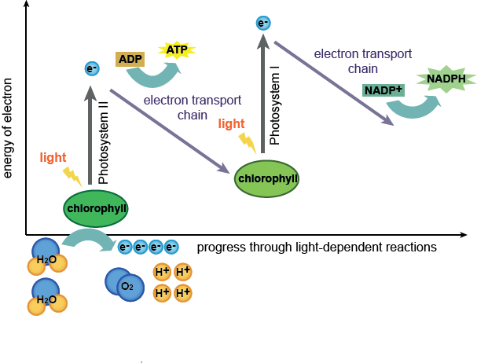
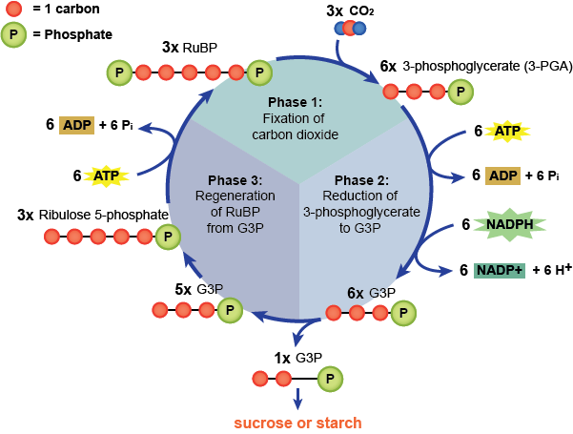
Do Now 1/4-5/16
Take and color both sheets of pictures from the bio book stacks

Slide 3
Do Now 1/5/16
Take your foldable from the stack
Stay seated

Slide 4
5th: Do Now 1/6-7/16
Take your foldable from the basket
We will finish these first
We have an activity and video set after grading your tests

Slide 5
Do Now 1/6-7/16
Take your foldable from the basket
We will finish these first
You will need a pen or colored pencil to grade your tests from before break
We have an activity and video set after grading your tests

Slide 6
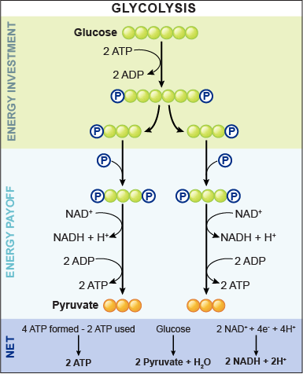
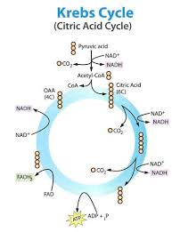

Slide 7
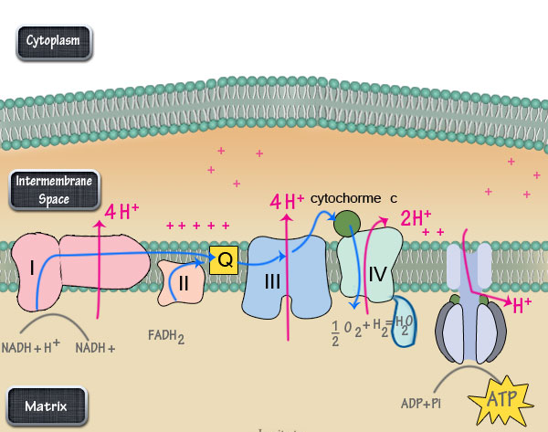

Slide 8
1 Cellular Respiration

Slide 9
2 Cellular Respiration Formula (Top)
Reactants Products
6O₂ + 6CO₂
C₆H₁₂O₆ +6H₂O
+ATP (energy)

Slide 10
2 Cellular Respiration Formula (Bottom)
Reactants Products
6 oxygens 6 carbon dioxides
+glucose (sugar) +6 waters
+ATP energy

Slide 11
3 Structures/Organelles (Top)
Cristae = increases surface area for Electron Transport Chain
Matrix = space with enzymes needed for Krebs Cycle

Slide 12
3 Structures/Organelles (Bottom)

Slide 13
4 Anaerobic - Glycolysis (Top)
Happens in cytoplasm
Does NOT need oxygen
Glyco = sugar, lysis = breaking
Breaks glucose in half

Slide 14
4 Anaerobic – Glycolysis (Bottom)

Slide 15
5 Aerobic – Krebs Cycle (Top)
Krebs = Citric Acid = TCA Cycle
How food gets broken down chemically in a series of repeating steps until it releases ATP to fuel cells
Happens in the matrix

Slide 16
5 Aerobic - Krebs Cycle (Bottom)

Slide 17
6 Aerobic – ETC (Top)
Electron Transport Chain
Happens in the cristae
Final, most important step
Makes 32-34 ATP (MOST of the energy!)
Requires oxygen as the final electron acceptor to make water

Slide 18
6 Aerobic - ETC (Bottom)

Slide 19
7 Anaerobic – Fermentation (Top)
Happens when no oxygen is available
Microorganisms are the only things that use this
Lactic Acid
Bacteria, fungi, animal cells
Used to make cheese & yogurt
Over-exercised muscles do this (painful!)
Product = lactate
Alcohol
Bacteria & yeast (fungi)
Used to make bread, beer, & wine
Product = ethanol

Slide 20
1 Photosynthesis

Slide 21
2 Photosynthesis Formula (Top)
Reactants Products
6CO₂ 6O₂
+6H₂O +C₆H₁₂O₆
+light (energy)

Slide 22
2 Photosynthesis Formula (Bottom)
Reactants Products
6 carbon dioxides 6 oxygens
+6 waters +glucose
+sunlight

Slide 23
3 Structures/Organelles (Top)
Chlorophyll = green pigment found in thylakoids, captures sunlight for PS, converts light energy to chemical energy

Slide 24
3 Structures/Organelles (Bottom)

Slide 25
4 Light-Dependent Reactions (Top)
LDR = energy from sunlight propels electrons into a high energy state
Electrons become “frat boys”
Includes the Electron Transport Chain
Sunlight & water used here
Energy (ATP) made here

Slide 26
4 Light-Dependent Reactions (Bottom)

Slide 27
5 Light-Independent Reactions (Top)
LIR = Carbon dioxide used here to make sugars (carbohydrates)
Takes help from ATP and NADPH electrons
3 phases
Carbon Fixation
Reduction
Regeneration

Slide 28
5 Light-Independent Reactions (Bottom)

Slide 29
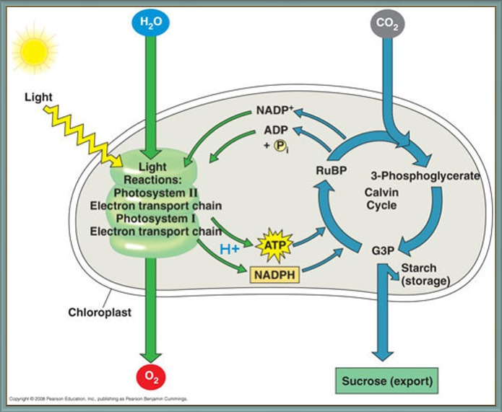
6 Summary (Bottom)

Slide 30
BEFORE you leave…
All trash, yours or not, to the trash can
Glue sticks capped and returned
Colored pencils picked up
Put unused pictures into the foldable
Turn in at the basket
We will finish next class

