Slide 1
Scientific Classification
Poster project in a group of 4-5
http://seaworld.org/en/animal-info/animal-infobooks/

Slide 2
Materials
Pencils
Markers
Colored pencils
Poster paper (1 per group)
Textbook Chapter 18
Species handout (1 per group – return when finished)
Return this powerpoint packet when finished

Slide 3
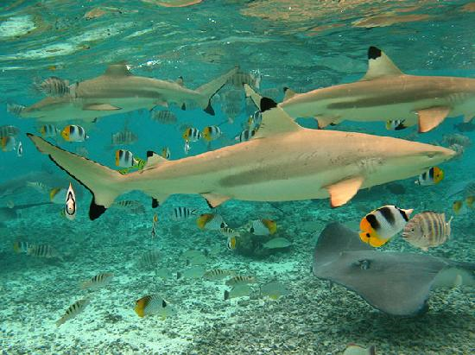
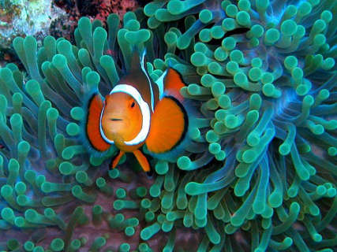
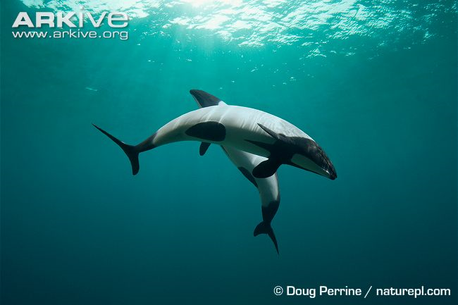
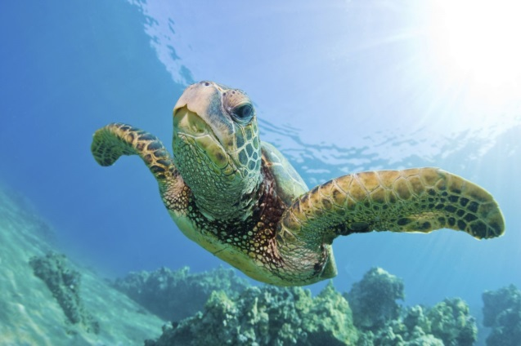
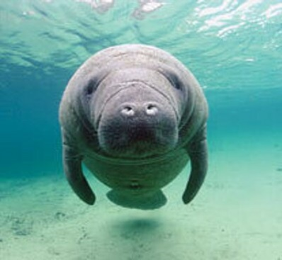
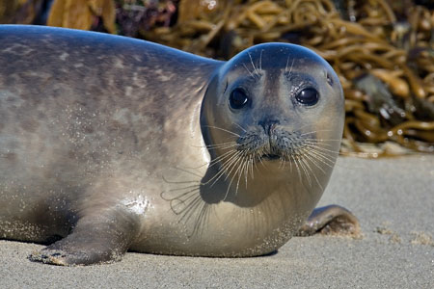
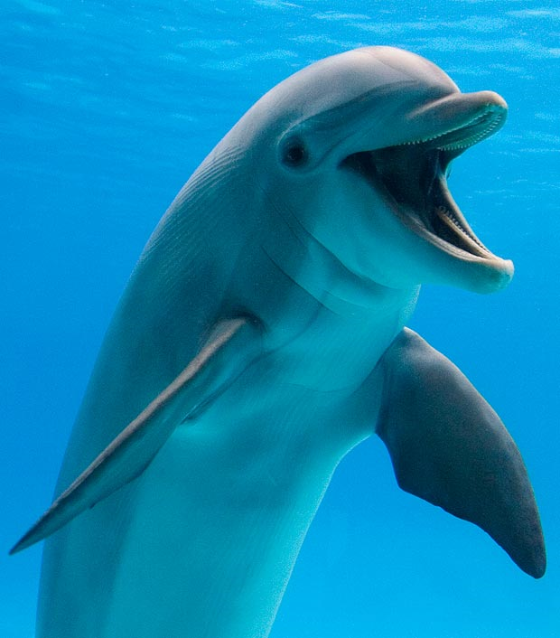
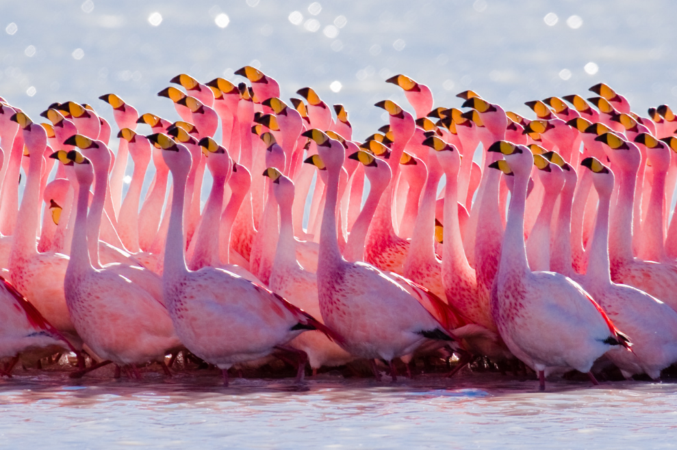
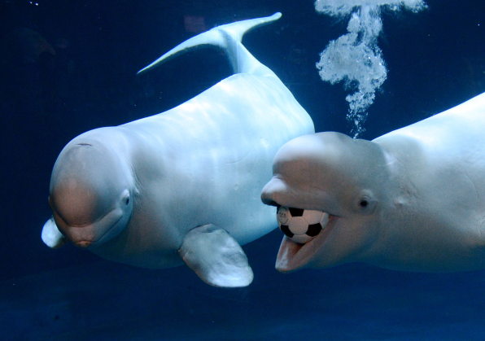
Instructions
Choose 1 of the various species handouts (first come-first served)

Slide 4
Instructions 50 pts.
Create a poster that includes:
Your group names, date, period
Large, colorful pictures of your species
As many scientific names as you can find on the handout
Begin with Kingdom, end with species/subspecies
Reasons why that species belongs in each of those classifications
The full scientific name
Some of you will have more than one
Is this organism’s classification permanent?
Could something cause the organism’s classification to change? If so, what could do that?
10 interesting facts about your animal
Examples of Fossil Record evidence
Your group will present your poster to the class.

