Slide 1
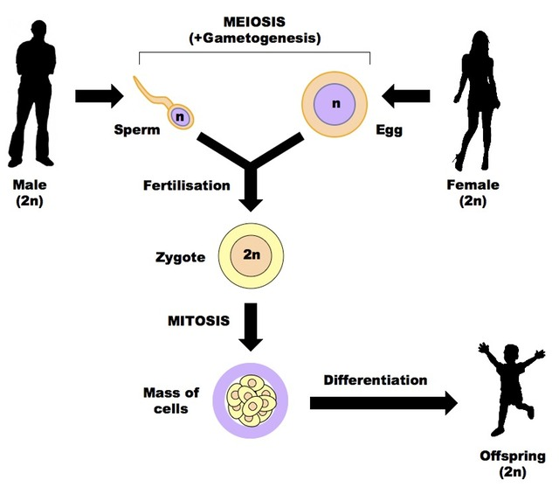
Human Reproduction
2015-2016
Ms. McCabe
SC.912.L.16.13 Describe the basic anatomy and physiology of the human reproductive system. Describe the process of human development from fertilization to birth and major changes that occur in each trimester of pregnancy.

Slide 2
Standard
SC.912.L.16.13
Describe the basic anatomy and physiology of the human reproductive system.
SC.912.L.16.13 Describe the basic anatomy and physiology of the human reproductive system. Describe the process of human development from fertilization to birth and major changes that occur in each trimester of pregnancy.

Slide 3
Guiding Questions
How are the male and female reproductive systems similar?
What changes will occur in a female if an egg is not fertilized after ovulation?
SC.912.L.16.13 Describe the basic anatomy and physiology of the human reproductive system. Describe the process of human development from fertilization to birth and major changes that occur in each trimester of pregnancy.

Slide 4
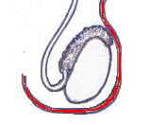
Male Reproductive System
Testes are suspended outside the abdominal cavity by the scrotum
Scrotum = a pouch of skin that keeps testes close or far from the body at an optimal temperature for sperm development
SC.912.L.16.13 Describe the basic anatomy and physiology of the human reproductive system. Describe the process of human development from fertilization to birth and major changes that occur in each trimester of pregnancy.

Slide 5
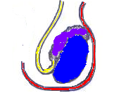
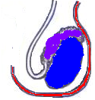
Male Reproductive System
Seminiferous tubules are inside each testis, and are where sperm are produced by meiosis.
Sperm mature in the epididymis
Sperm are released through the vas deferens
SC.912.L.16.13 Describe the basic anatomy and physiology of the human reproductive system. Describe the process of human development from fertilization to birth and major changes that occur in each trimester of pregnancy.

Slide 6
Male Reproductive System
Secretions from the seminal vesicles add fructose and proteins to sperm as they pass.
The prostate gland secretes a milky alkaline fluid.
SC.912.L.16.13 Describe the basic anatomy and physiology of the human reproductive system. Describe the process of human development from fertilization to birth and major changes that occur in each trimester of pregnancy.

Slide 7
Male Reproductive System
MEIOSIS forms sperm from gametes
Sperm forms in testes in the seminiferous tubules
Scrotum keeps cooler than rest of body
Sperm mature in the epididymis
Semen is sperm plus protecting fluid
Semen leaves testes through the vas deferens (sperm ducts) to the urethra before it exits.
SC.912.L.16.13 Describe the basic anatomy and physiology of the human reproductive system. Describe the process of human development from fertilization to birth and major changes that occur in each trimester of pregnancy.

Slide 8
Female Reproductive System
The ovaries are the female gonads that create eggs.
After the process of ovulation, an egg moves into a fallopian tube (oviduct) and travels to the uterus.
SC.912.L.16.13 Describe the basic anatomy and physiology of the human reproductive system. Describe the process of human development from fertilization to birth and major changes that occur in each trimester of pregnancy.

Slide 9
Ovum Formation
MEIOSIS forms the eggs (ova)
Eggs are formed before birth
1 egg per month is matured and released from ovaries, most of the time
Eggs travel through the fallopian tube where they may become fertilized
SC.912.L.16.13 Describe the basic anatomy and physiology of the human reproductive system. Describe the process of human development from fertilization to birth and major changes that occur in each trimester of pregnancy.

Slide 10
Reproductive System Card Activity
On notebook paper, number 1-15 (NDP, too!)
Take a reproductive system card and red the questions on the back
Take 2 minutes to write your answers
Find a partner with the same card
Compare answers for 1 minute
You may use your notes or Chapter 34 of the textbook for assistance
SC.912.L.16.13 Describe the basic anatomy and physiology of the human reproductive system. Describe the process of human development from fertilization to birth and major changes that occur in each trimester of pregnancy.

Slide 11
Reproductive System Card Activity
Find partners with new cards & exchange/swap cards
Repeat until all questions have been answered
You may use your notes or Chapter 34 of the textbook for assistance
Return the cards
Return to your seat
SC.912.L.16.13 Describe the basic anatomy and physiology of the human reproductive system. Describe the process of human development from fertilization to birth and major changes that occur in each trimester of pregnancy.

Slide 12
Class Concept Map
http://www.classzone.com/cz/books/bio_12_fl/resources/htmls/interactive_review/bio_intrev.html
2
On your concept map, locate the Reproductive Anatomy map
We will complete this as a class
SC.912.L.16.13 Describe the basic anatomy and physiology of the human reproductive system. Describe the process of human development from fertilization to birth and major changes that occur in each trimester of pregnancy.

Slide 13
Life’s Greatest Miracle Video WS ~54 minutes

Slide 14
Standard
SC.912.L.16.13
Describe the process of human development from fertilization to birth and major changes that occur in each trimester of pregnancy.
SC.912.L.16.13 Describe the basic anatomy and physiology of the human reproductive system. Describe the process of human development from fertilization to birth and major changes that occur in each trimester of pregnancy.

Slide 15
Guiding Questions
What is the difference between a fetus and an embryo?
What major changes occur in the first eight weeks of development in a human?

Slide 16
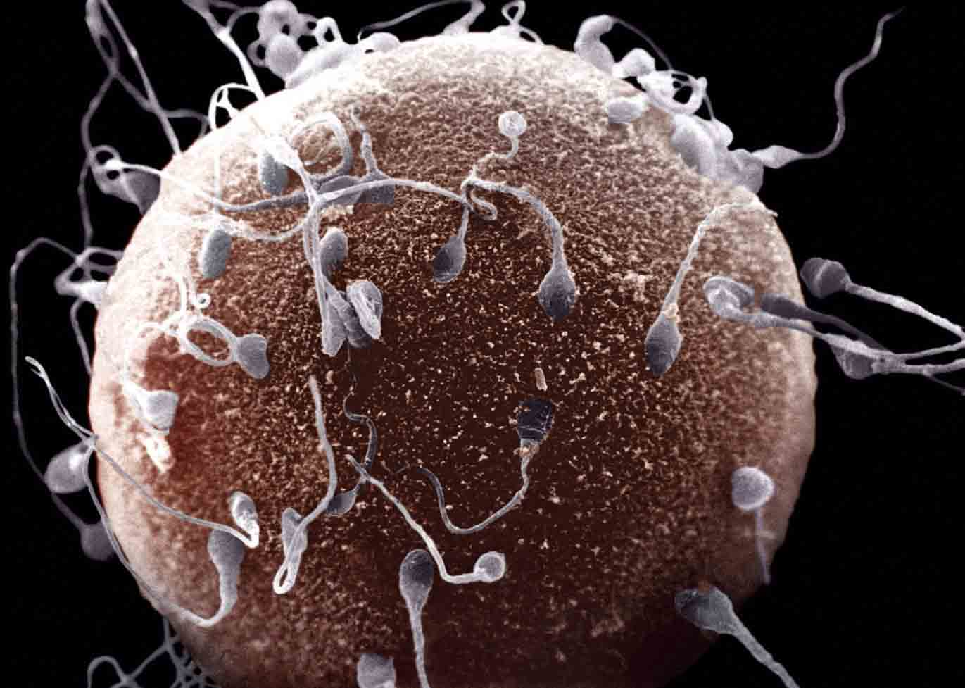
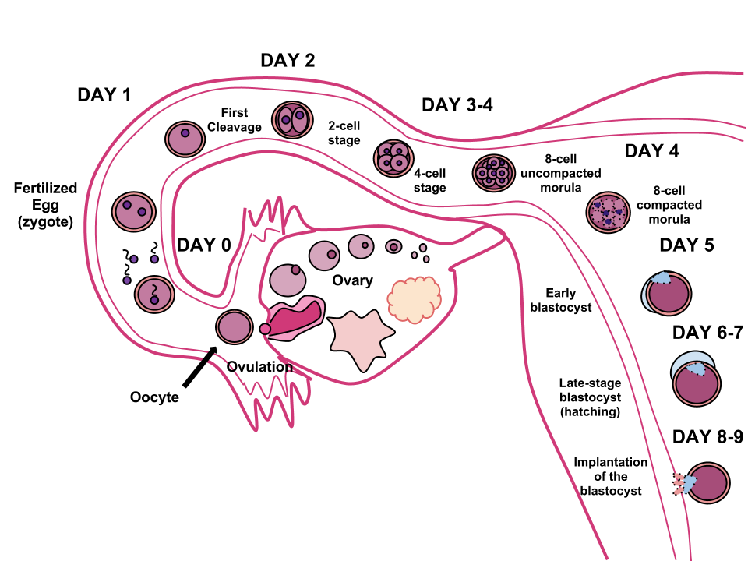
Fertilization and Development
During intercourse, sperm is deposited in the vagina.
When the sperm fertilizes an egg, a zygote forms.
The zygote goes through cell divisions as it moves toward the uterus.
SC.912.L.16.13 Describe the basic anatomy and physiology of the human reproductive system. Describe the process of human development from fertilization to birth and major changes that occur in each trimester of pregnancy.

Slide 17
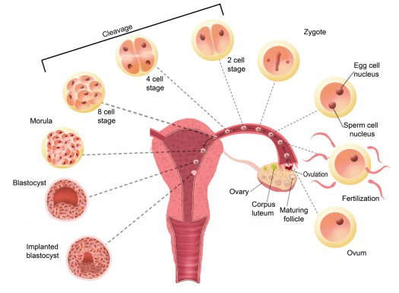
Fertilization and Development
At the uterus, the embryo implants into the uterine wall.
SC.912.L.16.13 Describe the basic anatomy and physiology of the human reproductive system. Describe the process of human development from fertilization to birth and major changes that occur in each trimester of pregnancy.

Slide 18
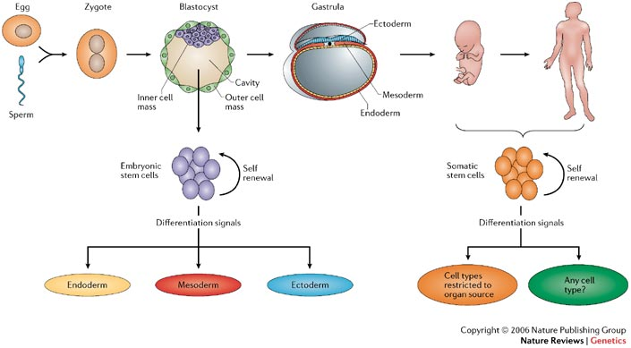
Implantation
Fertilized eggs are implanted into thick walls of uterus
Zygote grows into an embryo
Embryo gets air and nutrients through the umbilical cord
Mom’s uterus grows with the baby
SC.912.L.16.13 Describe the basic anatomy and physiology of the human reproductive system. Describe the process of human development from fertilization to birth and major changes that occur in each trimester of pregnancy.

Slide 19
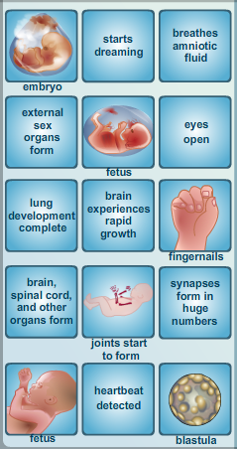
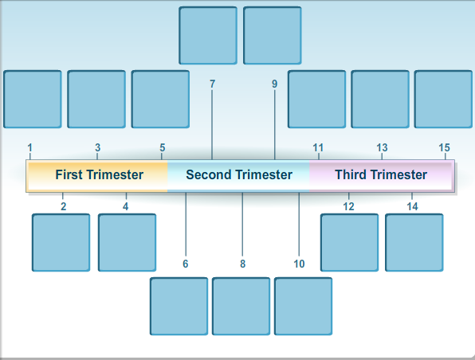
Trimester Timeline (1 trimester = 3 months, 3 trimesters = 9 month pregnancy)
SC.912.L.16.13 Describe the basic anatomy and physiology of the human reproductive system. Describe the process of human development from fertilization to birth and major changes that occur in each trimester of pregnancy.
Choose a partner & visit the following sites to create a timeline like below:
http://www.babycenter.com/2_inside-pregnancy-weeks-1-to-9_10302602.bc
http://virtualhumanembryo.lsuhsc.edu/HEIRLOOM/Stages/Stages_intro.html
http://www.classzone.com/cz/books/bio_12_fl/get_chapter_group.htm?cin=9&ci=34&rg=animated_biology&at=animated_biology&npos=2&spos=34&var=animated_biology

Slide 20
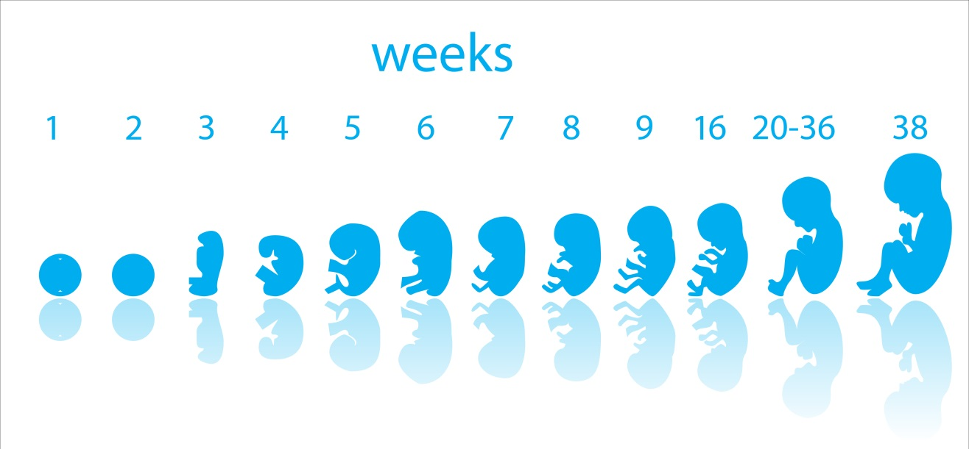
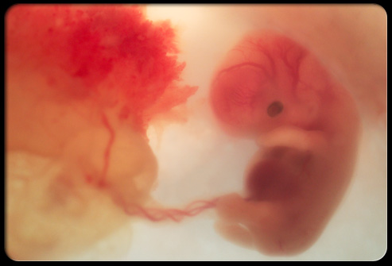
1st Trimester = 1st 12 weeks
Heart develops first
Neural tube develops
All body systems appear by Week 8 – Now a Fetus
SC.912.L.16.13 Describe the basic anatomy and physiology of the human reproductive system. Describe the process of human development from fertilization to birth and major changes that occur in each trimester of pregnancy.

Slide 21
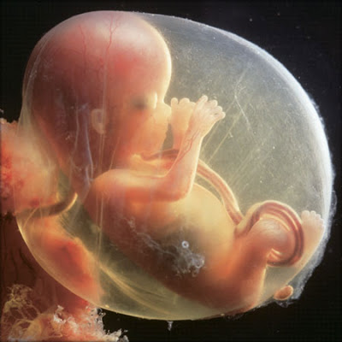
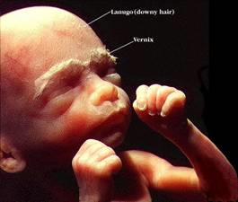
2nd Trimester = up to 24 weeks
Most growth
Looks more like a baby
Some preemies survive at this stage
SC.912.L.16.13 Describe the basic anatomy and physiology of the human reproductive system. Describe the process of human development from fertilization to birth and major changes that occur in each trimester of pregnancy.

Slide 22
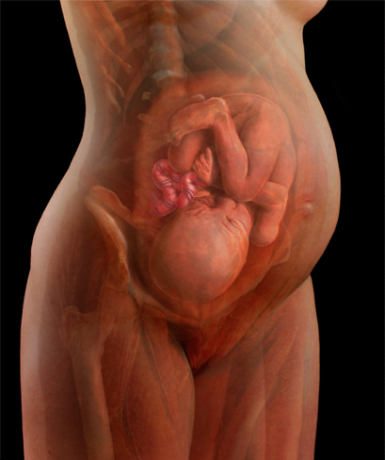
3rd Trimester = Up to 40 weeks
More growth
Kicking, rolling, stretching
Eyes open – Week 32
Lungs mature
Rotates to head-down position, unless baby is breech

Slide 23
Birth
Labor
Uterine contractions begin
Cervix dilates to 10 cm.
Birth
Uterus pushes baby through vaginal canal
Placenta delivered after baby
Cesarean Section (c-section) is a surgery that cuts through the uterus to deliver the baby if it cannot be born vaginally
SC.912.L.16.13 Describe the basic anatomy and physiology of the human reproductive system. Describe the process of human development from fertilization to birth and major changes that occur in each trimester of pregnancy.

Slide 24
Class Concept Map
http://www.classzone.com/cz/books/bio_12_fl/resources/htmls/interactive_review/bio_intrev.html
2
On your concept map, locate the Fetal Development map
Find a partner to complete this map
You may use your notes or Chapter 34 of the textbook
SC.912.L.16.13 Describe the basic anatomy and physiology of the human reproductive system. Describe the process of human development from fertilization to birth and major changes that occur in each trimester of pregnancy.

Slide 25
**Homework
On the back of your concept map, complete both diagrams
Turn in next class!
SC.912.L.16.13 Describe the basic anatomy and physiology of the human reproductive system. Describe the process of human development from fertilization to birth and major changes that occur in each trimester of pregnancy.

