Slide 1
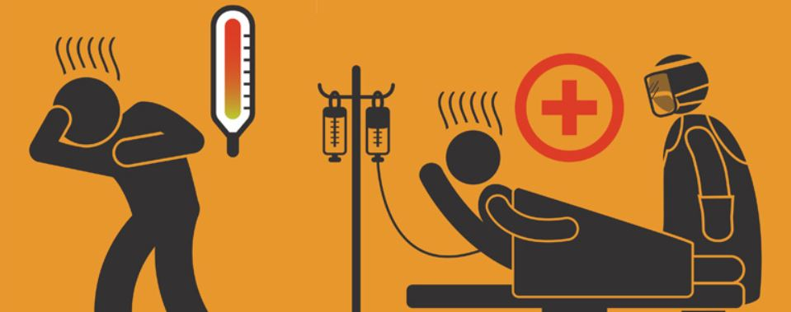
Infectious Disease Control
“Who should control it and how?”

Slide 2
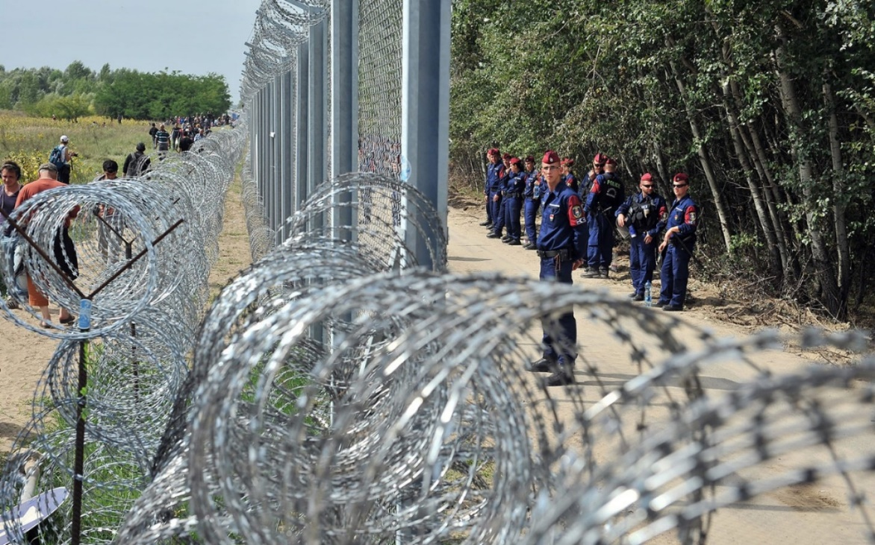
Essential Question:
Should international gateways be closed in the event of an outbreak of a contagious disease?

Slide 3
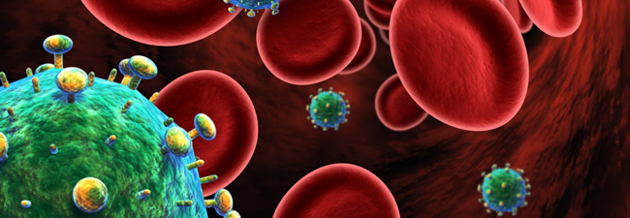
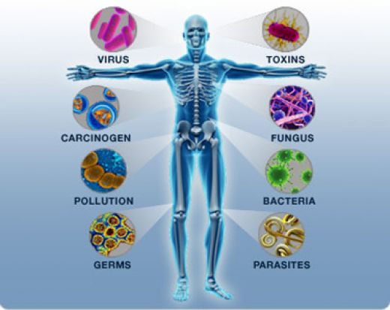
What is infectious disease?
Infectious diseases are disorders caused by organisms — such as bacteria, viruses, fungi or parasites.
Many organisms live in and on our bodies.
They're normally harmless or even helpful, but under certain conditions, some organisms may cause disease.
Some infectious diseases can be passed from person to person.

Slide 4
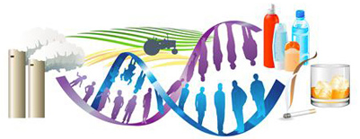
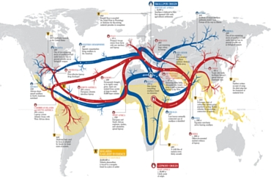
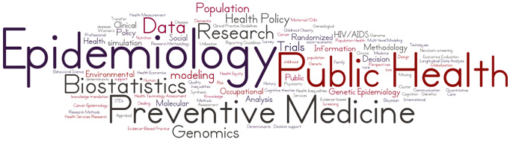
What is epidemiology?
Epidemiology is the study of the distribution and determinants of health-related states and events (not just diseases) in specified populations.
Epidemiology is the method used to find the causes of health outcomes and diseases in populations.
In epidemiology, the patient is part of the community and individuals are viewed collectively.
It is also the application of this study to the control of health problems.

Slide 5
What is observed?
Environmental exposures | Lead and heavy metals Air pollutants and other asthma triggers
Infectious diseases | Foodborne illness Influenza and pneumonia
Injuries | Increased homicides in a community National surge in domestic violence
Non-infectious diseases | Localized or widespread rise in a particular type of cancer Increase in a major birth defect
Natural disasters | Hurricanes Katrina and Rita (2005) Haiti earthquake (2010)
Terrorism | World Trade Center (2001) Anthrax release (2001)

Slide 6
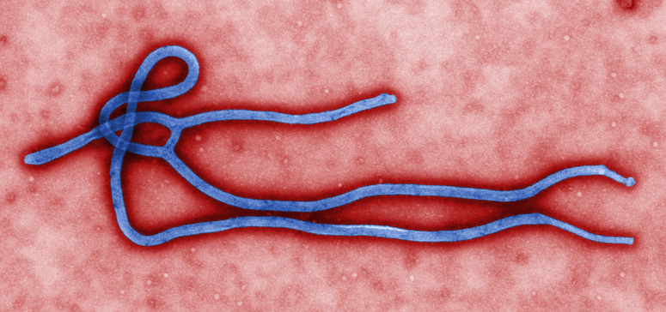
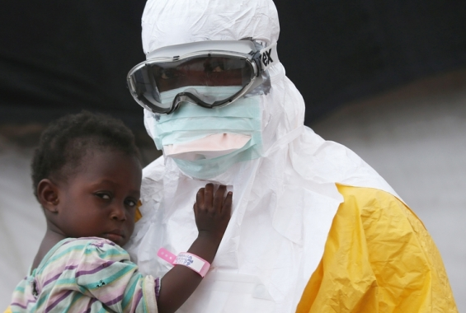
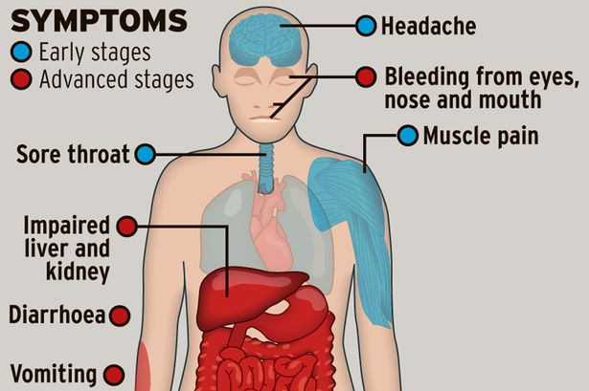
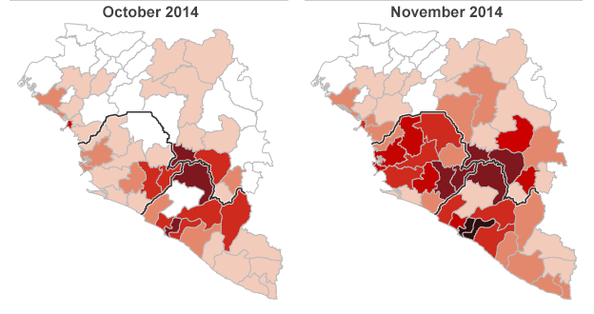
Ebola
Notes:
Pass out Ebola facts sheets -

Slide 7
Ethical Issues with Disease Control
Infectious control vs. people control
Individual interest vs. societal interest
Government responsibility vs. medical responsibility
Notes:
Class discussion – refer back to the movie contagion of illustrations shown of each

Slide 8
Group Assignment

