Slide 1
Mendelian Genetics
2015-2016
Ms. McCabe

Slide 2
standards
SC.912.L.16.1 Use Mendel’s laws of segregation and independent assortment to analyze patterns of inheritance.
SC.912.L.16.2 Discuss observed inheritance patterns caused by various modes of inheritance, including dominant, recessive, codominant, sex-linked, polygenic, and multiple alleles.

Slide 3
Guiding Question
SC.912.L.16.1 Use Mendel’s laws of segregation and independent assortment to analyze patterns of inheritance.
What influence did Gregor Mendel have on the study of genetics?
How can we analyze how genetic traits and disorders are inherited using pedigrees?

Slide 4
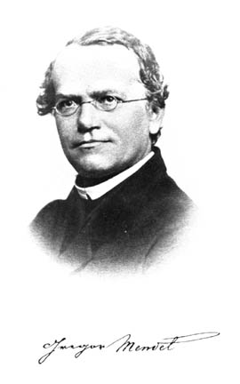
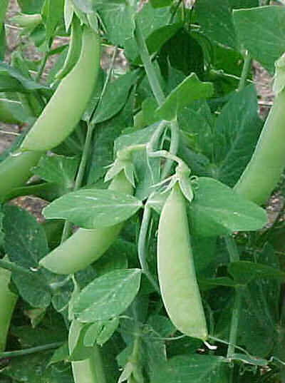
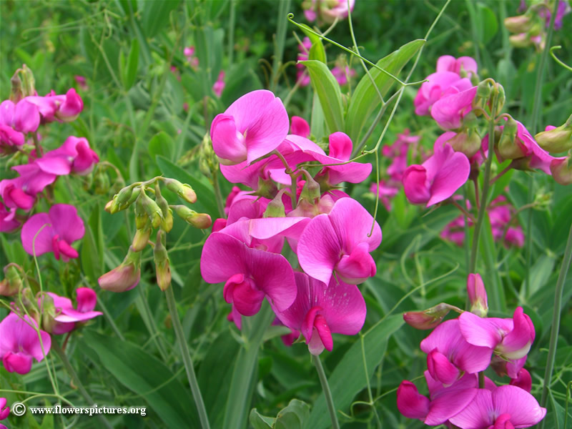
Gregor Mendel
SC.912.L.16.1 Use Mendel’s laws of segregation and independent assortment to analyze patterns of inheritance.
Austrian monk born in 1822
Cared for the garden at the monastery
Experimented with pea plants

Slide 5
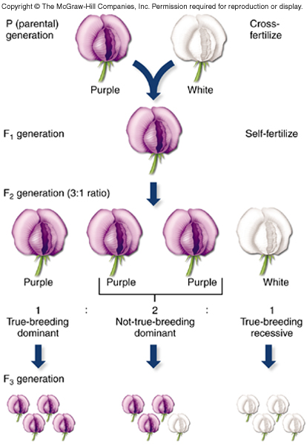
Gregor Mendel
SC.912.L.16.1 Use Mendel’s laws of segregation and independent assortment to analyze patterns of inheritance.
True breeders = homozygous genotypes that can only make offspring that look like themselves

Slide 6
Notes:
https://www.youtube.com/watch?v=Mehz7tCxjSE

Slide 7
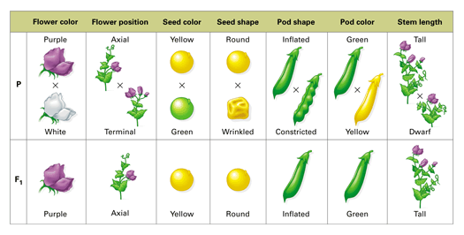

Slide 8
Gregor Mendel
SC.912.L.16.1 Use Mendel’s laws of segregation and independent assortment to analyze patterns of inheritance.
Monohybrid cross = a single cross of one trait, ex. pea color
Parent plants: YY (yellow) x yy (green)
F₁ generation (f = filial, kids):
All kids’ genotypes:
All kids’ phenotypes:
Punnett Square
 | Y | Y
y
y

Slide 9
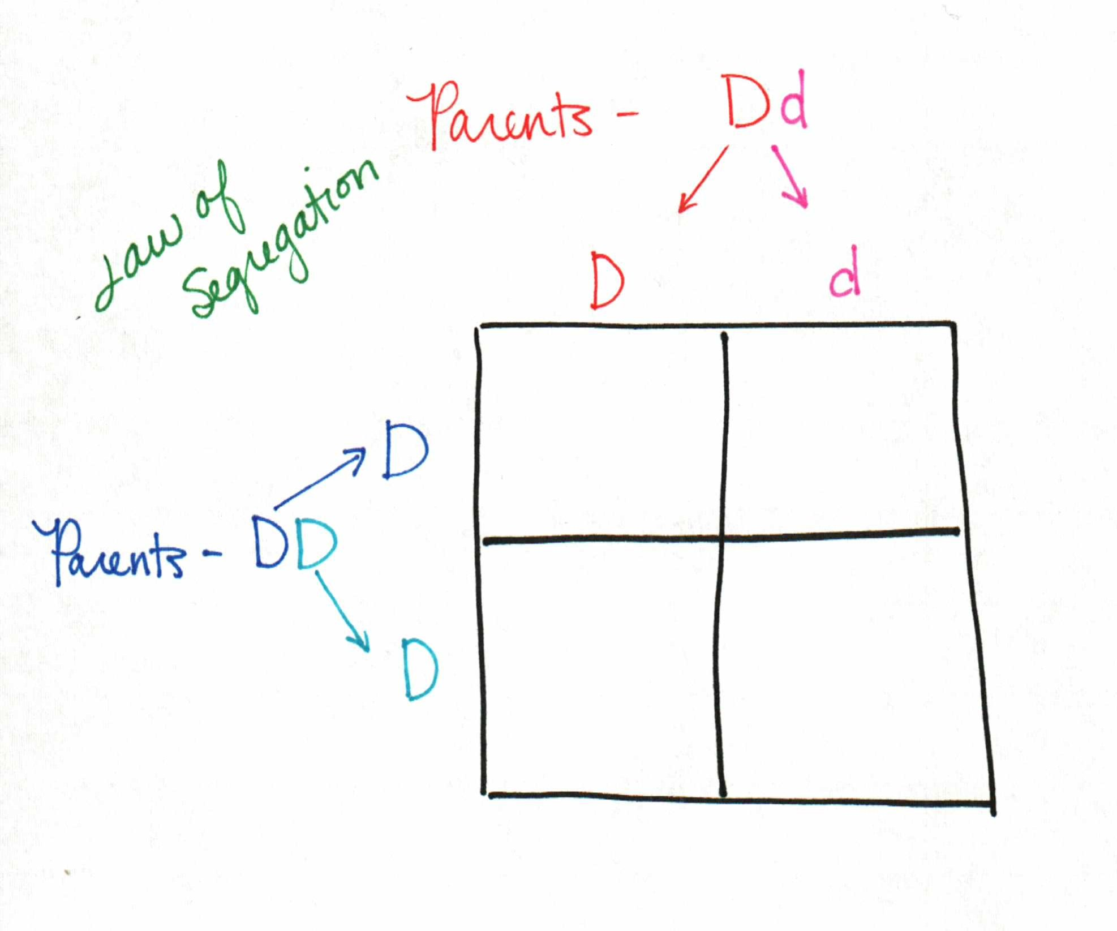
Gregor Mendel
SC.912.L.16.1 Use Mendel’s laws of segregation and independent assortment to analyze patterns of inheritance.
Law of Segregation = 2 alleles will separate (Anaphase 1) during meiosis to create a gamete with half the DNA that will then have all DNA in fertilization

Slide 10
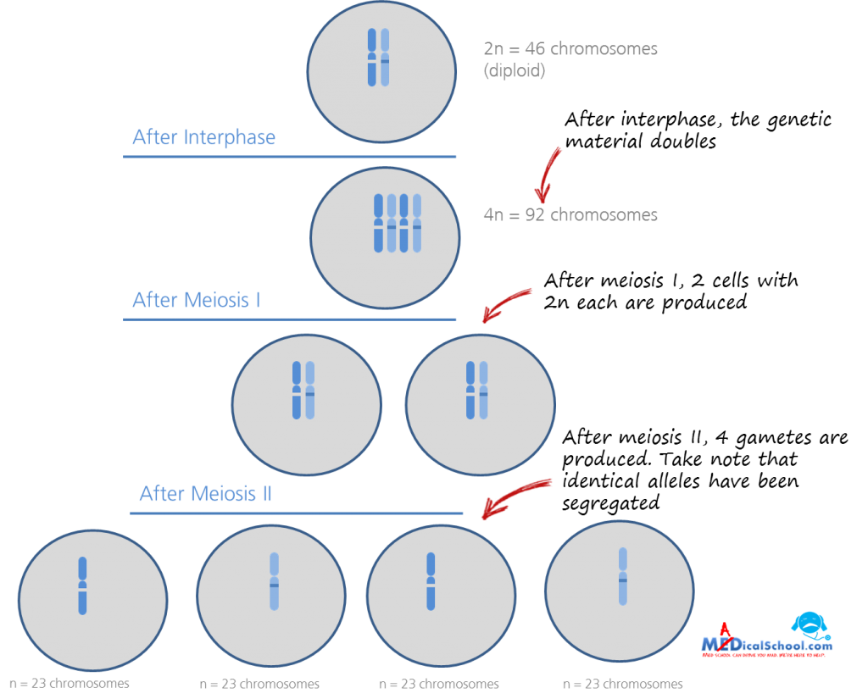
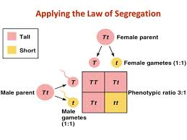

Slide 11
Gregor Mendel
SC.912.L.16.1 Use Mendel’s laws of segregation and independent assortment to analyze patterns of inheritance.
Dihybrid cross = breeding of 2 traits, ex. color & texture
Parent plants: YYRR (yellow/round) x yyrr (green, wrinkled)
Find possible gametes:

Slide 12
Dihybrid Cross
SC.912.L.16.1 Use Mendel’s laws of segregation and independent assortment to analyze patterns of inheritance.
Parent plants: YYRR (yellow/round) x yyrr (green, wrinkled)
F₁ Generation Geno: Pheno:
 | YR | YR | YR | YR
yr | YyRr | YyRr | YyRr | YyRr
yr | YyRr | YyRr | YyRr | YyRr
yr | YyRr | YyRr | YyRr | YyRr
yr | YyRr | YyRr | YyRr | YyRr

Slide 13
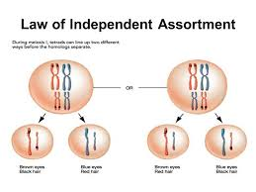
Gregor Mendel
SC.912.L.16.1 Use Mendel’s laws of segregation and independent assortment to analyze patterns of inheritance.
Law of Independent Assortment = during gamete formation, alleles are distributed randomly

Slide 16
Mendelian Genetics Practice
SC.912.L.16.1 Use Mendel’s laws of segregation and independent assortment to analyze patterns of inheritance.
Copy and complete on your own paper
Notes:
(5 min) Nn x NN, BB x bb, Dd x dd

Slide 17
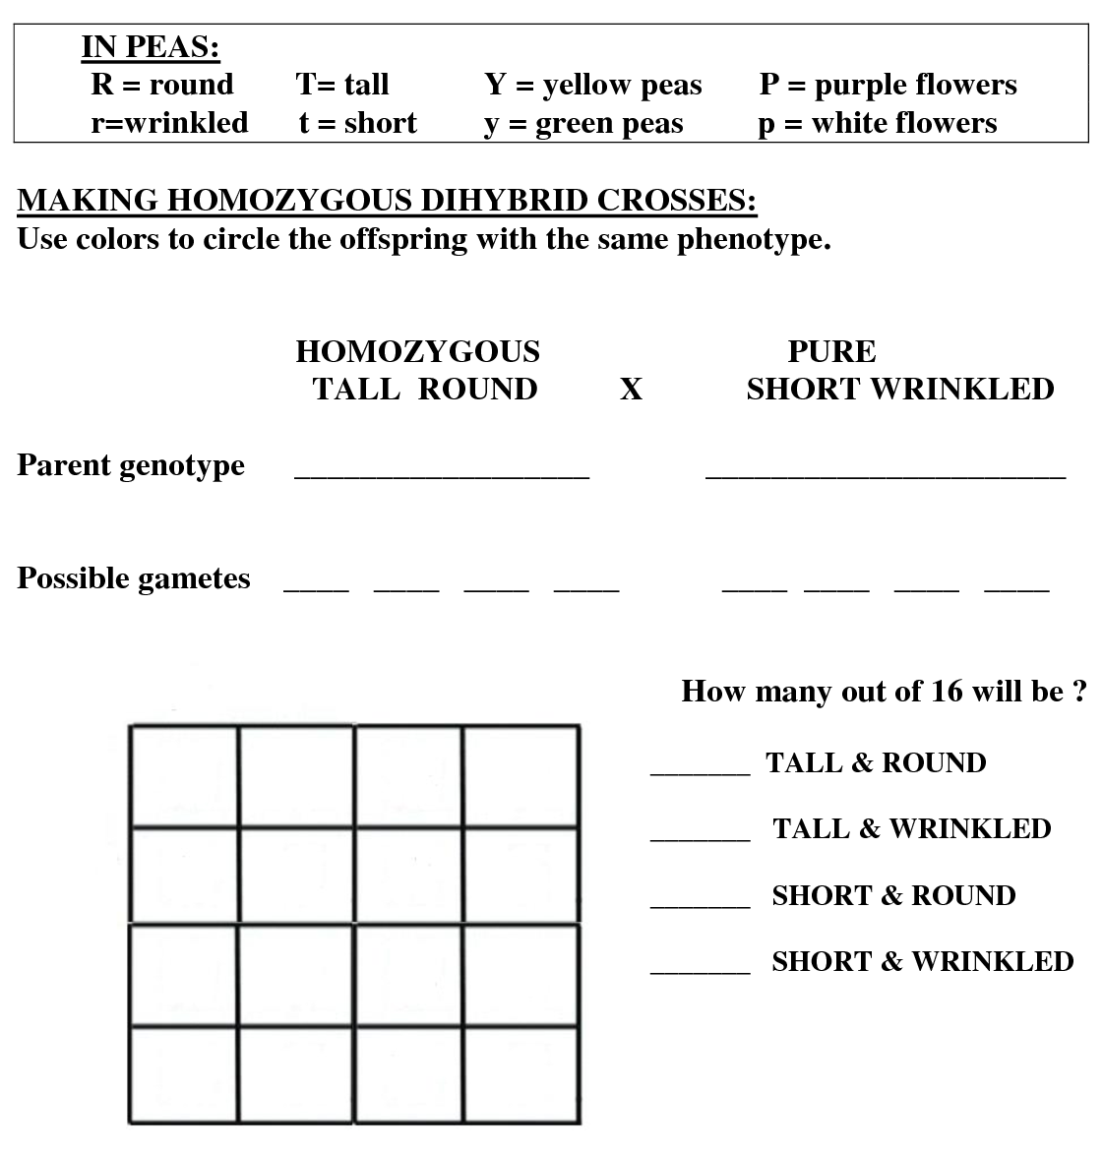
Mendelian Genetics Practice
SC.912.L.16.1 Use Mendel’s laws of segregation and independent assortment to analyze patterns of inheritance.
Copy and complete on your own paper
Notes:
15 min

Slide 18
Keep this paper to study
Your semester 1 exam is next class
Your Must Do’s since Day 1 of school are due next class
The class website is: www.mccabesbiology.weebly.com
Turn in any missing assignments before the end of school today!

