Slide 1
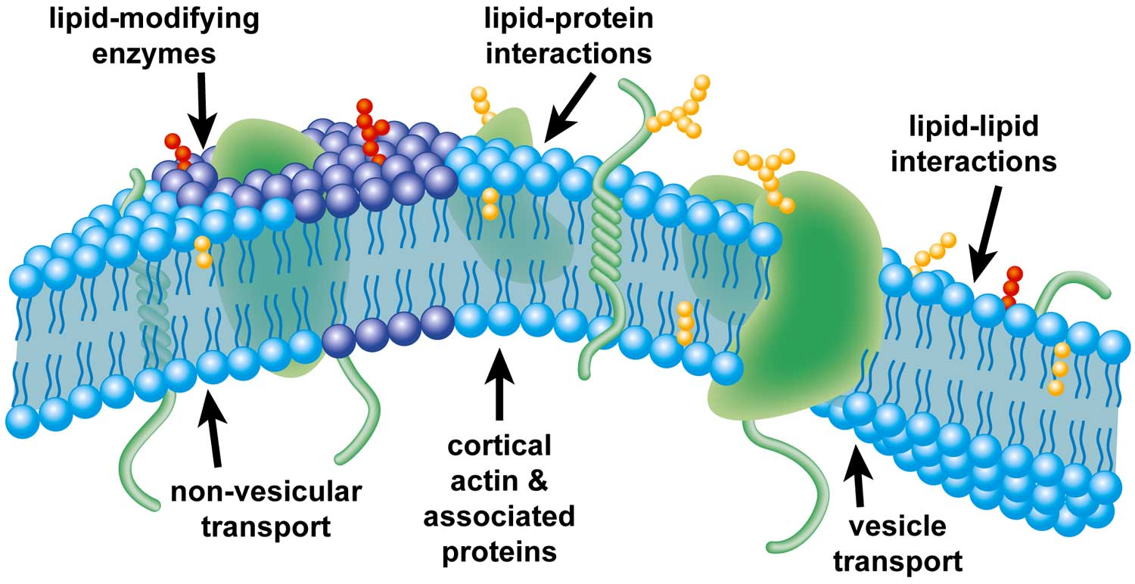
Unit 3: Cell Membrane & Transport Foldable
2015-2016 Ms. McCabe

Slide 2
Materials per student
Pencil
3 colors of colored pencils
Scissors
1 sheet of legal-sized white paper
Section 7.3 of the Biology textbook
Use the Table of Contents to find the page numbers!!

Slide 3
Directions
Fold the paper hotdog style
On the half facing up – separate into 4 sections
Write Diffusion, Osmosis, Facilitated Diffusion and Active Transport (in that order)
Cut 3 slits on the segments ONLY of the half of the paper facing you
On the back, write Concentration Gradients and draw two right triangles

Slide 4
Directions
Open the paper so that the cut half is on top
For each section, answer the following in a complete sentence.
Do they use energy?
What’s moving? Water OR Solutes
Is it moving from High to Low OR Low to High?
Does it move through the Phospholipid Bilayer OR Protein Channel?
On the back, along the bottom, copy this key:
Solute (sugar/salt)
WATER
ENERGY
Direction of particles

Slide 5
Front

Slide 6
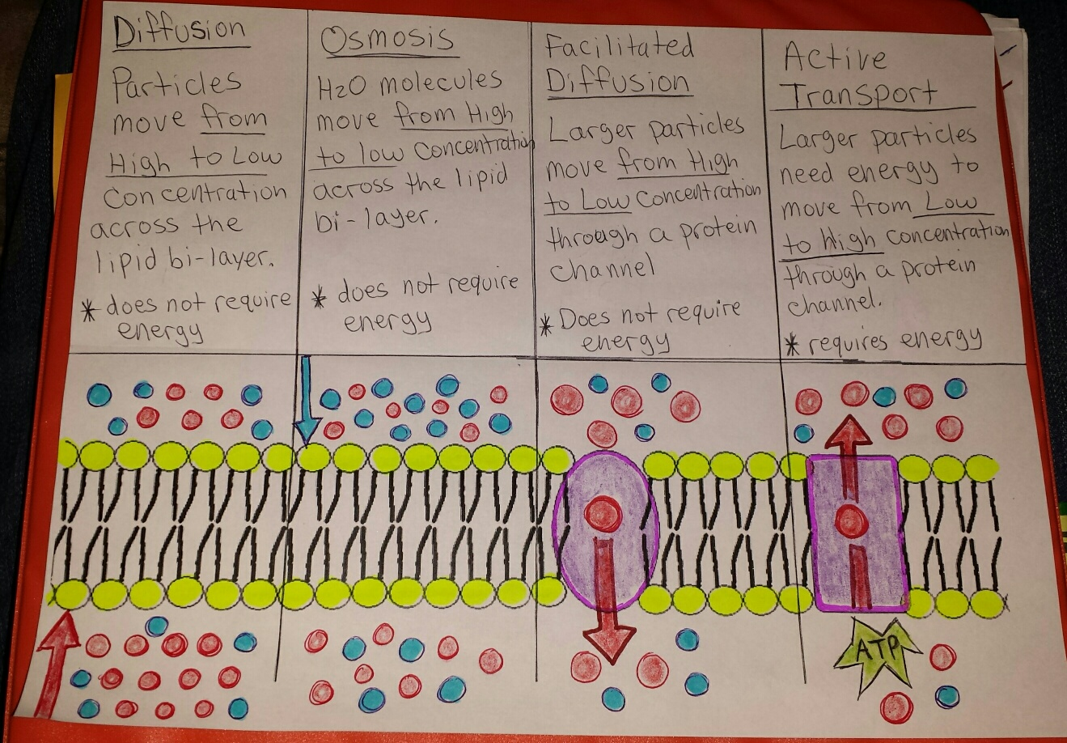
Inside

Slide 7
Back

