Slide 1
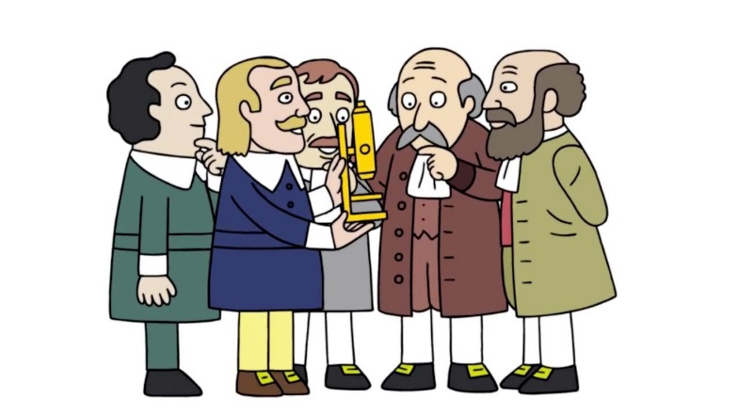
Unit 3: Cell Theory & Development of Microscopes
Theory That!
2015-2016
Ms. McCabe

Slide 2
Standards
SC.912.L.14.1 Describe the scientific theory of cells (cell theory) and relate the history of its discovery to the process of science.
SC.912.L.14.4 Compare and contrast structure and function of various types of microscopes.

Slide 3
Guiding Questions
What are the tenets of cell theory?
What is the relationship between a theory and a law?
What role did scientific claims and argumentation have in the development of a scientific cell theory?
How has the development of the microscope contributed to cell theory?

Slide 4
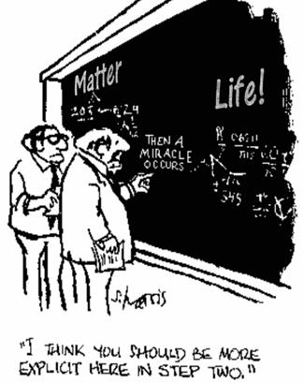
Engage – Theory That!
N, D, P and title a sheet of notebook paper: Theory That!
Take a pink, laminated half sheet
Complete the Do Now Portion on your own notebook paper

Slide 5
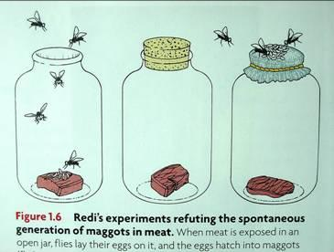
Engage - Seeing is Believing
Spontaneous Generation: Until the second half of the 19th century it was thought that life could appear spontaneously from nonliving matter
What do you think led to the development of this theory?
Be prepared for random calls.
Notes:
Engage: Learners engage with an activity that captures their thinking, access prior knowledge and reveals misconceptions.
Spontaneous Generation: Until the second half of the 19th century it was thought that life could arise spontaneously from nonliving matter, a process known as spontaneous generation. Francesco Redi was an early opponent of this theory and demonstrated in 1668 that maggots, fly larvae, do not arise spontaneously from meat. Many people still believed in the theory. In 1745, John Needham poured heated nutrient fluids into covered flasks and found the presence of microorganisms. He took this as evidence of spontaneous generation. Twenty years later Lazzaro Spallanzani showed that Needham’s microorganisms entered the flasks after boiling. In 1861, Louis Pasteur designed the experiments that finally ended this long debate. He showed that flasks left open to the air after boiling would soon be contaminated but if they were sealed, they remained free of microorganisms. He also used flasks with s-shaped curves. Air could enter the flasks however the microorganisms could not and the contents of the flask remained sterile. This proved that microorganisms are present throughout the environment but can be destroyed. He also developed methods of blocking access of airborne microorganisms to nutrient environments, these methods were the basis of aseptic technique. Pasteur pipets are named after Louis Pasteur and are used in laboratories around the world.

Slide 6
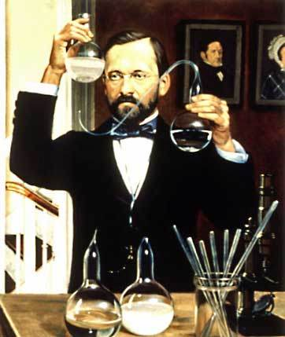
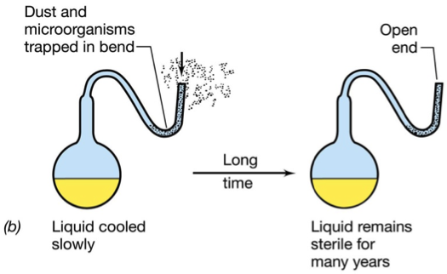
Engage - Seeing is Believing
What do you think happened to change the theory about how living things arise?
Be prepared for random calls

Slide 7
Explore – Spontaneous Generation Theory
Notes:
Bill Nye Video, can stop at 1:32
Explore: Learners explore common, hands‐on experiences that help them begin constructing concepts and skills aligned to benchmarks.
Cell Theory Tenants:
All living things are made of cells.
Cells are the basic units of structure and function in living things.
New cells are produce from existing cells.

Slide 8
Explore/Explain – Timeline Card Sort
Seat 1A will distribute the Cell Theory Evidence
Read and discuss each Evidence Card and sort them into a timeline.
Random Calls:
What do you notice about the timeline? When did it start? Which countries were involved?
How are the people involved in the theory similar and different?
Complete #1only of the During the Lesson portion of the half pink sheet on your paper
Notes:
Explore: Learners explore common, hands‐on experiences that help them begin constructing concepts and skills aligned to benchmarks.
Cell Theory Tenants:
All living things are made of cells.
Cells are the basic units of structure and function in living things.
New cells are produce from existing cells.

Slide 9
Elaborate – Wacky History of Cell Theory
As you watch the video, complete #2 of the During the lesson portion on your own paper
After the video, complete the After the Lesson portion on your own paper
Notes:
Explore: Learners explore common, hands‐on experiences that help them begin constructing concepts and skills aligned to benchmarks.
Cell Theory Tenants:
All living things are made of cells.
Cells are the basic units of structure and function in living things.
New cells are produce from existing cells.

Slide 10
Elaborate – Wacky History of Cell Theory
Notes:
Explore: Learners explore common, hands‐on experiences that help them begin constructing concepts and skills aligned to benchmarks.
Cell Theory Tenants:
All living things are made of cells.
Cells are the basic units of structure and function in living things.
New cells are produce from existing cells.

Slide 11
Evaluate – Quick Quiz #1
The cell theory was first proposed in 1838. Evidence obtained through additional scientific investigations resulted in the current cell theory. Which statement describes a component of the original cell theory that was removed because of the new scientific knowledge?
All living things are made of cells.
All cells come from other preexisting cells.
Cells form through spontaneous generation.
Cells are the basic structural and functional units of life.
Notes:
C

Slide 12
Evaluate – Quick Quiz #2
Which invention from the 17th century allowed for the development of modern cell theory?
A. X-rays
B. computers
C. the light microscope
D. the scanning electron microscope
Notes:
C

Slide 13
Evaluate – Quick Quiz #3
The goal of scientific experimentation is to increase what we know about how the natural world operates. If a hypothesis is tested repeatedly by a wide variety of experimental approaches in many scientific investigations and cannot be proved false, then the hypothesis could be called a
conclusion.
fact.
rule.
theory.
Notes:
D

Slide 14
Evaluate – Quick Quiz #4
Cell theory is a result of the contributions of several different scientists, and applies to all living things. Which of the following explains why cell theory will not ever become the law of cells?
Cells of different organisms are so diverse that it is impossible to come up with a law that would apply to all of them.
Because cells undergo change as mutations occur within them, developing anything beyond a cell theory would be impractical.
Scientific theories are well-tested explanations, while laws are well-tested descriptions of natural phenomena; one cannot become the other.
Scientific theories can only become laws if all possible cases can be tested; it would be impossible to test all living things to see if they have cells.
Notes:
C

Slide 15
Evaluate – Quick Quiz #5
Choose two of the following questions.
Explain your answers in a short paragraph.
What are the tenets of cell theory?
What is the relationship between a theory and a law?
What role did scientific claims and argumentation have in the development of a scientific cell theory?
How has the development of the microscope contributed to cell theory?

Slide 16
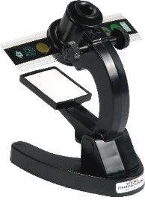
Explore – Microviewer Lab
Complete the Brainstorm on the Microscope WS
Today you are going to view evidences for cell theory
We are using 6 prepared slides on the microviewers
Do not remove the slide from the microviewer
Take a pencil and Microscope WS only to the lab
Find a numbered station with a group
Notes:
Explore: Learners explore common, hands‐on experiences that help them begin constructing concepts and skills aligned to benchmarks.
Cell Theory Tenants:
All living things are made of cells.
Cells are the basic units of structure and function in living things.
New cells are produce from existing cells.

