Slide 1
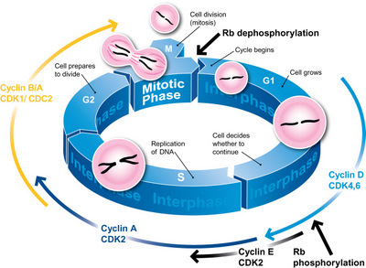
The Cell Cycle
2015-2016
Ms. McCabe

Slide 2
Do Now Cells Quiz 20 Points
Skipping lines, number 1-10
Name, Date, Period
The title is: Cell Quiz
Answer 1-5 in complete sentences
For 6-10, write the word and the matching definition

Slide 3
Cells Quiz Short Answer 20 Points
What is the main difference between prokaryotes and eukaryotes?
What is the function of the nucleus?
Name an example of a prokaryotic cell.
Do all cells have a cell membrane?
What is the function of ribosomes?

Slide 4
Cells Quiz Matching 20 Points
Cell wall
Golgi body
Rough/smooth ER
Animalia/Plantae
Chloroplast
Makes lipids (fats)
Protective layer outside of plant cells
Eukaryotic Cells
Modifies, sorts, and packages items for transport within or out of the cell
Energy-capturing organelle in plant cells

Slide 5
Standards
SC.912.L.16.14 Describe the cell cycle, including the process of mitosis. Explain the role of mitosis in the formation of new cells and its importance in maintaining chromosome number during asexual reproduction.
SC.912.L.16.8 Explain the relationship between mutation, cell cycle, and uncontrolled cell growth potentially resulting in cancer.
SC.912.L.16.15 (Honors) Compare and contrast binary fission and mitotic cell division.

Slide 6
Guiding Questions
How can we describe the stages in the life cycle of a cell?
What impact can mutations and uncontrolled cell growth have on the cell cycle?
How can we compare and contrast mitosis and binary fission in asexual reproduction?

Slide 7
Cell Cycle & Cancer

Slide 8
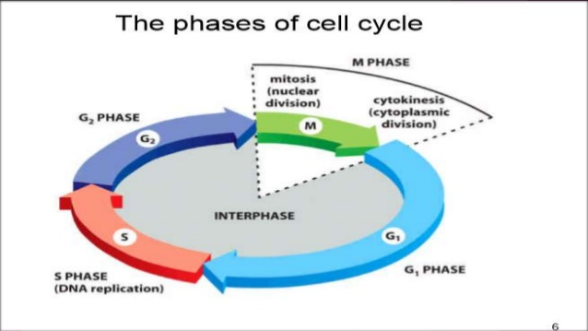
How can we describe the stages in the life cycle of a cell?
SC.912.L.16.14 Describe the cell cycle, including the process of mitosis. Explain the role of mitosis in the formation of new cells and its importance in maintaining chromosome number during asexual reproduction.
Remember “IPMAT”
There are 2 main parts:
I = Interphase
PMAT = Mitosis/dividing phases

Slide 9
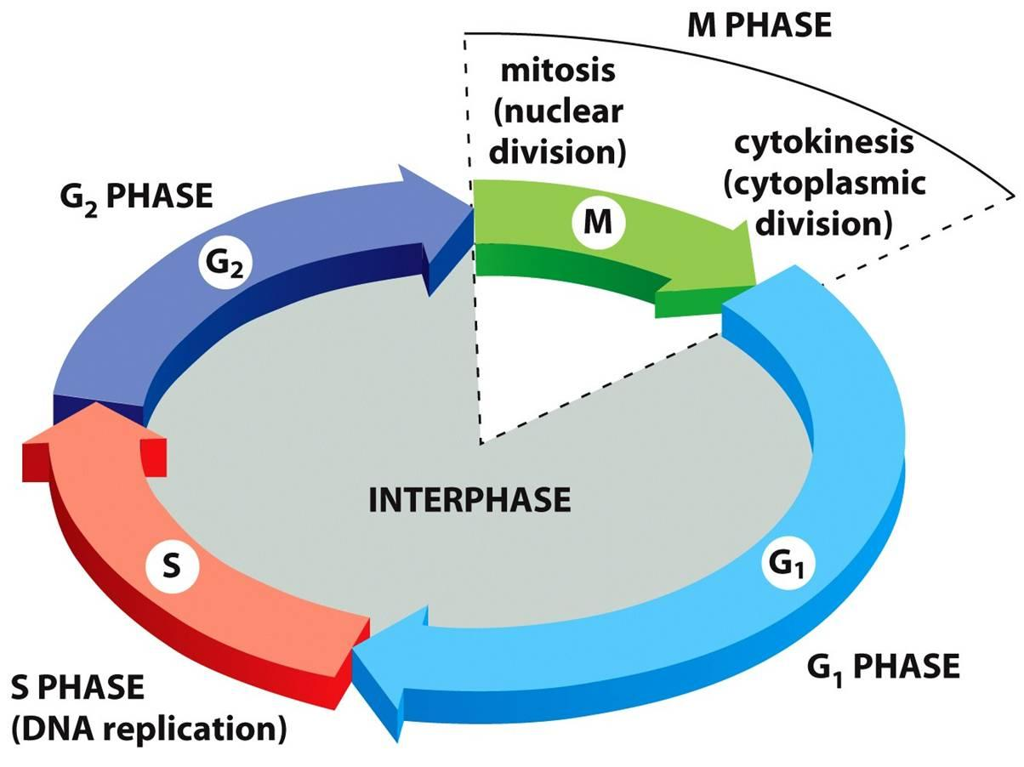
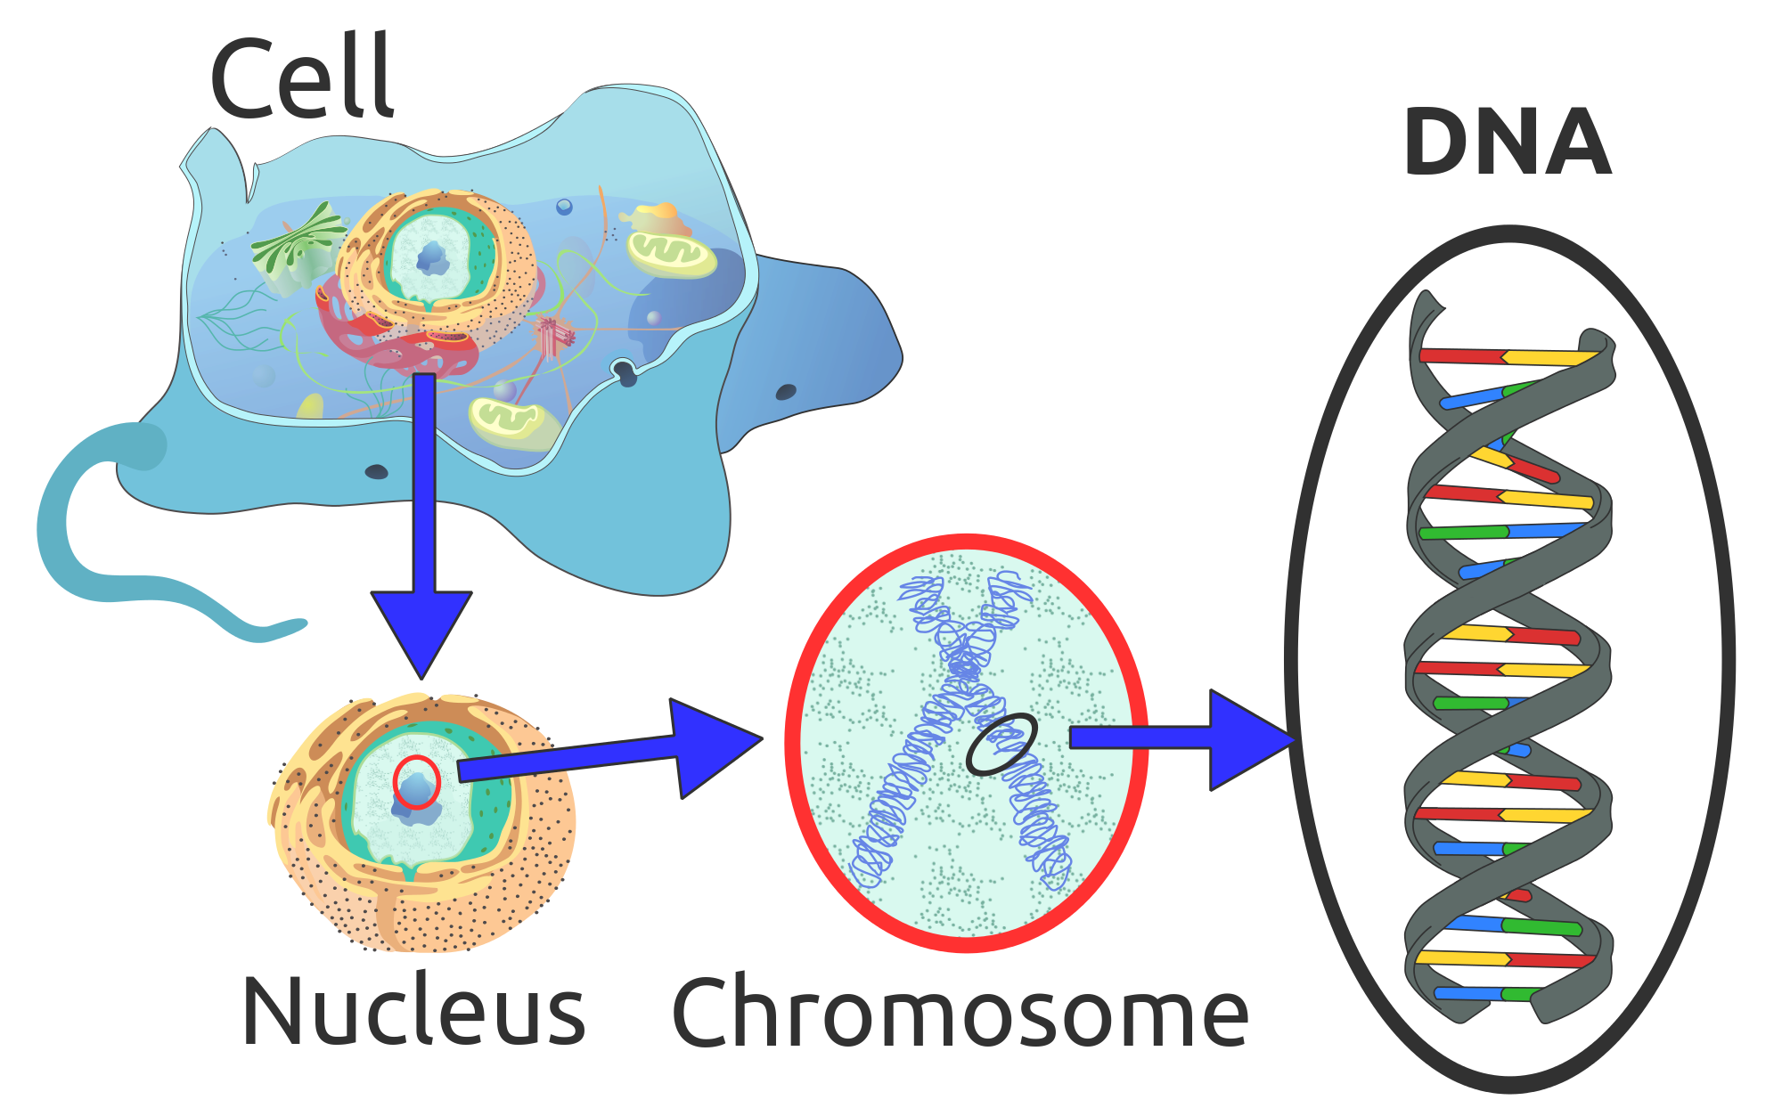
The Cell Cycle aka Cell Division
The instructions for making cell parts are encoded in the DNA, so each new cell must get a complete set of the DNA molecules

Slide 10
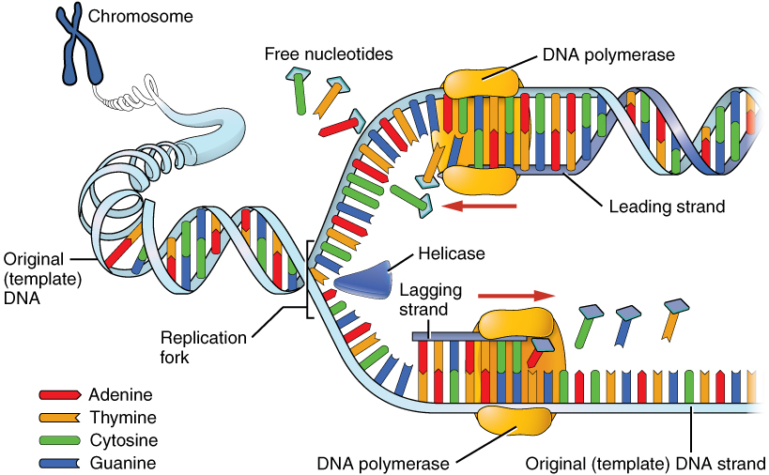
DNA Replication =
DNA must be copied or replicated before cell division
Each new cell will then have an identical copy of the DNA

Slide 11
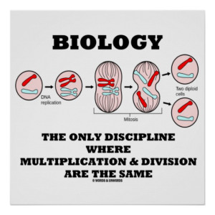
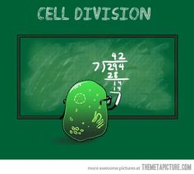
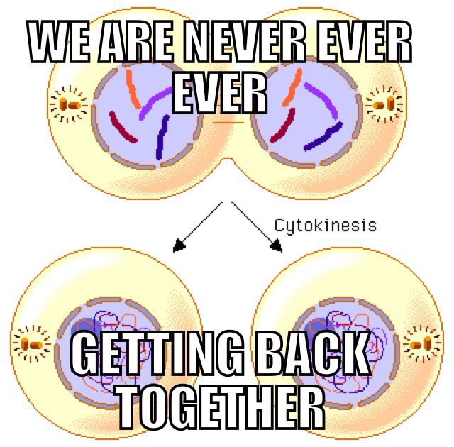
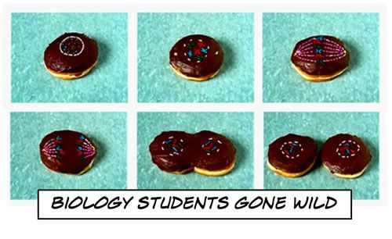
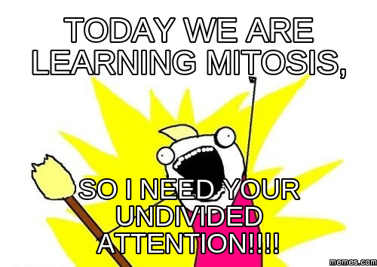

Slide 12
Types of Cell Reproduction

Slide 13
How can we describe the stages in the life cycle of a cell?
SC.912.L.16.14 Describe the cell cycle, including the process of mitosis. Explain the role of mitosis in the formation of new cells and its importance in maintaining chromosome number during asexual reproduction.
“IPMATC”
I is for Interphase which is separated into three stages

Slide 14
How can we describe the stages in the life cycle of a cell?
SC.912.L.16.14 Describe the cell cycle, including the process of mitosis. Explain the role of mitosis in the formation of new cells and its importance in maintaining chromosome number during asexual reproduction.
Interphase:
G1 = gap 1, cell grows & makes more cytoplasm and organelles
S = synthesis, DNA gets replicated
G2 = gap 2, cell grows & makes division organelles: centrioles (only in animal cells)

Slide 15
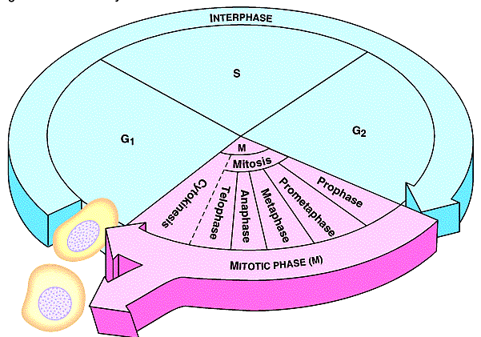
Stop & Sketch *3 pts.
SC.912.L.16.14 Describe the cell cycle, including the process of mitosis. Explain the role of mitosis in the formation of new cells and its importance in maintaining chromosome number during asexual reproduction.
DNA Copied
Cells Mature
Cells prepare for Division
Daughter Cells
Cell Divides into Identical cells

Slide 16
How can we describe the stages in the life cycle of a cell?
SC.912.L.16.14 Describe the cell cycle, including the process of mitosis. Explain the role of mitosis in the formation of new cells and its importance in maintaining chromosome number during asexual reproduction.
“IPMATC”
Mitosis = “tos/toes” toes are somatic (body) cells that do mitosis
PMATC = Mitosis, or cell division, only happens in eukaryotes, and does NOT happen in brain cells
Mitosis is separated into:
Prophase 5. Cytokinesis
Metaphase
Anaphase
Telophase

Slide 17
How can we describe the stages in the life cycle of a cell?
SC.912.L.16.14 Describe the cell cycle, including the process of mitosis. Explain the role of mitosis in the formation of new cells and its importance in maintaining chromosome number during asexual reproduction.
PMATC = Mitosis
P = Prophase
Chromatin (tangled DNA) turns into chromosomes (DNA) in the X-shape becoming visible
Centrioles create spindle fibers
Nuclear membrane breaks down so that DNA can separate into each daughter cell

Slide 18
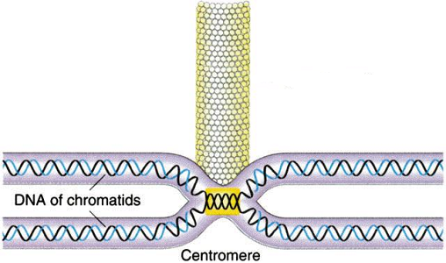
Spindle Fiber attached to Chromosome
Kinetochore Fiber
Chromosome

Slide 19
Review of Prophase
What the cell looks like
What’s happening

Slide 20
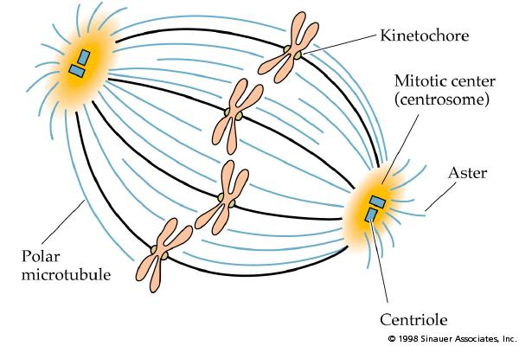
Stop & Sketch *3 pts.
SC.912.L.16.14 Describe the cell cycle, including the process of mitosis. Explain the role of mitosis in the formation of new cells and its importance in maintaining chromosome number during asexual reproduction.

Slide 21
How can we describe the stages in the life cycle of a cell?
SC.912.L.16.14 Describe the cell cycle, including the process of mitosis. Explain the role of mitosis in the formation of new cells and its importance in maintaining chromosome number during asexual reproduction.
PMATC = Mitosis
M = Metaphase
Meta = middle
Chromosomes line up in the middle of the cell at the cell plate

Slide 22
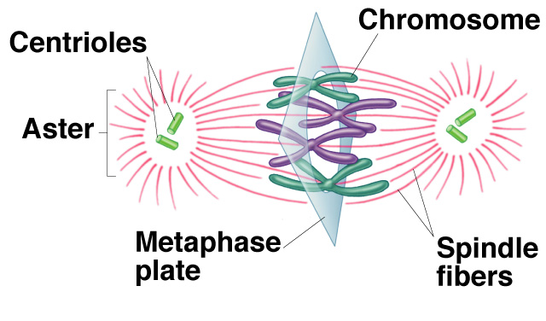
Equator of Cell
Pole of the Cell

Slide 23
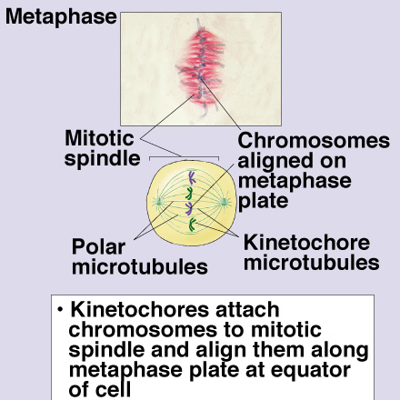
Review of Metaphase
What the cell looks like
What’s happening

Slide 24
How can we describe the stages in the life cycle of a cell?
SC.912.L.16.14 Describe the cell cycle, including the process of mitosis. Explain the role of mitosis in the formation of new cells and its importance in maintaining chromosome number during asexual reproduction.
PMATC = Mitosis
A = Anaphase
“Sisters Ana & Elsa separate”
Sister chromatids separate toward opposite poles/ends of the cell

Slide 25
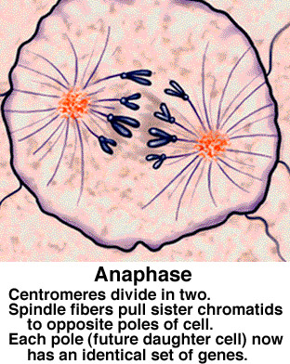
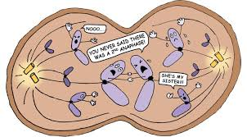
Review of Anaphase
What the cell looks like

Slide 26
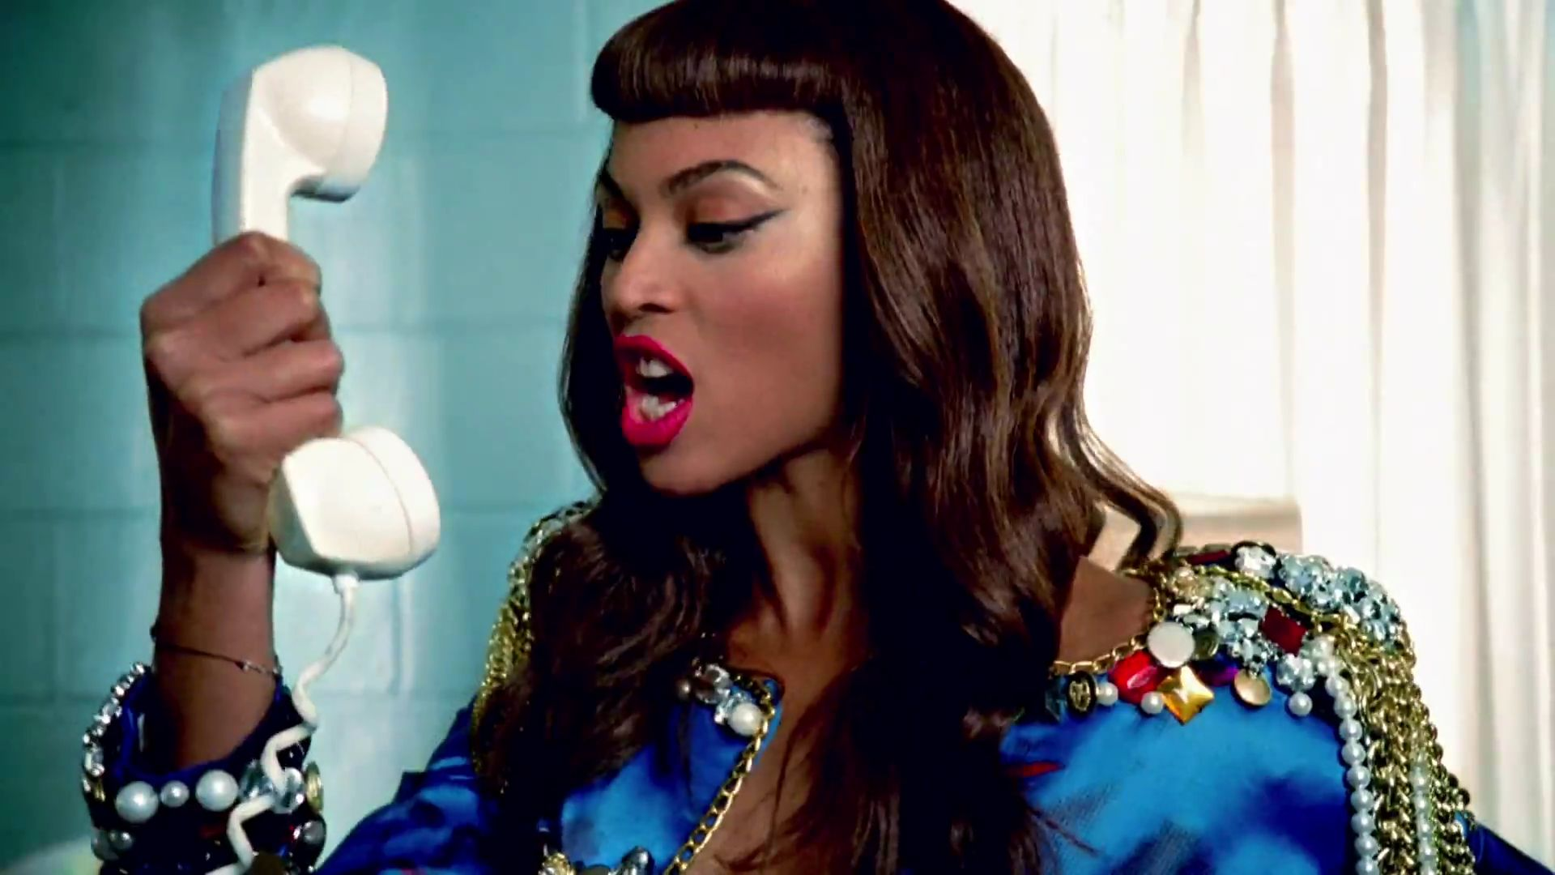
How can we describe the stages in the life cycle of a cell?
SC.912.L.16.14 Describe the cell cycle, including the process of mitosis. Explain the role of mitosis in the formation of new cells and its importance in maintaining chromosome number during asexual reproduction.
PMATC = Mitosis
T = Telophase
“Looks like a telephone”
DNA at poles of cell
Chromosomes (X shape) turn back into chromatin (tangles)
Nuclear membrane reappears

Slide 27
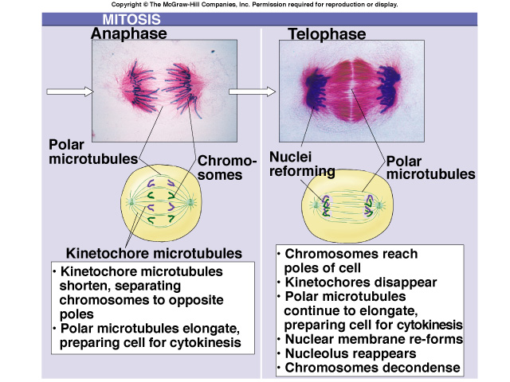
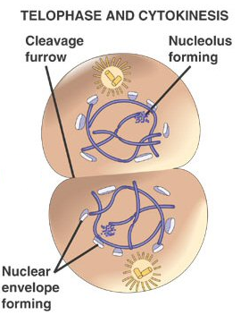
Comparing Anaphase & Telophase

Slide 28
How can we describe the stages in the life cycle of a cell?
SC.912.L.16.14 Describe the cell cycle, including the process of mitosis. Explain the role of mitosis in the formation of new cells and its importance in maintaining chromosome number during asexual reproduction.
PMATC = Mitosis
C = Cytokinesis
Cyto = cytoplasm/cell, Kinesis = splits
The cell splits into 2 daughter cells
In plant cells, cell plate forms at the equator to divide cell
In animal cells, cleavage furrow forms to split cell

Slide 29
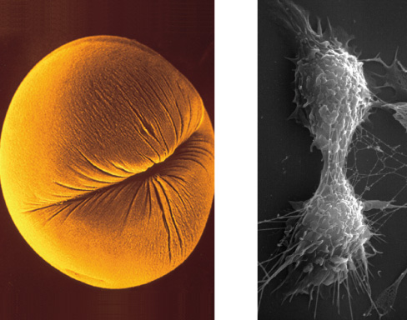
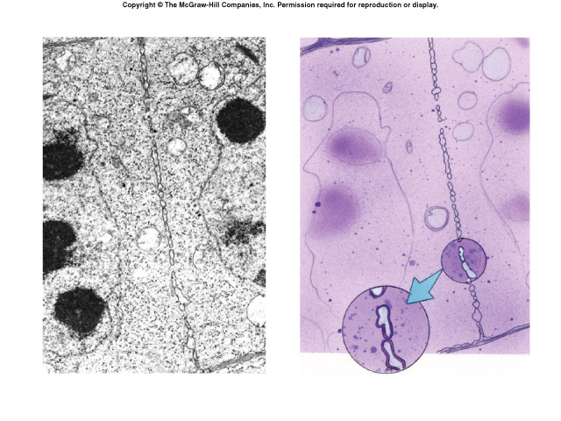
Cytokinesis
Cleavage furrow in animal cell
Cell plate in plant cell

Slide 30
How can we describe the stages in the life cycle of a cell?
SC.912.L.16.14 Describe the cell cycle, including the process of mitosis. Explain the role of mitosis in the formation of new cells and its importance in maintaining chromosome number during asexual reproduction.
THE END PRODUCTS:
2 Identical diploid (2n) daughter cells
Same number of chromosomes as each other and as the parent cell from which they were formed
Identical to each other, but smaller than parent cell
Must grow in size to become mature cells (G1 of Interphase)

Slide 31
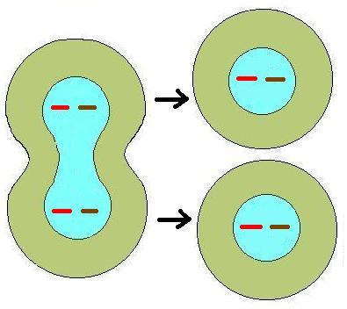
Identical Daughter Cells
What is the 2n or diploid number?
2
Chromosome number the same, but cells smaller than parent cell

Slide 32
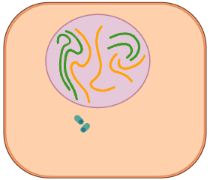
Mitosis Animation
Name each stage as you see it occur.

Slide 33
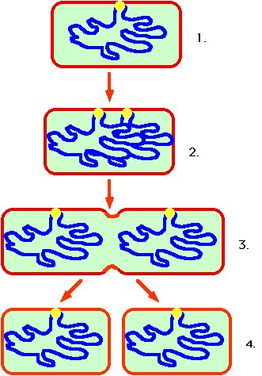
How can we compare and contrast mitosis and binary fission in asexual reproduction?
SC.912.L.16.15 (Honors) Compare and contrast binary fission and mitotic cell division.
Parent cell
Prokaryotes such as bacteria divide into 2 identical cells by the process of binary fission
Single chromosome makes a copy of itself
Cell wall forms between the chromosomes dividing the cell
Chromosome doubles
Cell splits
2 identical daughter cells

Slide 34
Binary Fission Animation

Slide 35
Mitosis Square Dance Activity

Slide 36
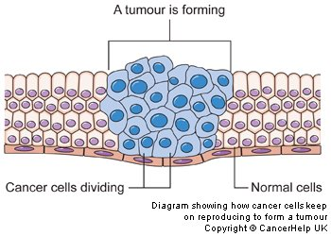
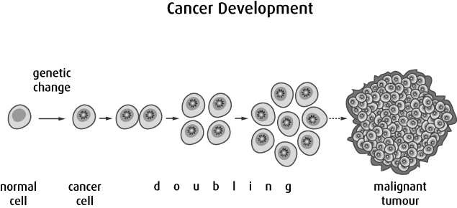
What impact can mutations and uncontrolled cell growth have on the cell cycle?
SC.912.L.16.8 Explain the relationship between mutation, cell cycle, and uncontrolled cell growth potentially resulting in cancer.
If mitosis is not controlled, unlimited cell division occurs causing cancerous tumors
Oncogenes are special proteins that increase the chance that a normal cell develops into a tumor cell

Slide 37
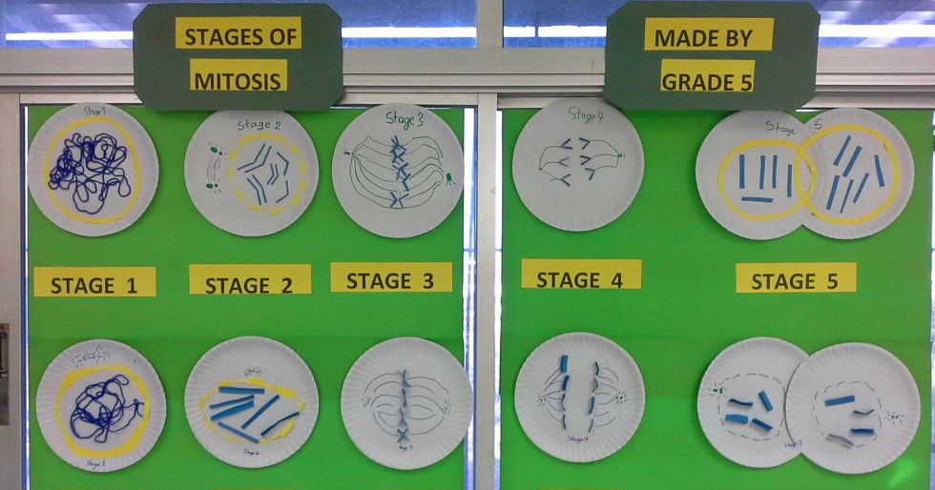
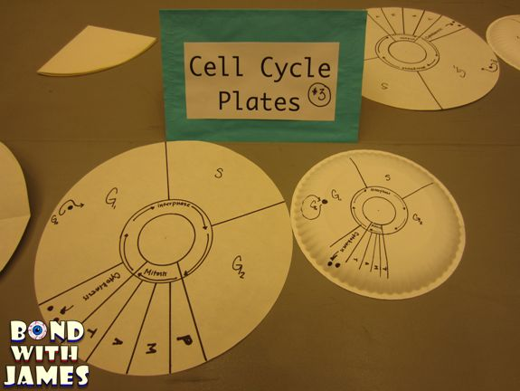
Your turn… *30 pts.
Your assignment is to re-create the phases of the Cell Cycle with paper plates
You will create one set per group
Each phase plate will have its own detailed, colored, 3-D plate
Each phase plate will have a 3-5 sentence summary of the phase on the back
You will create a way to display these plates and connect them
DUE AT THE BEGINNING OF CLASS FRIDAY 11/20 & MONDAY 11/23
Examples:

