Slide 1
Unit 4: ATP
2015-2016
Ms. McCabe

Slide 2
Standard
SC.912.L.18.10 Connect the role of adenosine triphosphate (ATP) to energy transfers within a cell.

Slide 3
Guiding question
SC.912.L.18.10 Connect the role of adenosine triphosphate (ATP) to energy transfers within a cell.
How do cells obtain and transform the energy required for biological processes?

Slide 4
How do cells obtain and transform the energy required for biological processes?
SC.912.L.18.10 Connect the role of adenosine triphosphate (ATP) to energy transfers within a cell.
Homeostasis is hard work. Organisms and the cells within them have to grow and develop, move materials around, build new molecules, and respond to environmental changes.
What powers so much activity, and where does that power come from?
Think for 10 seconds then be prepared for random calling!

Slide 6
How do cells obtain and transform the energy required for biological processes?
SC.912.L.18.10 Connect the role of adenosine triphosphate (ATP) to energy transfers within a cell.
Energy = the ability to do work
Your cells are busy using energy to build new molecules, contract muscles, and carry out active transport.
Without the ability to obtain and use energy, life would cease to exist.

Slide 7
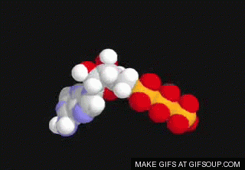
How do cells obtain and transform the energy required for biological processes?
SC.912.L.18.10 Connect the role of adenosine triphosphate (ATP) to energy transfers within a cell.
One of the most important compounds that cells use to store and release energy is adenosine triphosphate (ATP).
ATP consists of adenine, a 5-carbon sugar called ribose, and three phosphate groups.
C
C
C
C
C

Slide 8
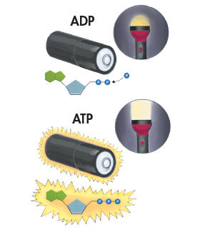
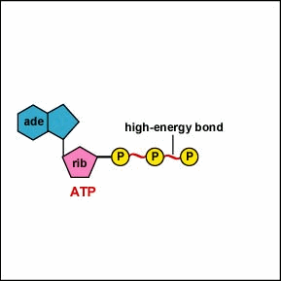
How do cells obtain and transform the energy required for biological processes?
SC.912.L.18.10 Connect the role of adenosine triphosphate (ATP) to energy transfers within a cell.
STORING ENERGY
Adenosine diphosphate (ADP) looks almost like ATP, except that it has two phosphate groups instead of three.
ADP contains some energy, but not as much as ATP.

Slide 9
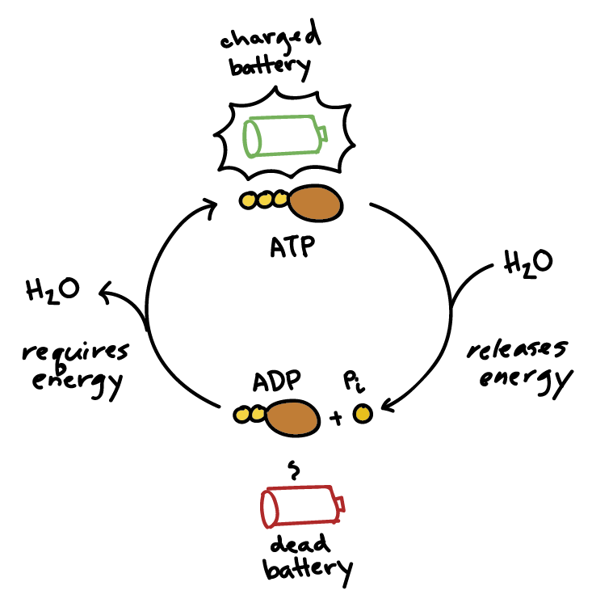
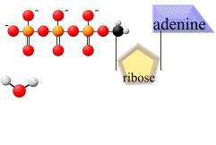
How do cells obtain and transform the energy required for biological processes?
SC.912.L.18.10 Connect the role of adenosine triphosphate (ATP) to energy transfers within a cell.
STORING ENERGY
When a cell has energy available, it can store small amounts of it by adding phosphate groups to ADP, producing ATP.
ADP is like a rechargeable battery that powers the machinery of the cell.

Slide 10
How do cells obtain and transform the energy required for biological processes?
SC.912.L.18.10 Connect the role of adenosine triphosphate (ATP) to energy transfers within a cell.
RELEASING ENERGY
Cells can release the energy stored in ATP by breaking the bonds between the second and third phosphate groups.
Because a cell can add or subtract these phosphate groups, it has an efficient way of storing and releasing energy as needed.

Slide 11
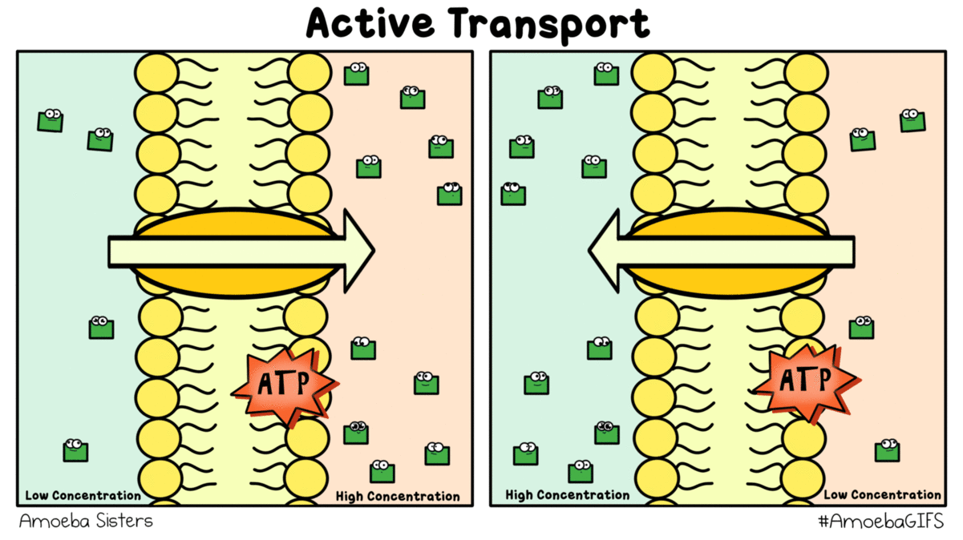
How do cells obtain and transform the energy required for biological processes?
SC.912.L.18.10 Connect the role of adenosine triphosphate (ATP) to energy transfers within a cell.
USING ENERGY
One way cells use the energy provided by ATP is to carry out active transport.
Many cell membranes contain sodium-potassium pumps. ATP provides the energy that keeps these pumps working, maintaining a balance of ions on both sides of the cell membrane.

Slide 12
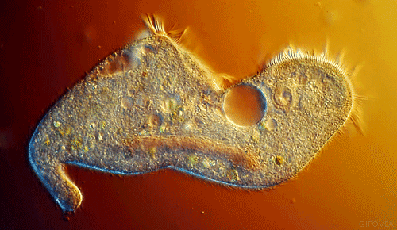
How do cells obtain and transform the energy required for biological processes?
SC.912.L.18.10 Connect the role of adenosine triphosphate (ATP) to energy transfers within a cell.
USING ENERGY
ATP powers movement, providing the energy for motor proteins that contract muscle and power the movement of cilia and flagella.

Slide 13
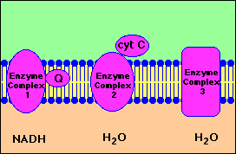
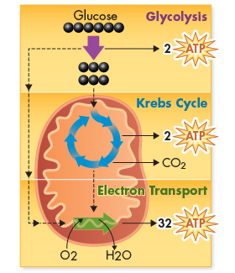
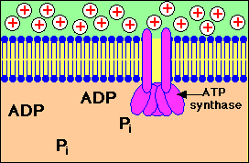
How do cells obtain and transform the energy required for biological processes?
SC.912.L.18.10 Connect the role of adenosine triphosphate (ATP) to energy transfers within a cell.
USING ENERGY
ATP is not a good molecule for storing large amounts of energy over the long term.
It is more efficient for cells to keep only a small supply of ATP on hand.
Cells can regenerate ATP from ADP as needed by using the energy in foods like glucose.

Slide 14
How do cells obtain and transform the energy required for biological processes?
SC.912.L.18.10 Connect the role of adenosine triphosphate (ATP) to energy transfers within a cell.
YOUR TURN
Now you are going to create your own model of ATP
You will need:
1 sheet of yellow paper
Pencil
Scissors
Fold the yellow paper hamburger style, then open it up
Create the model by drawing the adenine first with its bond lines exactly as shown in the picture (use a half of the paper)

Slide 15
How do cells obtain and transform the energy required for biological processes?
SC.912.L.18.10 Connect the role of adenosine triphosphate (ATP) to energy transfers within a cell.
YOUR TURN
Now make the 5-carbon sugar that we call ribose
Create the model by drawing the adenine first with its bond lines exactly as shown in the picture (use a quarter of the paper)

Slide 16
How do cells obtain and transform the energy required for biological processes?
SC.912.L.18.10 Connect the role of adenosine triphosphate (ATP) to energy transfers within a cell.
YOUR TURN
Finally, make the 3 phosphate groups
Make 2 pieces like the pictures below on the remaining part of the yellow paper:
WRITE YOUR NAME ON EACH PIECE OF YOUR ATP MOLECULE!!

Slide 17
Photosynthesis & Cellular Respiration
2015-2016
Ms. Mccabe

Slide 18
Standards
SC.912.L.18.9 Explain the interrelated nature of photosynthesis and cellular respiration.
SC.912.L.18.7 Identify the reactants, products, and basic functions of photosynthesis.
SC.912.L.18.8 Identify the reactants, products, and basic functions of aerobic and anaerobic cellular respiration.

Slide 19
Guiding questions
SC.912.L.18.10 Connect the role of adenosine triphosphate (ATP) to energy transfers within a cell.
How do cells obtain and transform the energy required for biological processes?
How are photosynthesis and cellular respiration related?
What are the essential reactants and products of photosynthesis?
How do the light-dependent reactions and light independent reactions work together to synthesize sugar?
What are the essential reactants and products of aerobic and anaerobic respiration?

Slide 20
Common misconceptions
SC.912.L.18.10 Connect the role of adenosine triphosphate (ATP) to energy transfers within a cell.
Animals carry out cellular respiration and plants only carry out photosynthesis. Correction: Plants carry out both cell respiration and photosynthesis.
Plants get their energy and food from the soil through their roots. Correction: Plants produce their own food through the process of photosynthesis by converting light energy into the chemical energy in glucose.
Plants depend on humans. Correction: Humans and other animals depend on plants.
Respiration and breathing are the same thing. Correction: Breathing involves gas exchange and occurs in animals, whereas respiration is the breakdown of glucose to produce ATP.
Photosynthesis only occurs when the plant has access to light. Correction: Only the light-dependent reaction of photosynthesis requires light energy.
Notes:
Use in the next class period after ATP for intro to PS & CR

