Slide 1
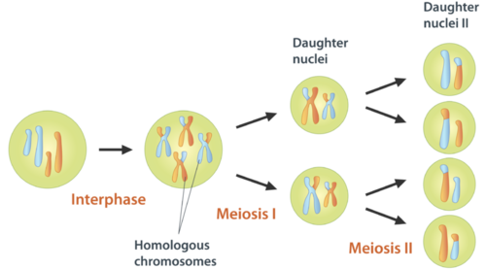
Meiosis
2015-2016
Ms. mcCabe

Slide 2
Do Now 12/1-2/15
Turn in any missing assignments
Rearrange ALL desks (even the empty ones) into 4 straight rows of 7 desks each
Copy the Must Do on your own notebook paper
Put that paper in your folder
Put all materials under your desk and out of sight
Have out ONLY a pencil
NO notes, papers (even blank ones), or anything else at all!

Slide 3
UNIT 3 QUIZ
Write your name, date, and period on the quiz
Eyes on your own paper, zero/F for even attempting to cheat
No talking
When you finish, turn in your quiz at the blue basket on top of the Biology Books
Take a Unit 5: Meiosis Guided Notes paper
Write your name, date, and period on this paper

Slide 4
STANDARDS
SC.912.L.16.16 Describe the process of meiosis, including independent assortment and crossing over. Explain how reduction division results in the formation of haploid gametes or spores.
SC.912.L.16.17 Compare and contrast mitosis and meiosis and relate to the processes of sexual and asexual reproduction and their consequences for genetic variation.

Slide 5
Guiding Questions
What is the relationship between meiosis and sexual reproduction?
What is the relationship between meiosis and the formation of haploid gametes or spores?
What is the role of crossing over in genetic variation?
What similarities and differences exist between the processes of mitosis and meiosis?

Slide 6
What is the relationship between meiosis and sexual reproduction?
Meiosis = the process of reduction division in the body’s sex cells
Reduction division = the 46 chromosomes we began with in the diploid (2n) parent cell is halved to 23 chromosomes in the haploid (1n) gamete cells/sex cells/spores (ex. sperm & eggs)

Slide 7
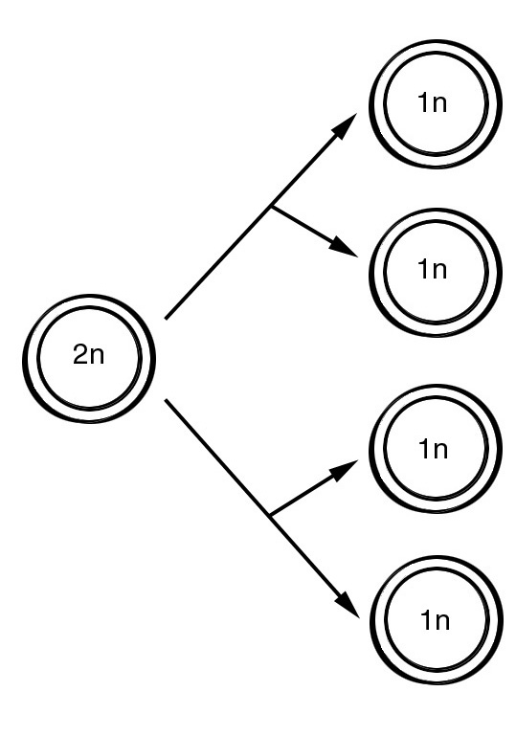
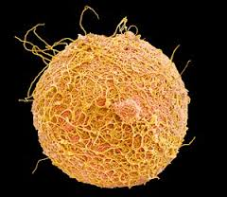
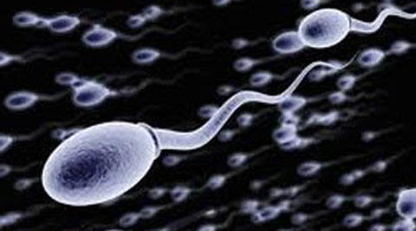
What is the relationship between meiosis and sexual reproduction?
Meiosis is not a cycle UNLIKE mitosis, which is a cycle
The purpose is to produce haploid gametes (1n) (sperm & egg cells)

Slide 8
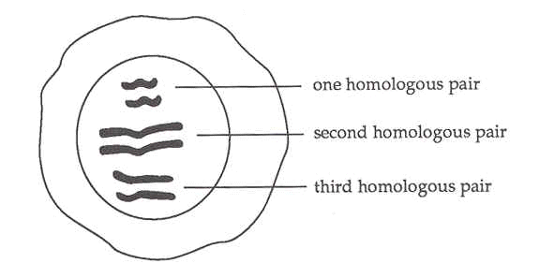
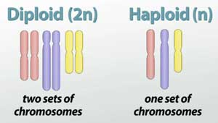
What is the relationship between meiosis and sexual reproduction?
Diploid = a cell containing homologous chromosomes (1 from each parent)
Represented by the symbol (2n), includes body cells like skin and hair
The human diploid or (2n) number = 46 chromosomes
Sexual reproduction = there are 2 parents with 2 sets of DNA involved in making the daughter (new) cells’ DNA set

Slide 9
What is the relationship between meiosis and sexual reproduction?
Haploid = a cell with a single set of chromosomes from only one parent
Represented by the symbol (1n), includes sperm (male) & egg (female) cells only
The human haploid or (1n) number = 23 chromosomes

Slide 10
What is the relationship between meiosis and sexual reproduction?
Spermatogenesis = formation of sperm begins at puberty; 4 sperm formed from each germ cell
Oogenesis = egg formation begins before birth, is completed after puberty; one egg and 3 polar bodies formed from each germ cell

Slide 11
What is the relationship between meiosis and sexual reproduction?
Spermatogenesis
Oogenesis

Slide 12
What is the relationship between meiosis and the formation of haploid gametes?
Meiosis involves 2 distinct divisions, called Meiosis I and Meiosis II
By the end of Meiosis II, the 1 diploid cell that entered meiosis has become 4 haploid cells

Slide 13
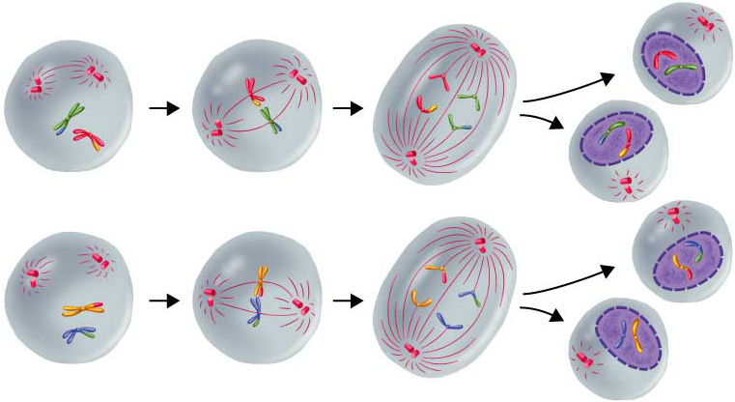
and Sketch – Add the titles to your picture
Interphase
Prophase 1
Anaphase 1
Prophase 2
Metaphase 2
Anaphase 2
Metaphase 1
Telophase 1 &
Cytokinesis
Meiosis 1
Telophase 2 &
Cytokinesis
Meiosis 2

Slide 14
What is the relationship between meiosis and the formation of haploid gametes?
MEIOSIS 1
(You do not need to draw these, Just showing you the stages)

Slide 15
What is the relationship between meiosis and the formation of haploid gametes?
Prophase1
Corresponding homologous chromosomes from each parent pair up to form homologous pairs
When homologous chromosome overlap it’s called crossing over
Centrioles
Spindle fibers
Homologous Pairs (Humans have 23 pairs making 46 total chromosomes)

Slide 16
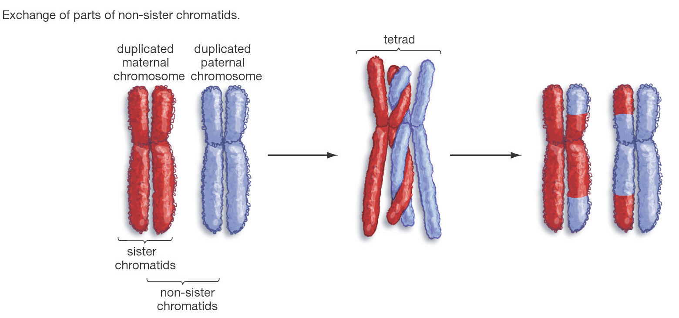
What is the relationship between meiosis and the formation of haploid gametes?
Prophase1
Crossing over happens when parts of the homologous chromosomes switch places after overlapping

Slide 17
How can siblings look alike but not exactly the same if they come from the same parents?

Slide 18
How can siblings look alike but not exactly the same if they come from the same parents?

Slide 19
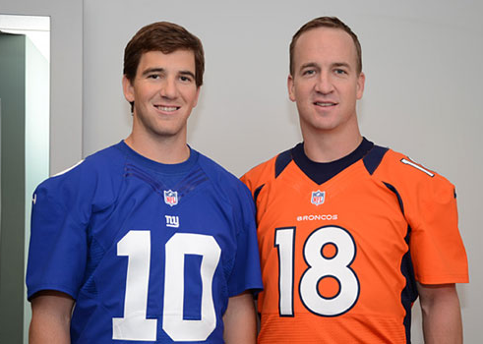
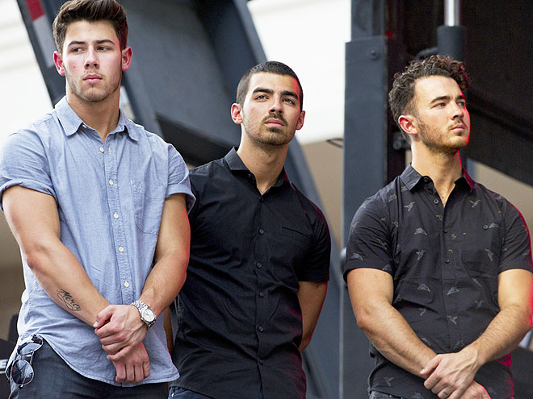
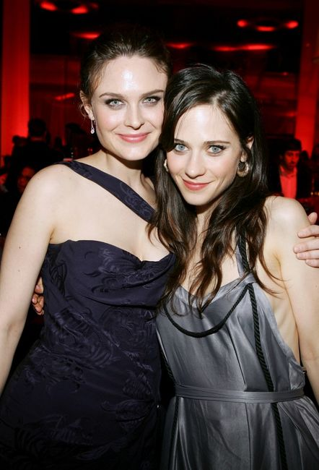
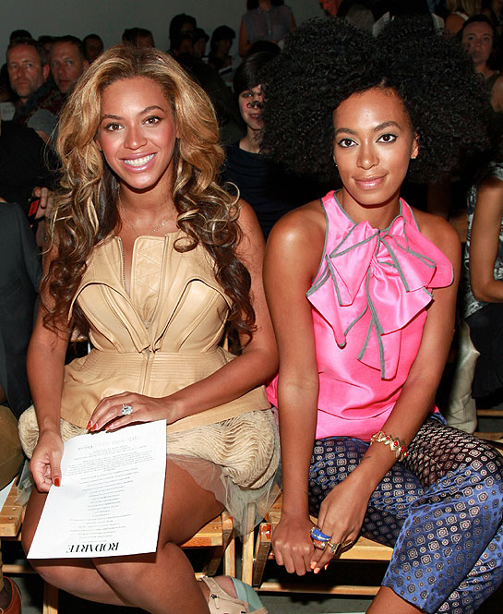
What is the relationship between meiosis and the formation of haploid gametes?
Prophase1
The importance of crossing over is that it increases genetic diversity (Think WAYYY back to biodiversity in ecology)
The gene combinations that a person gets from his or her parents will be different, to varying degrees, than the combination a sibling may get

Slide 20
What is the relationship between meiosis and the formation of haploid gametes?
Metaphase I
Meta = middle
The centrioles send out spindle fibers
Homologous pairs line up in the middle of the cell along the metaphase plate
Centrioles
Spindle fibers
Homologous Pairs

Slide 21
What is the relationship between meiosis and the formation of haploid gametes?
Anaphase I
The spindle fibers separate the homologous pairs
Each homologous chromosome is pulled to the opposite pole of the cell
Centrioles
Spindle fibers
Homologous Chromosomes

Slide 22
What is the relationship between meiosis and the formation of haploid gametes?
Anaphase I
If the centrioles do not properly attach the spindle fibers to the homologous chromosome before they start to pull, then a nondisjunction will occur
Nondisjunction causes gametes to have the wrong number of chromosomes

Slide 23
What is the relationship between meiosis and the formation of haploid gametes?
Telophase I & Cytokinesis
Telophase I – the cell creates a temporary nucleus around the two homologous chromosome sets
Cytokinesis – the cell divides into two cells
Centrioles
Homologous Chromosomes
Nuclear Membrane

Slide 24
What is the relationship between meiosis and the formation of haploid gametes?
MEIOSIS II
The two new cells produced by meiosis I now enter a second meiotic division
The cells do NOT replicate DNA resulting in four haploid cells
Each cell has half of the original DNA
2N ÷ 2 = N

Slide 25
What is the relationship between meiosis and the formation of haploid gametes?
Prophase 1I
Each of the Meiosis II stages are running in 2 cells at the same time.
Similar to Prophase of Mitosis
Centrioles attach spindle fibers to the chromosomes
Centrioles
Spindle fibers
Chromosomes

Slide 26
What is the relationship between meiosis and the formation of haploid gametes?
Metaphase1I
Similar to Metaphase of Mitosis
Centrioles use spindle fibers to line up the chromosomes in the middle at the metaphase plate
Centrioles
Spindle fibers
Chromosomes

Slide 27
What is the relationship between meiosis and the formation of haploid gametes?
Anaphase1I
The centrioles use the spindle fibers to separate the chromosomes into individual chromatids
Each chromatid is pulled to the opposite pole of the cell
The chromosomes go from X-shaped (chromosome) to stick-shaped (chromatid)
Centrioles
Spindle fibers
Chromatids

Slide 28
What is the relationship between meiosis and the formation of haploid gametes?
Telophase II & Cytokinesis
Telophase II – the cells create a permanent nucleus around the two haploid chromosome sets
Cytokinesis – the cells divides into four haploid daughter cells
Chromatids
Nuclear Membrane

Slide 30
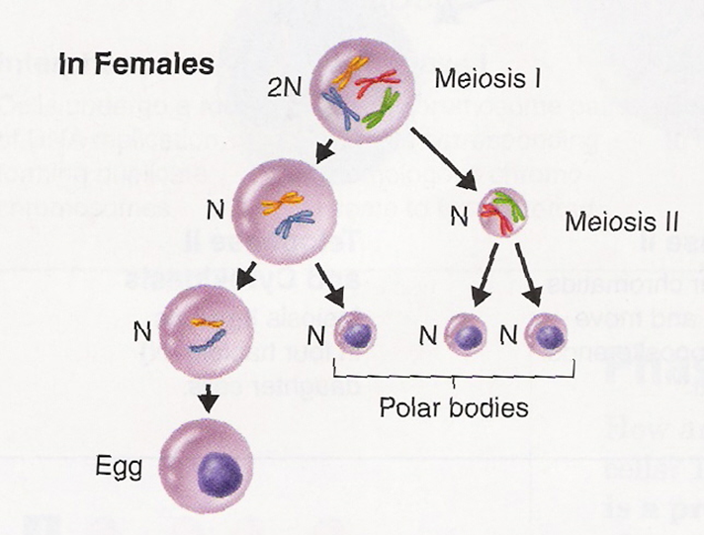

Slide 31
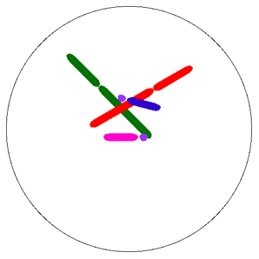
MEIOSIS
Animation
Meiosis I Animation
http://wps.prenhall.com/wps/media/objects/487/498728/CDA9_1/CDA9_1b/CDA9_1b.htm
Meiosis II Animation
http://wps.prenhall.com/wps/media/objects/487/498728/CDA9_1/CDA9_1c/CDA9_1c.htm

Slide 32
Vocabulary
Reduction division – When the number of chromosomes per cell is cut in half
Haploid – A cell that has half the amount of chromosomes. A cell that is “N” for chromosome amount
Diploid – A cell that has twice the amount of chromosome. A cell that is “2N” for chromosome amount
Gamete – the haploid “sex” cells (in animals they are sperm and egg cells)
Somatic Cell – all diploid cells (body cells) that are not gametes
Zygote – fertilized egg cell formed form the joining of the gametes (sperm and egg)

Slide 33
Vocabulary
Centrioles – Organelles in the cell that help to move chromosomes during cell division
Chromatin – What you call the DNA during Interphase, Very easy to access the genes for transcription and translation to create proteins
Chromosome – What you call the DNA during the actual cell division stages (Pro-, Meta-, Ana-, and Telophase). Condensed/packed DNA for easy movement during cell division
Chromatid – One of the “arms” of a chromosome ‘X’. Each chromatid is identical to the other because it is created by replication. A chromosome is made of two Sister Chromatids.
Spindle Fiber – fibers created and used by the centrioles to move the chromosomes around during the division stages.

Slide 34
Vocabulary
Homologous Chromosomes – the same numbered chromosome that pair up from mother and father (ex: mom’s chromosome 1 and dad’s chromosome 1)
Crossing Over – A kind of chromosomal mutation that happens in Prophase 1 of meiosis. Homologous chromosomes overlap and exchange pieces of the chromosome which caused genetic variability.
Nondisjuction – Happens in either Anaphase 1 or Anaphase 2 of meiosis when one centriole does not connect to the chromosome with a spindle fiber. Causes the gametes to have extra or missing chromosomes.
Fertilization – The process of making a zygote. When egg and sperm cells fuse and combine their genetic information (DNA)

Slide 35
What similarities & differences exist between the processes of mitosis and meiosis?
Complete this table on your note sheet
Find the answers in the next set of slides given on your note sheet
When you finish, KEEP everything from today
 | Mitosis | Meiosis
Number of Starting cells
Number of ending cells
Number of Human Chromosomes
Genetic Make up of cells
Type of cells

Slide 36
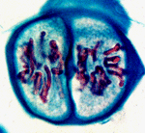
Comparing Mitosis & Meiosis
Number of cells at beginning of process
Mitosis = 1 Diploid cell
Meiosis = 1 Diploid Cell
Number of cells at the end of the process
Mitosis = 2 Diploid Cells
Meiosis = 4 Haploid Cells

Slide 37
Comparing Mitosis & Meiosis
Number of chromosomes at the START
Mitosis = 46 (Diploid, “two sets”)
Meiosis = 46
Number of chromosomes at the END
Mitosis = 46
Meiosis = 23 (Haploid, “one set”)

Slide 38
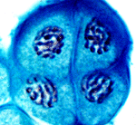
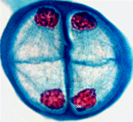
Comparing Mitosis & Meiosis
Is the genetic make-up of the daughter cells UNIQUE or IDENTICAL?
Mitosis produces 2 IDENTICAL CELLS
Meiosis produces 4 UNIQUE CELLS

Slide 39
Comparing Mitosis & Meiosis
Type of cell in the human body that can undergo each phase
Mitosis produces Somatic BODY cells (skin)
Meiosis produces Gamete SEX cells (sperm or eggs)

Slide 40
Interesting facts
Females produce all their eggs at once, and store them at a very early age (They release one each month during menstruation)
Why is this not necessarily a good thing?
Males make sperm constantly from puberty until they die

