Slide 1
UNIT 6 – Nucleic Acids: DNA
2015-2016
Ms. McCabe
Do Now 1/26-27/16
Copy today’s Must Do & Homework, this paper goes in your class notebook
Turn in your DNA Coloring WS for homework, they will not be accepted after the beginning of class today!
Find and remain in your new seat please

Slide 2
STANDARD
SC.912.L.16.3 Describe the basic process of DNA replication and how it relates to the transmission and conservation of the genetic information.

Slide 3
GUIDING QUESTIONs
SC.912.L.16.3 Describe the basic process of DNA replication and how it relates to the transmission and conservation of the genetic information.
What is the structure and function of DNA?
When does DNA replicate?
How does DNA replicate?
How is DNA replication a semi-conservative process?

Slide 4
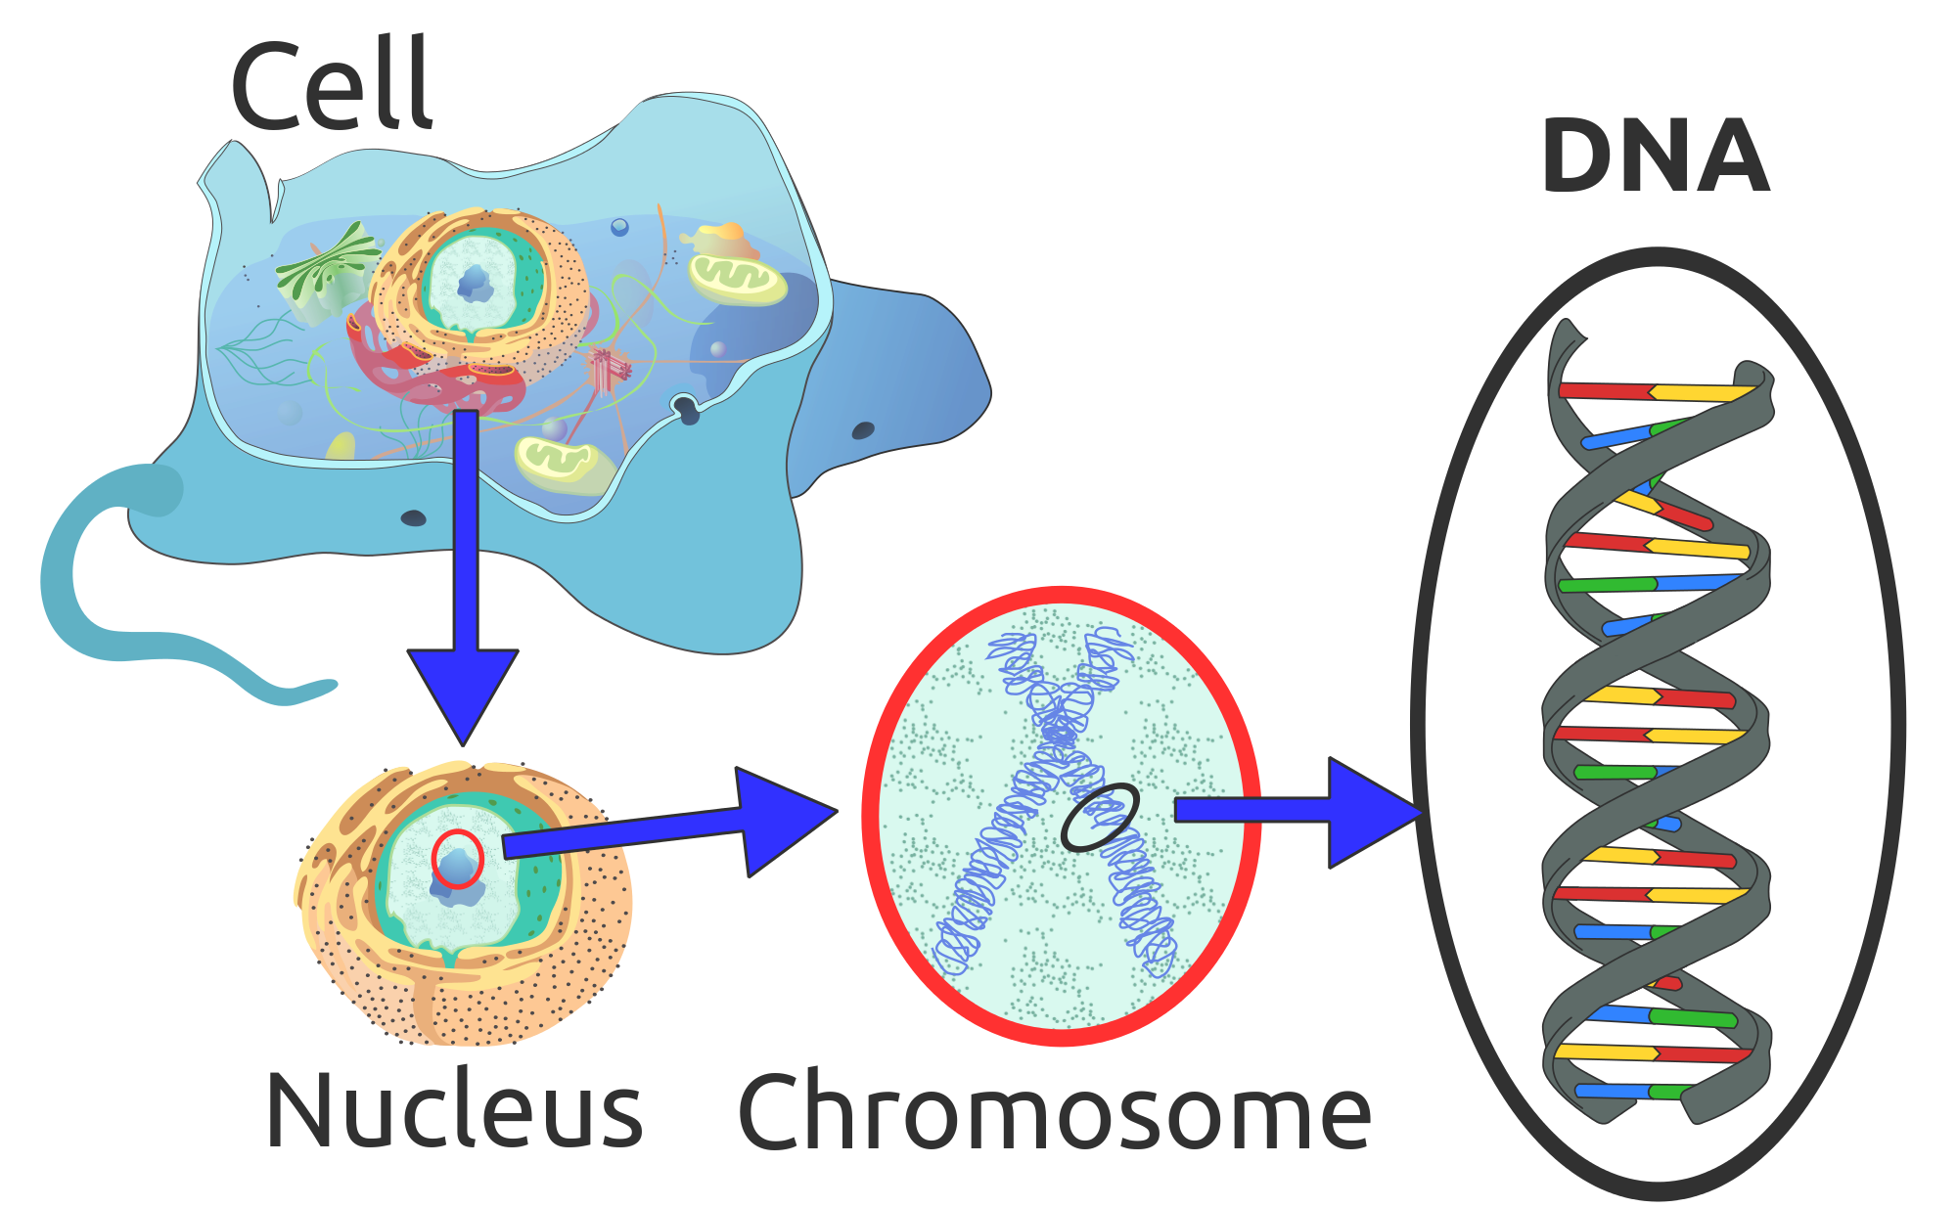
What is the structure & function of DNA?
SC.912.L.16.3 Describe the basic process of DNA replication and how it relates to the transmission and conservation of the genetic information.
DNA stands for Deoxyribonucleic acid
It is the genetic code found in ALL living organisms and viruses (non-living)
Which macromolecule includes DNA?
Lipids
Carbohydrates
Proteins
Nucleic acids
Evaluate

Slide 5
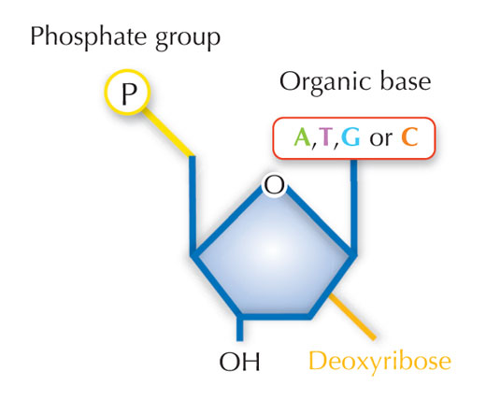
What is the structure & function of DNA?
SC.912.L.16.3 Describe the basic process of DNA replication and how it relates to the transmission and conservation of the genetic information.
Explain
DNA is made of the following monomers:
Deoxyribose = 5-carbon sugar
Phosphate group
Nitrogenous bases (4 total)
*Monomer* = basic building blocks
*-ose* = sugars

Slide 6
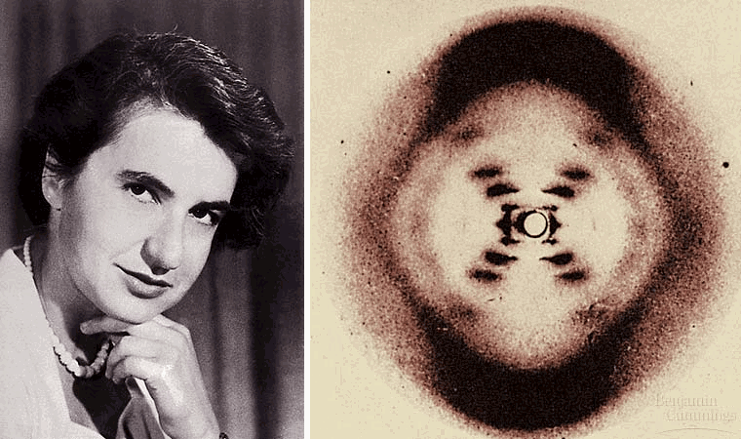
What is the structure & function of DNA?
SC.912.L.16.3 Describe the basic process of DNA replication and how it relates to the transmission and conservation of the genetic information.
Explain
Rosalind Franklin used a method called X-Ray Diffraction to find clues about DNA structure
The picture shows that the strands are twisted into coils, or a helix
The angle suggests two strands

Slide 7
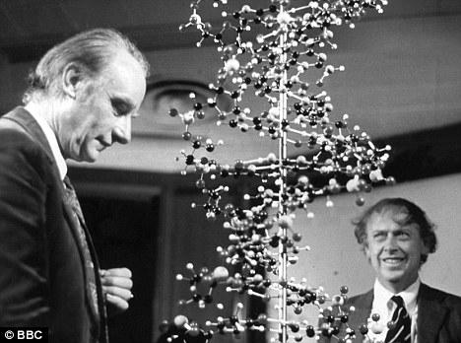
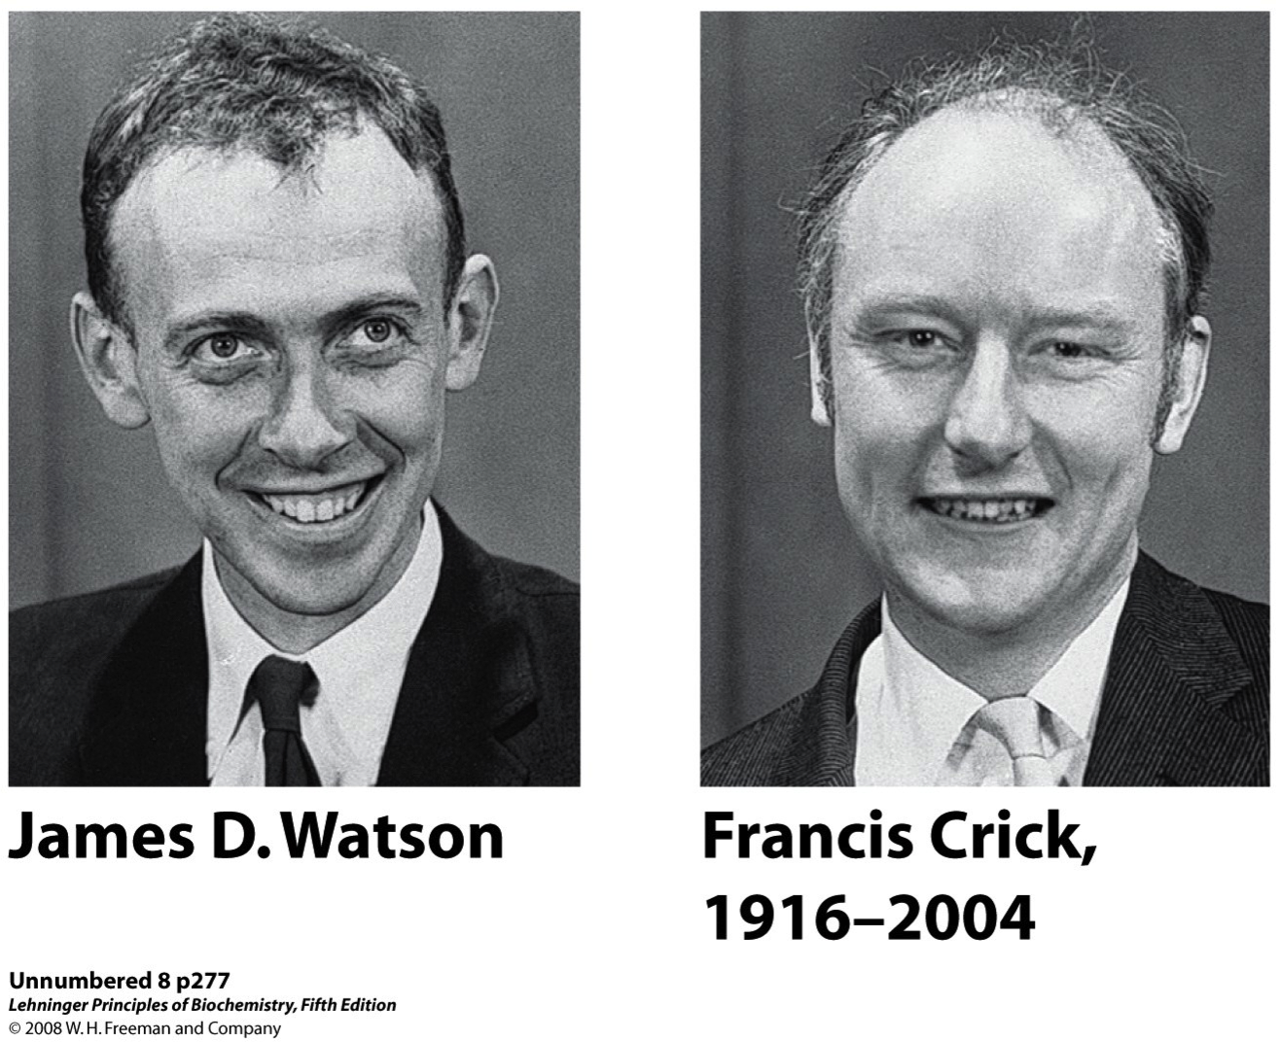
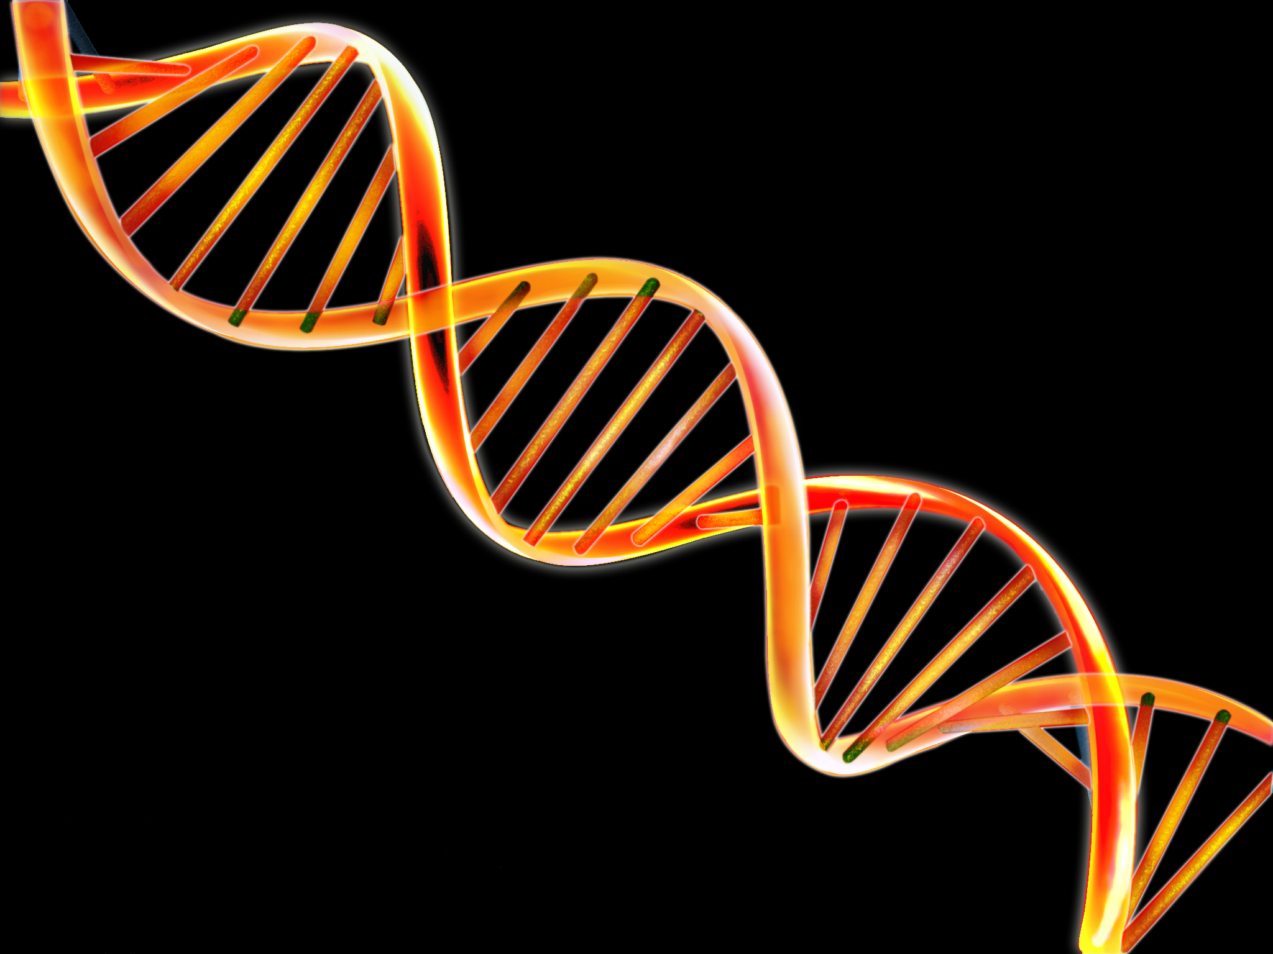
What is the structure & function of DNA?
SC.912.L.16.3 Describe the basic process of DNA replication and how it relates to the transmission and conservation of the genetic information.
Explain
Watson & Crick built 3-D models of DNA
They used Franklin’s model to determine that DNA was a double-helix, like a twisted ladder

Slide 8
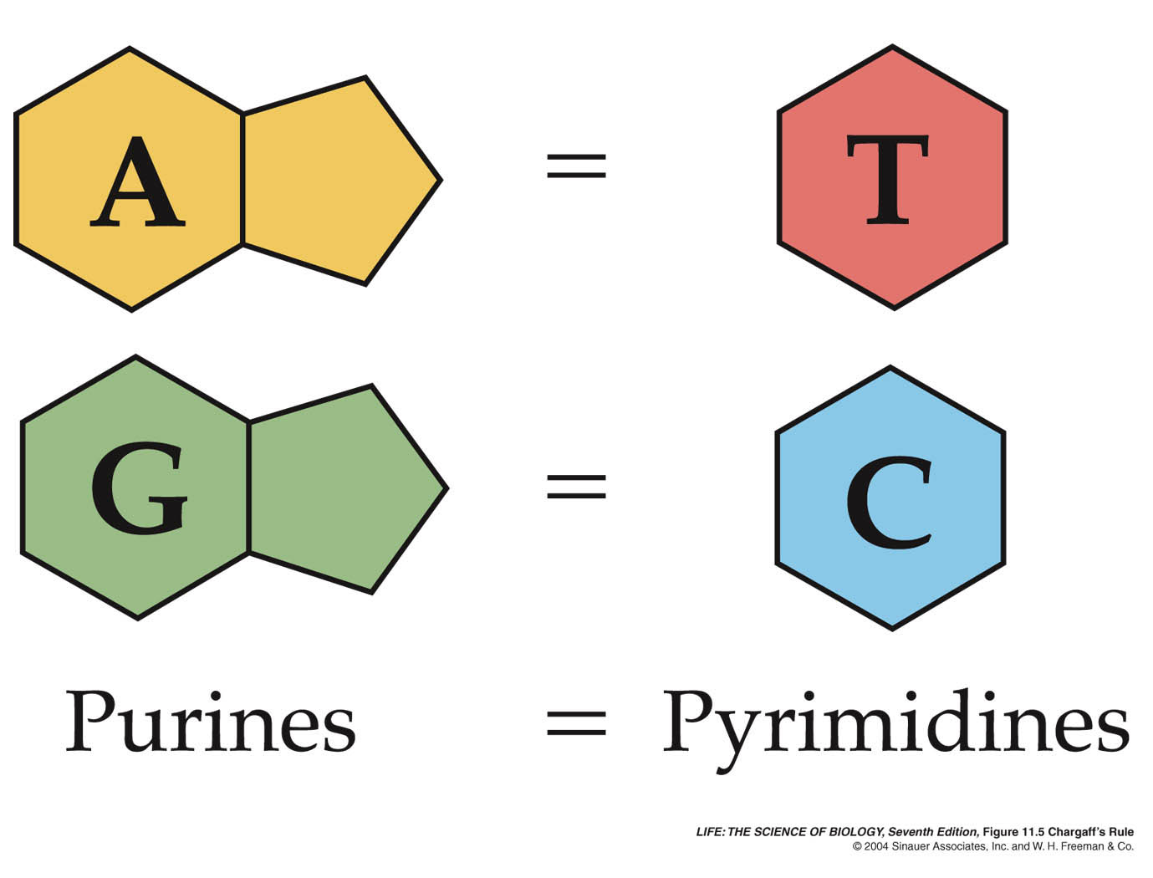
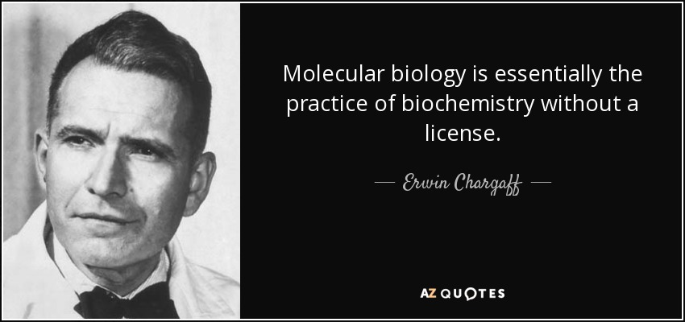
What is the structure & function of DNA?
SC.912.L.16.3 Describe the basic process of DNA replication and how it relates to the transmission and conservation of the genetic information.
Explain
Watson & Crick’s findings supported that of another scientist, Erwin Chargaff
Chargaff’s Rule states that certain nitrogenous bases always pair together by hydrogen bonds
Adenine with Thymine
Guanine with Cytosine

Slide 9
What is the structure & function of DNA?
SC.912.L.16.3 Describe the basic process of DNA replication and how it relates to the transmission and conservation of the genetic information.
Evaluate
When you hear me say, “GO,” gather materials & quickly pair up with the person next to you
You need: 1 whiteboard, 1 paper towel, and 2 different dry-erase markers
Use your own marker to show your work for finding the matching strand of DNA
Copy your original strand on your whiteboard and begin:
G A C T A G T T C

Slide 10
What is the structure & function of DNA?
SC.912.L.16.3 Describe the basic process of DNA replication and how it relates to the transmission and conservation of the genetic information.
Explain
DNA makes up genes and performs the following tasks:
Storing information = contains instructions for cell jobs and traits
Copying information = before cells divide, they must make a complete copy of every single one of its genes
Transmitting information = genes are passed on from one generation to the next (Mendel), DNA must be carefully sorted and passed along during cell division

Slide 11
What is the structure & function of DNA?
SC.912.L.16.3 Describe the basic process of DNA replication and how it relates to the transmission and conservation of the genetic information.
Evaluate
List the 3 major components of DNA structure.
When cells divide in mitosis, why is it important for them to make a copy of all genes in its DNA?
How is DNA transmitted? Hint: are sperm & eggs haploid or diploid?

Slide 12
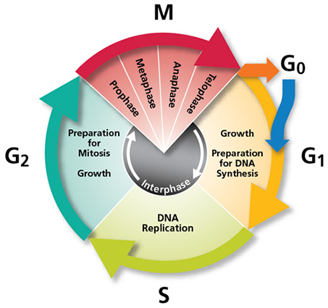
When does DNA replicate?
SC.912.L.16.3 Describe the basic process of DNA replication and how it relates to the transmission and conservation of the genetic information.
Explain
Think back to the cell cycle including Mitosis…
DNA is replicated or copied during S (synthesis) phase of the cell cycle
This is a part of Interphase

Slide 13
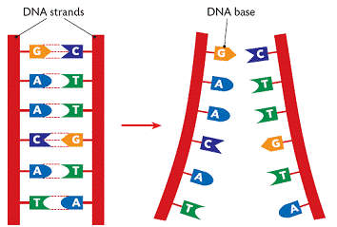
How does DNA replicate?
SC.912.L.16.3 Describe the basic process of DNA replication and how it relates to the transmission and conservation of the genetic information.
Explain
Each base on 1 strand pairs with only one base on the opposite strand
Because each strand can be used to make the other strand, they are said to be complementary

Slide 14
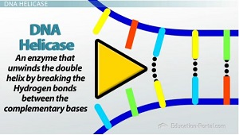
How does DNA replicate?
SC.912.L.16.3 Describe the basic process of DNA replication and how it relates to the transmission and conservation of the genetic information.
Explain
Enzymes separate (unzip) the strands by breaking the hydrogen bonds between them
As each new strand forms, new bases are added following the rules of base pairing
*-ase* = enzymes

Slide 15
How does DNA replicate?
SC.912.L.16.3 Describe the basic process of DNA replication and how it relates to the transmission and conservation of the genetic information.
Evaluate
In what phase of the cell cycle does DNA replicate?
Since bases on each strand pair up, what do we call the two strands of DNA?
How do we open the DNA to copy the strands?

Slide 16
How does DNA replicate?
SC.912.L.16.3 Describe the basic process of DNA replication and how it relates to the transmission and conservation of the genetic information.
Explain
*-ase* = enzymes
DNA polymerase is an enzyme that joins individual nucleotides to produce a new strand of DNA
It also “proofreads” each new DNA strand, ensuring that each molecule is a perfect copy of the original

Slide 17
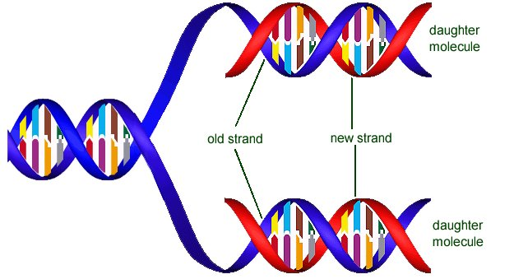
How is DNA replication a semi-conservative process?
SC.912.L.16.3 Describe the basic process of DNA replication and how it relates to the transmission and conservation of the genetic information.
Explain
The end product of DNA replication includes two identical strands of DNA
This process is semi-conservative = each strand contains an original piece and a copy

