Slide 1
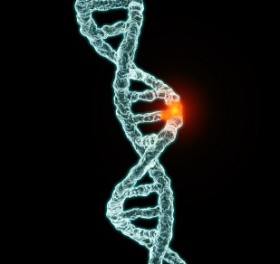
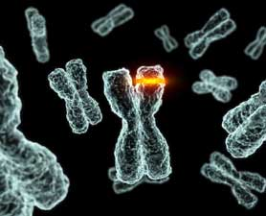
Unit 6 – Nucleic Acids: Mutations
2015-2016
Ms. McCabe

Slide 2
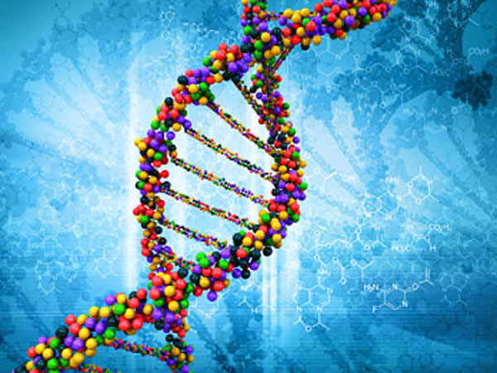
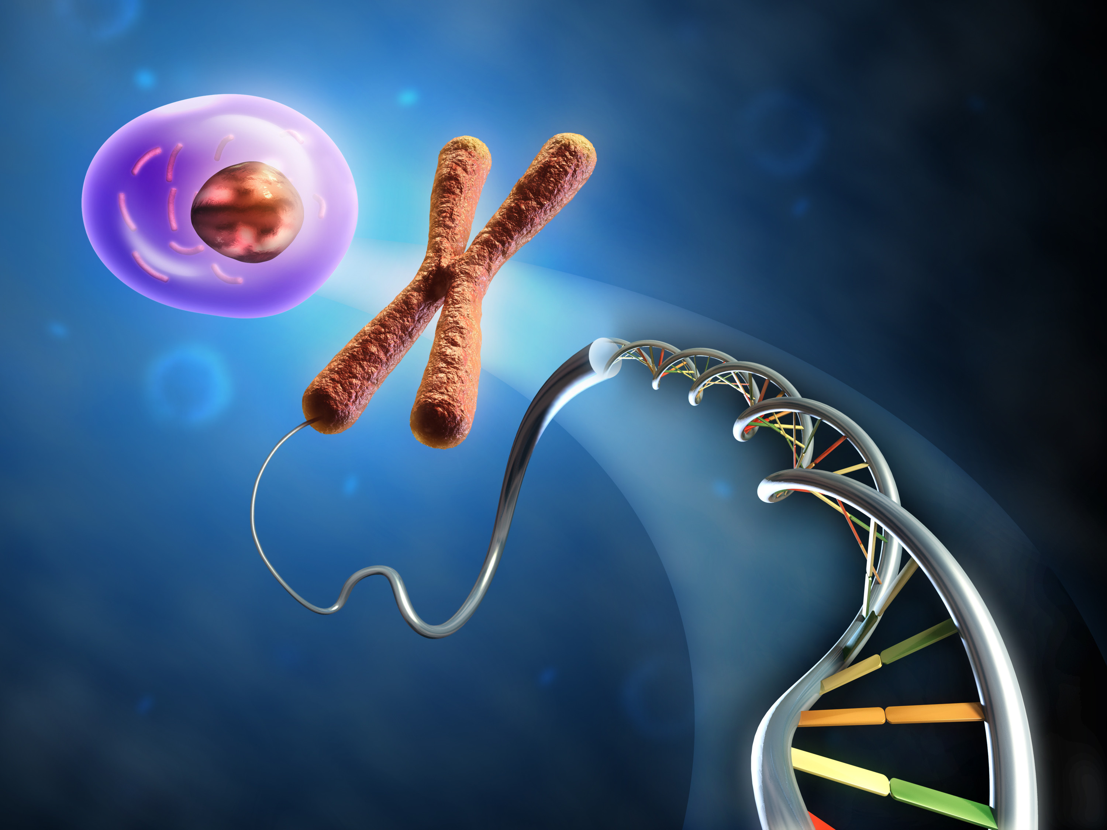
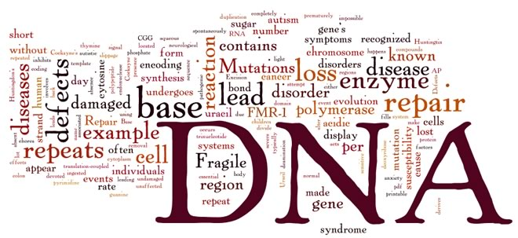
DO NOW 2/1-2/16
Evaluate
On a half-sheet, complete & turn in the assignment below
In 4-5 sentences, discuss the following information regarding DNA (NO notes):
Structure
Function
Purpose of replication

Slide 3
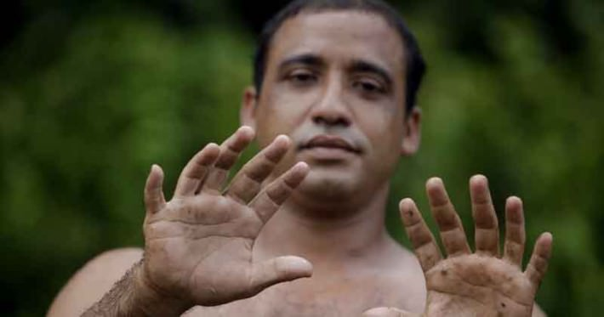
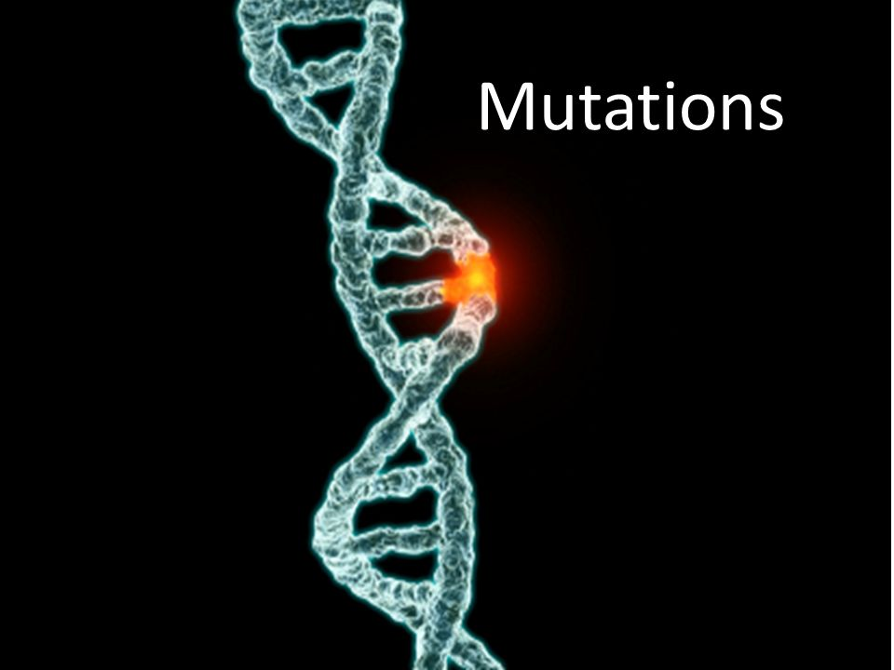
standards
SC.912.L.16.4 Explain how mutations in the DNA sequence may or may not result in phenotypic change. Explain how mutations in gametes may result in phenotypic changes in offspring.
HE.912.C.1.7 Analyze how heredity and family history can impact personal health.

Slide 4
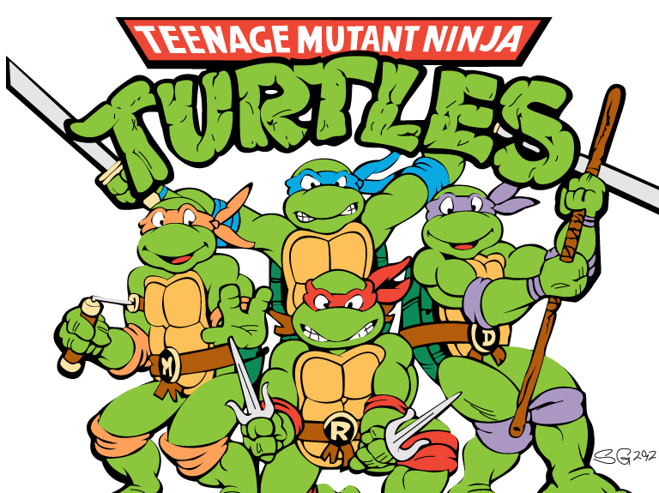
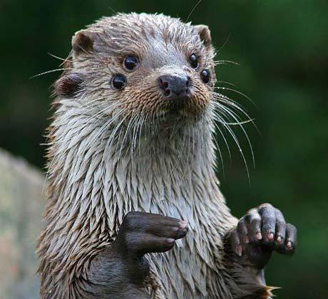
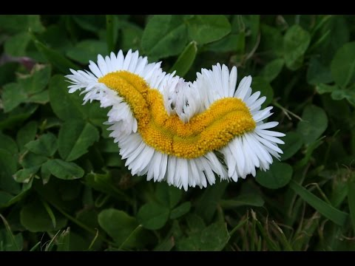
Guiding Question
How can we describe the impacts of various types of mutations that may occur in a DNA sequence?

Slide 5
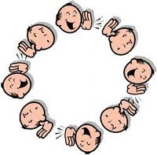
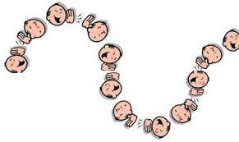
Telephone game
Engage
Stand by your desk please
I will whisper a word to one of you
That person will whisper to the next
This continues to the last person
The last person will be asked to share what he/she heard

Slide 6
Telephone game discussion
Engage
Why did the original message differ from the end message?
Similarly, mistakes in the message, or genetic code, can occur as they are copied and passed on to offspring through gametes.

Slide 7
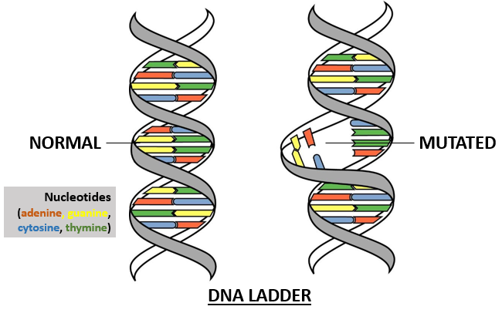
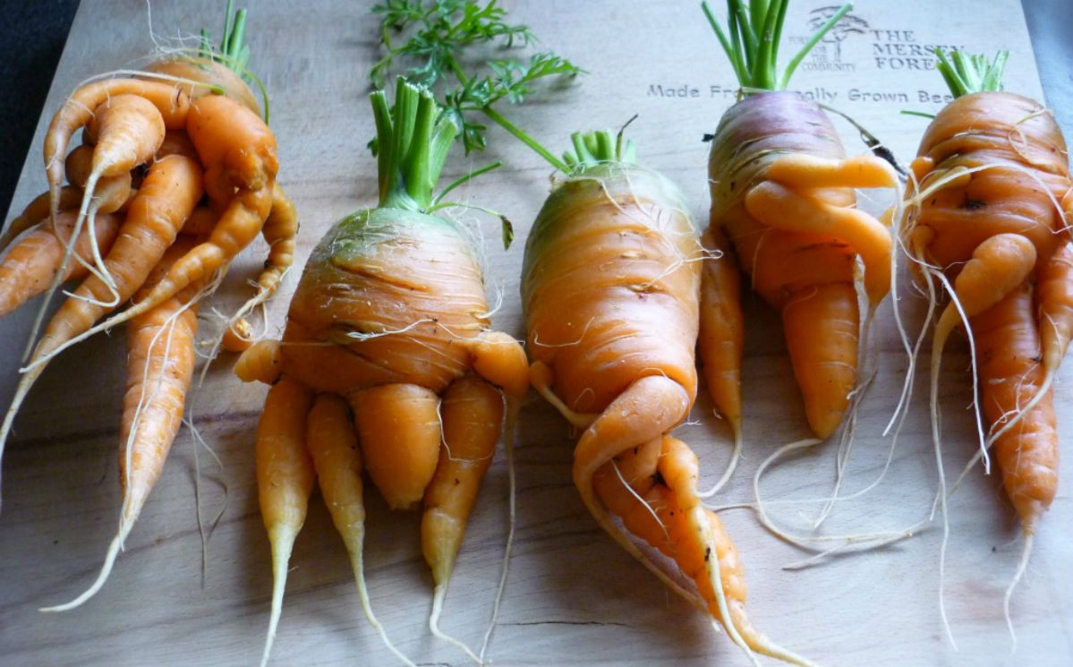
Mutations
Heritable = can be passed on or inherited
Mutations = heritable variations or changes in the DNA sequence of bases (genetic information)
Explain

Slide 8
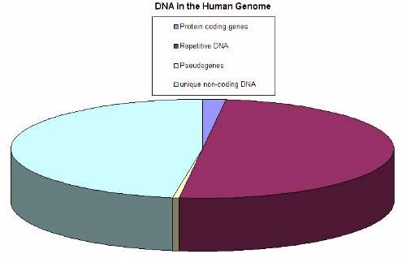
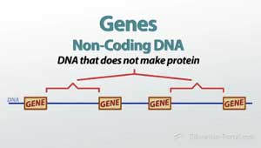
Mutations
Most of the DNA in an organism’s genome (total DNA) is noncoding, or “junk DNA”
Changes to a DNA sequence in noncoding DNA does not affect protein production and, therefore, does not result in phenotypic changes
Explain

Slide 9
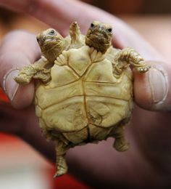
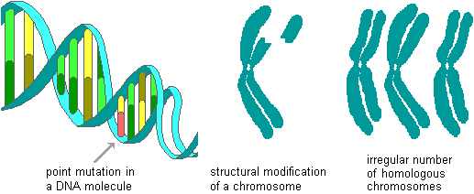
2 categories of Mutations
Gene mutations involve changes in one or a few nucleotides = point mutations
Chromosomal mutations involve changes in the number or structure of chromosomes
Explain

Slide 10
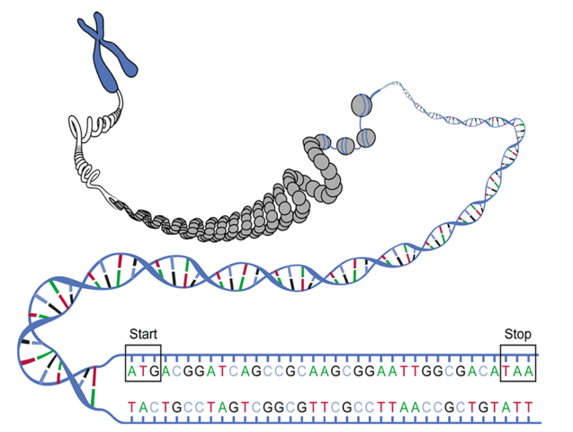
Gene/Point mutations
Occur at a single point in the DNA sequence
Substitutions = single base “subbed”/changed for another, usually affect no more than a single amino acid
Insertions = single base is inserted into the DNA sequence, an extra letter shifts the reading frame
Deletions = single base is removed from the DNA sequence, a missing letter shifts the reading frame
Explain

Slide 11
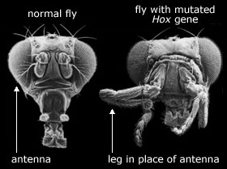
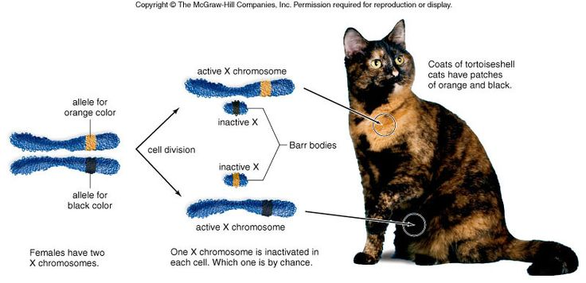
Engage

Slide 12
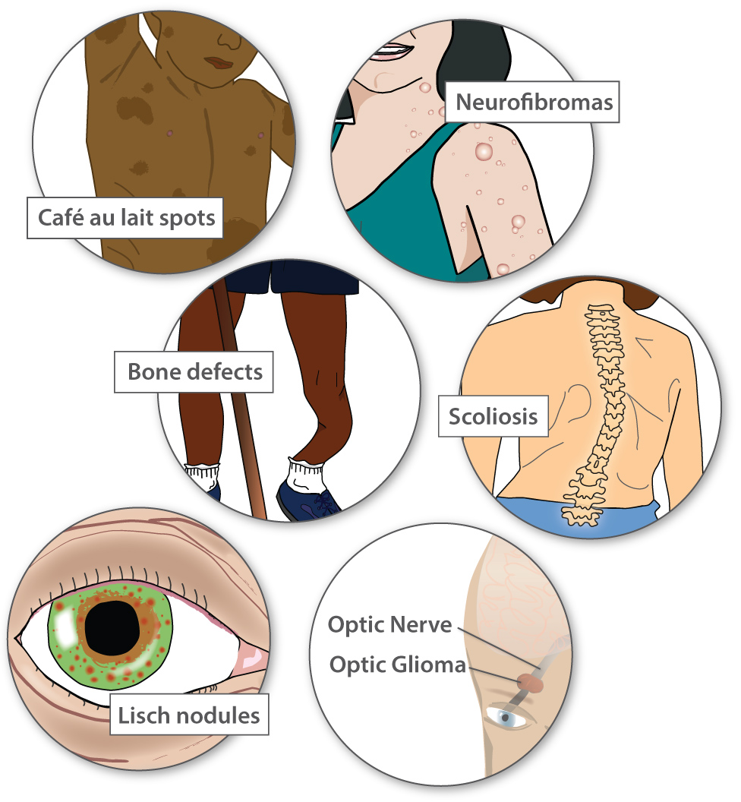
Engage

Slide 13
Gene/Point mutations
Using index cards cut in half, create flashcards for each type of point/gene mutation
Include the following on the blank side of the card
Name of mutation
Point mutation or whole chromosome mutation?
Include the following on the lined side of the card
Brief description
Example with DNA sequence or picture
Possible effects
Use page 373 in the textbook
Explore/Explain/Evaluate
10 minutes

Slide 14
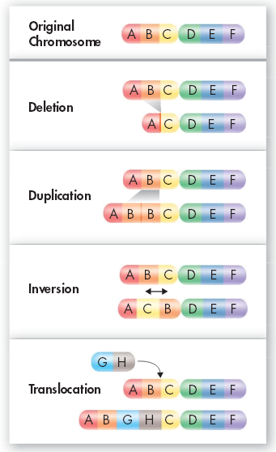
Chromosomal Mutations
Explain
Involve changes in the number or structure of chromosomes

Slide 15
Explore

Slide 16
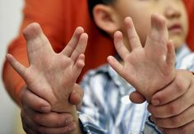
Engage

Slide 17
Chromosomal Mutations
Using index cards cut in half, create flashcards for each type of chromosomal mutation
Include the following on the blank side of the card
Name of mutation
Point mutation or whole chromosome mutation?
Include the following on the lined side of the card
Brief description
Example with DNA sequence or picture
Possible effects
Use page 374 in the textbook
Explore/Explain/Evaluate
10 minutes

Slide 18
Effects of mutations Essay
Use 13.2 in the textbook
2-3 paragraph essay including examples & descriptions of the following topics:
Gene vs. chromosome mutations
Harmful & helpful mutations
Frameshift mutations
Effect of mutations on living things
How might scientists determine if a mutation has occurred in a species?
What you don’t finish in class is …
This website is VERY helpful!
http://learn.genetics.utah.edu/content/history/
Explore/Explain/Evaluate

