Slide 1
Unit 7: Mechanisms of Evolution
Mutation & Recombination
2016-2017
Ms. McCabe

Slide 2
Standard
SC.912.L.15.15
Describe how mutation and recombination increase genetic variation.

Slide 3
Lesson Guiding Question
How do mutation and genetic recombination impact evolutionary change?

Slide 4
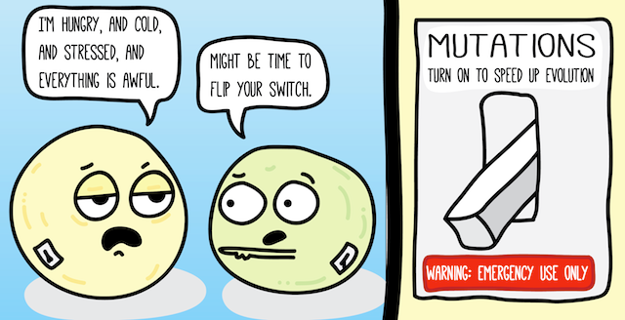

Slide 6
What do we know already?
Chromosomes carry traits that are controlled by genes
Changes in genes & chromosomes are the cause of variation
Genotype is the combination of alleles (versions of a trait)
Phenotype is the physical appearance of those traits

Slide 7
Natural Selection (Add this to your notes)
In any population, some individuals have phenotypes that are better suited to their environment than are the phenotypes of other individuals
The better fit individuals live longer to produce more offspring to pass on their more “fit” genes

Slide 8
Raise your hand to answer...
How does natural selection affect a genotype if it only acts on the phenotype?
(Write this answer on your paper, too!)

Slide 9
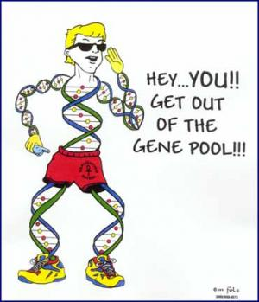
Populations & Gene Pools
Populations are a group of individuals of the same species that can mate to produce offspring…
...because they interbreed, they share a gene pool = all the different genes/alleles within a population
Allele frequency = how often an allele occurs in a gene pool

Slide 10
Mouse Allele Frequency Practice
Turn to page 483 in your textbook
Look at figure 17-2
To determine whether a population is evolving, scientists study its allele frequencies

Slide 11
Mouse Allele Frequency Practice
If there are 25 individuals in the population, how many total alleles are present?
Calculate the number of mice with each genotype.
homozygous black
heterozygous black
homozygous brown

Slide 12
Mouse Allele Frequency Practice
Calculate the number of B alleles (B = black) and b alleles (b = brown).
If the current generation of bb mice had no offspring, how would this affect the allele frequency of the b allele in the next generation?

Slide 13
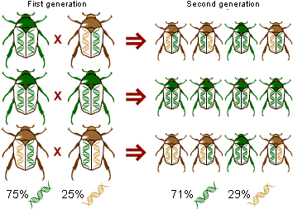
Evolution
Evolution = a change in the allele frequency in a population over time

Slide 14
Evolution
Evolution depends on genetic diversity
If no changes occur and natural selection is not acting on phenotypes, there is no change in allele frequency in that population over time

Slide 15
Genetic Variation Graphic Organizer
Mutations
Genetic Recombination
3 Sources of Genetic Variation
Lateral Gene Transfer
Complete the graphic organizer and turn this page in when finished.

