Slide 1
Unit 7: Hominid Evolution Timeline & Foldable
2015-2016
Ms. McCabe

Slide 2
DIRECTIONS
Fold a legal-size paper hotdog style
Fold it hamburger style 3 times – you need 8 total sections
Cut on only one side of the folds to have 8 flaps

Slide 3
DIRECTIONS
On the side that is NOT cut, turn horizontally
Label this side: Timeline of Hominid Evolution

Slide 4
DIRECTIONS
Label the 8 cut tabs:
Standard p. 765
Shared Primate Characteristics p. 765
Major Primate Groups p. 766
Adaptations to Walk Upright p. 767
Other Adaptations & Comparisons p. 767
The Genus Homo p. 770
Homo neanderthalensis p. 772
Modern Homo sapiens p. 772

Slide 5
Standard p. 765

Slide 6
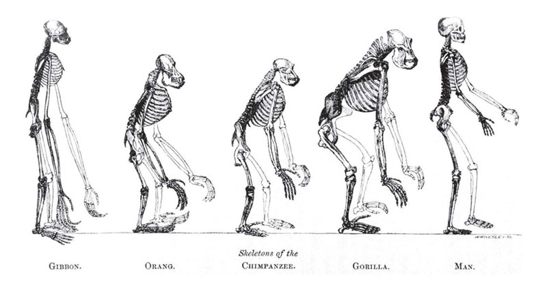
(Write the purple only on the inside of the flap)
Identify basic trends in hominid evolution from early ancestors 6 million years ago to modern humans, including brain size, jaw size, language, and manufacture of tools.

Slide 7
Shared Primate Characteristics p. 765

Slide 8
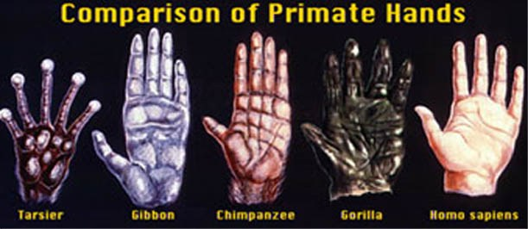
(Write the purple only on the inside of the flap)
Primates are mammals
Long fingers & toes
Nails, NOT claws
Arms rotate at shoulders
Clavicle (collar bone)
Binocular vision (use both eyes to see)
Well developed cerebrum (front part of brain)

Slide 9
Major Primate Groups p. 766

Slide 10
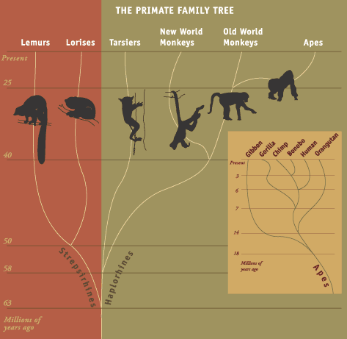
(Write the purple only on the inside of the flap)
Lemurs & Lorises
Tarsiers & Anthropoids
Monkeys
Great Apes
Humans

Slide 11
Adaptations to Walk Upright p. 767

Slide 12
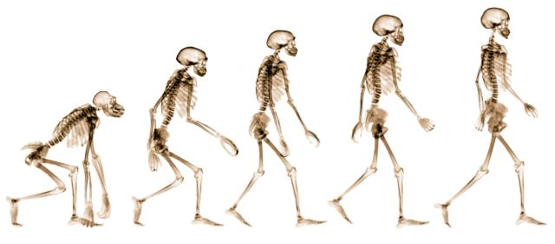
(Write the purple only on the inside of the flap)
Human bipedal motion = walking on 2 feet
Skull sits on an S-shaped spine
Spinal cord exits the brain at the bottom of the skull
Hip bones
Arms shorter than legs
Bowl-shaped pelvis
Thigh bones angled inward

Slide 13
Other Adaptations & Comparisons p. 767

Slide 14
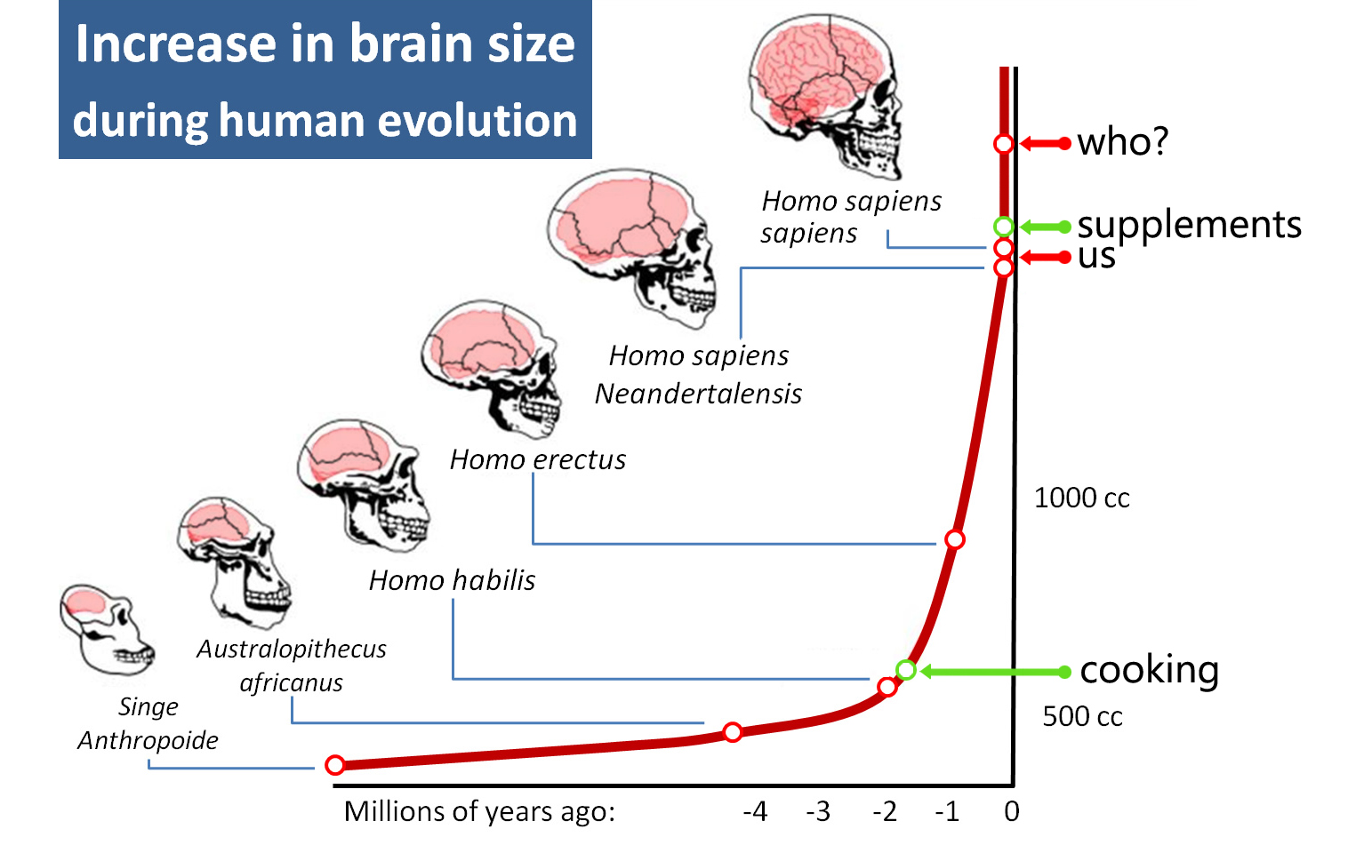
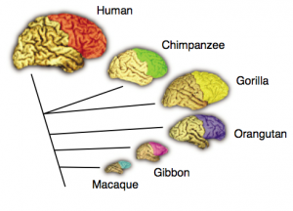
(Write the purple only on the inside of the flap)
Walk upright, on 2 feet
Opposable, grasping thumbs
Larger brains
Chimp brains average = 280-450 cubic centimeters
Homo sapiens brains average = 1200 – 1600 cubic centimeters
(bigger brain because of bigger cerebrum)

Slide 15
The Genus Homo p. 770

Slide 16
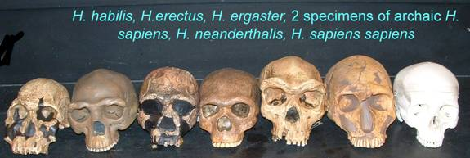
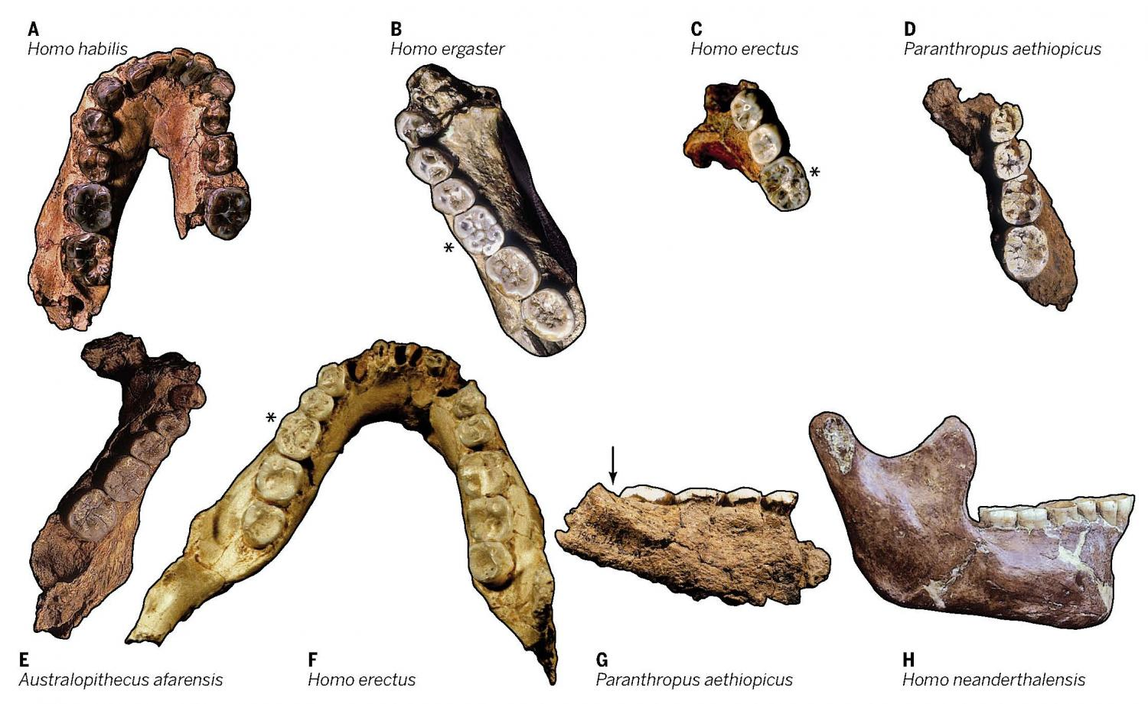
(Write the purple only on the inside of the flap)
2 million year old fossils found with tools made of stone and bones
Earliest members of this genus had bigger brains & downward-facing nostrils
1st found in Africa, then India, then China and throughout Southeast Asia
Supported by analysis of mitochondrial DNA

Slide 17
Homo neanderthalensis p. 772

Slide 18
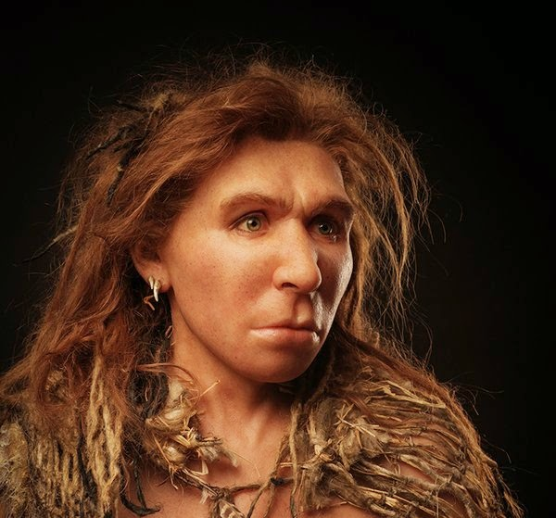
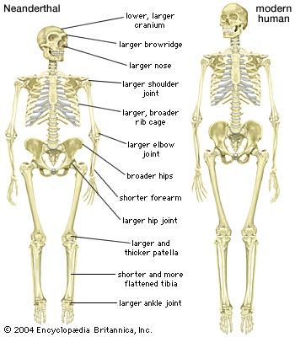
(Write the purple only on the inside of the flap)
Lived as early as 200,000 years ago in Europe & West Asia
Used stone tools and fire
Hunters
Formed complex social groups, social rituals

Slide 19
Modern Homo sapiens p. 772

Slide 20
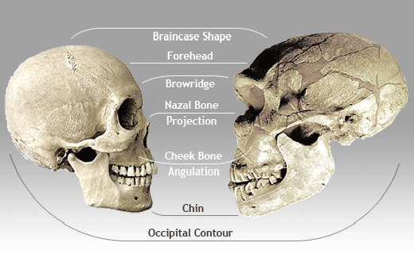
(Write the purple only on the inside of the flap)
100,000 years ago arrived in the Middle East from Africa
50,000 years ago fossils were found near more sophisticated tools with stone blades and cave paintings

Slide 21
DIRECTIONS
For each flap, create a picture or use your book to illustrate each concept flap

Slide 22
Timeline of Hominid Evolution
Find a partner
Complete a labeled timeline of hominid evolution that shows when important species lived and characteristics that accompanied them
Begin with 65-56 million years ago
End with modern humans in 2016

