Slide 1
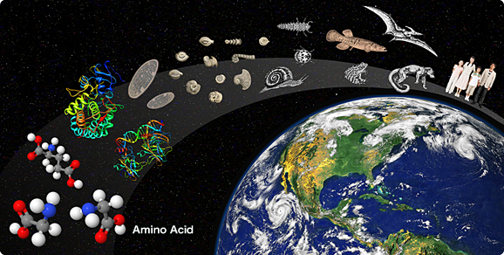
Origin of Life
Ms. McCabe
Biology I/ Biology I Honors
2015-2016
Unit 7: Origin and Evolution of Living Things

Slide 2
Standards
SC.912.L.15.8
Describe the scientific explanations of the origin of life on Earth.
SC.912.L14.5 (Honors)
Explain the evidence supporting the scientific theory of the origin eukaryotic cells (endosymbiosis).

Slide 3
Lesson Guiding Questions
How did past experiments lead to the development of the scientific explanation for the origin of life?
(Honors) How did eukaryotic cells originate?

Slide 4
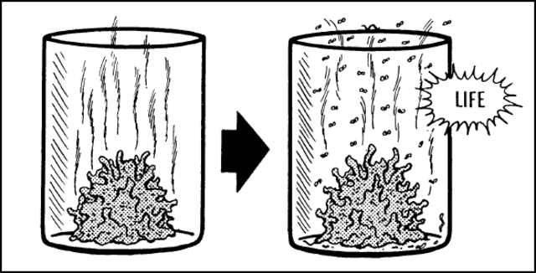
Does life suddenly appear?
Spontaneous Generation

Slide 5
How did we get the complexity of Life?
Spontaneous Generation perhaps?

Slide 6
Life had to start somewhere… but where?

Slide 8
What do you think?

Slide 9
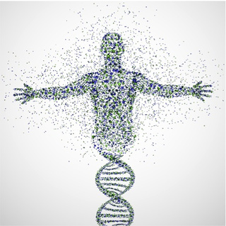
Life comes from pre-existing life… but where did “life” come from to begin with?... And how did Life forms become so complex?

Slide 10
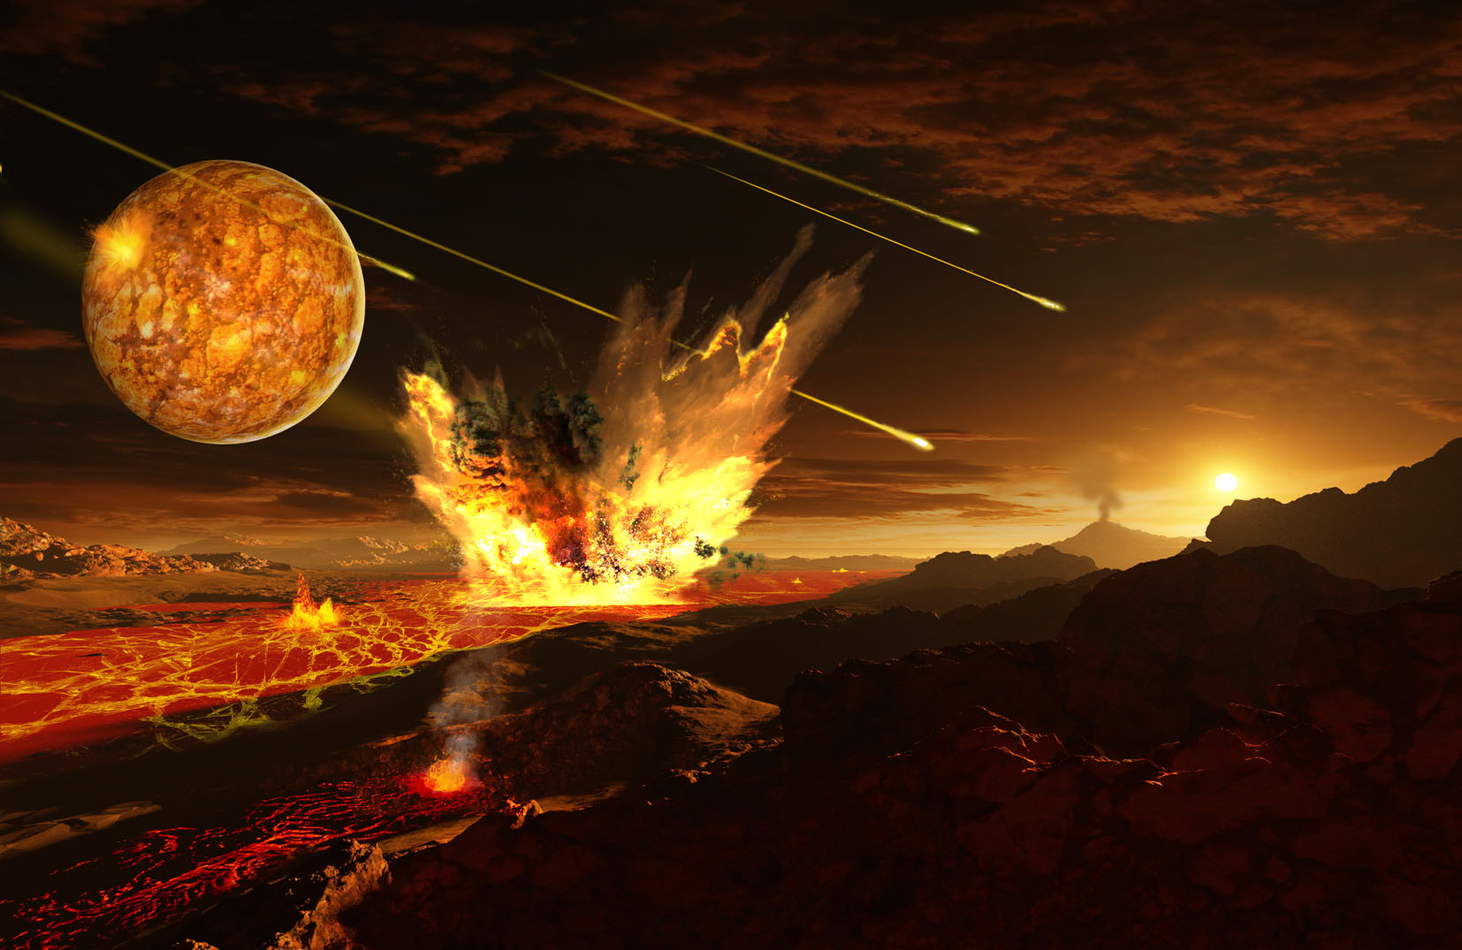
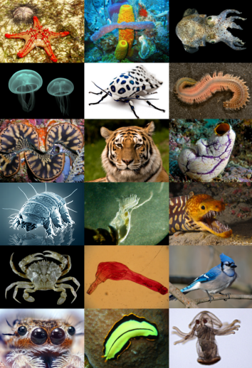
How did we go from here to here???

Slide 12
DO NOW - Map it Out: (Read pages 553-563, USE 2 LEGAL-SIZE PAGES - TAPED)
Individually, construct a flowchart that shows what scientists hypothesize are the major steps from the origin of Earth (the “early Earth”) to the appearance of eukaryotic cells.
In your own words, define/describe the endosymbiotic theory.
Summarize the Miller & Urey experiment in your own words. You may sketch the apparatus to aid you in your explanation.
Turn in when complete!!!

